Slide 1


Proposal-Writing Strategies for the National Science Foundation
Thomas J. Baerwald
Senior Science Advisor
Division of Behavioral and Cognitive Sciences
Directorate for Social, Behavioral, and Economic Sciences
National Science Foundation
Webinar Presentation for the University of Mississippi
October 17-18, 2018

Slide 2
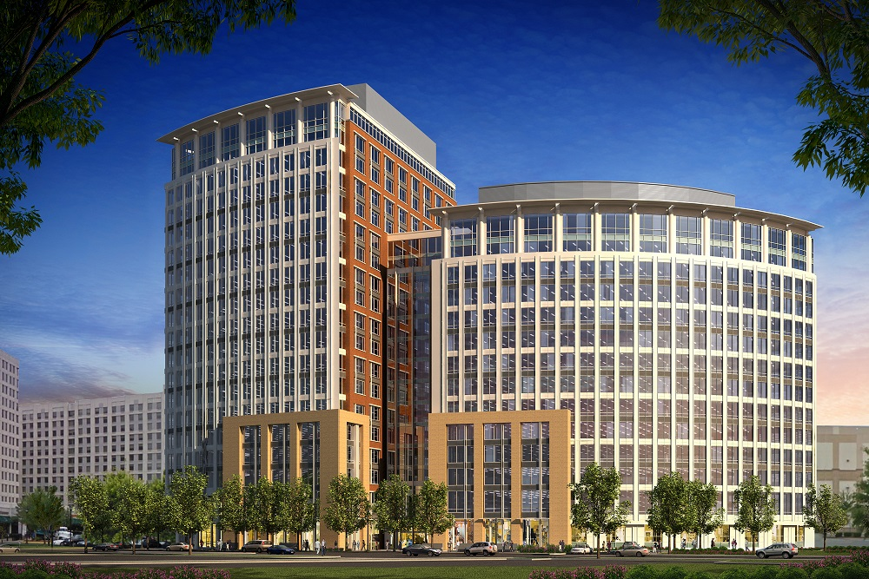
NSF is a Government Agency, But We're Staffed by Real People Who Take Public Service Seriously
NSF's new headquarters building is at
2415 Eisenhower Ave, Alexandria, Virginia
(just inside the beltway)
Notes:
There are people here!! And we like to help, really. We can not provide feedback on drafts of proposals, but we can give general tips.
Also, we are very willing to discuss your declines… (and recall that most proposal are declined!).

Slide 3
NSF is an Independent Agency of the Executive Branch of the U.S. Government
President
Office of Management and Budget
Science Advisor: Office of Science and Technology Policy
Other Boards, Councils
Ag
HHS
DOI
DOT
DOD
DOC
DOE
HUD
Ed
DOS
DOJ
DOL
DHS
DVA
Treas
Cabinet
Independent Agencies
NASA
EPA
Smithsonian Inst
Nuclear Reg Comm
Others
NSF
Notes:
NSF is an independent agency, not a part of a large cabinet agency (as Census is a part of the Dept of Commerce and NIH is part of HHS) In reality, NSF tends to link with the White House through OSTP..

Slide 4

NSF is Organized into Seven Directorates
National Science Board
Director
Deputy Director
Inspector General
Staff Offices
Biological
Sciences
Computer and
Information
Science
and Engineering
Engineering
Geosciences
Mathematics
and Physical
Sciences
Social, Behavioral,
and Economic
Sciences
Education
and Human
Resources
Budget, Finance, and Award Management
Information Resource
Management
Notes:
NSF is broken down into directorates
GSS sits in SBE; division of BCS
For DDRI can mention co-review here...

Slide 5
Directorates Are Divided into Divisions;
Divisions Are Divided into Programs or Sections
Social Behavioral, and Economic Sciences
Behavioral and Cognitive Sciences
Social and Economic Sciences
National Center for Science and Engineering Statistics
SBE Multidisciplinary Activities
Geography and Spatial Sciences
Anthropology Programs
Psychology and Linguistics Programs
Economics
Decision, Risk, and Management Sciences
Methodology, Measurement, and Statistics
Sociology
Political Science
Law and Social Science
Science, Technology, and Society

Slide 6
Understand the Core Principles
NSF seeks to invest its funds in projects that best advance its goals.
NSF uses an organized process to determine how funds should be allocated.
Your job is to write a proposal that will make a strong and compelling case for helping NSF meet its goals.

Slide 7
NSF's First Strategic Goal
Expand knowledge in science, engineering, and learning
  Advance knowledge through investments in ideas, people, and infrastructure
  Advance the practice of research
- NSF Strategic Plan for 2018-2022

Slide 8
NSF's Second Strategic Goal
Advance the capability of the nation to meet current and future challenges
  Support research and promote partnerships to accelerate innovation and to provide new capabilities to meet pressing societal needs
  Foster the growth of a more capable and diverse research workforce and advance the scientific and innovation skills of the nation
- NSF Strategic Plan for 2018-2022

Slide 9
NSF Funds
BASIC SCIENCE RESEARCH!
Basic research is situated in a theoretical framework
Basic research focuses on one or a few specific questions rooted in that framework
Basic research uses scientifically sound methods to explore viable answers to those questions
Basic research contributes generalizable knowledge and advances broader theory

Slide 10
As a result...
Basic scientific research contributes to general understanding
It’s research that’s well grounded in a general theoretical framework or that generates development of new frameworks
It’s research that’s valuable even if we don’t care about its specific findings or applications
It’s research that often increases our knowledge of how we expand our knowledge

Slide 11
Basic "vs." Applied Research
It's not "either/or"
Basic research results often have great direct and indirect utility and applicability
But at its core, basic research is first and foremost about broader theoretical development, not the focused application of specific research results
Basic research is not WISCy (wallowing in a specific case)

Slide 12
How Do You Gain Access to Some of NSF’s Funds?
Submit a proposal to compete in standing program competitions for “unsolicited proposals”
Submit a proposal for a special competition
  Topics often cross-cut programs, divisions, and directorates

Slide 13
In Addition to Its Standing Programs, NSF Has Many
Special Funding Opportunities
INFEWS
NRT
ADVANCE
IGERT
EGB
Minority
RPGs/CAAs
RCN
CAREER
RAPID
EAGER
PECASE
CI-TEAM
EaSM
ITR
SATC
SBIR
EPSCoR
RUI/ROA
SRN
REU
GOALI
CNH
GK-12
NANO
AccelNet
CSSI
Check the NSF Web site for more information or contact relevant program officers

Slide 14
NSF's "Big Ideas"
Research ideas
  Harnessing the Data Revolution
  The Future of Work at the Human-Technology Frontier
  Navigating the New Arctic
  Windows on the Universe: Multi-Messenger Astrophysics
  The Quantum Leap: Leading the Next Quantum Revolution
  Understanding the Rules of Life
Process ideas
  Mid-Scale Research Infrastructure
  Growing Convergence Research
  NSF INCLUDES
  NSF 2050: Integrative Foundational Fund

Slide 15
To Which Programs or Competitions Should You Apply?
Remember that NSF supports basic research that yields significant new findings that have wide-ranging theoretical benefit
Identify the communities that you think will be most interested in your findings
  Identify the journals where you expect to publish your findings -- the readers likely will be in the communities for which your research will have greatest value
"Map" those communities against NSF programs and competitions
Send a prospectus to the program officers of the programs/competitions you think may be interested

Slide 16
What Should Be in a Prospectus?
A paragraph or so about each of the following:
  Theoretical foundations of the project
  Core questions on which you'll focus
  Methods to be used to assess answers to questions
  Expected intellectual merit and broader impacts
  Nature of the scope of the project and who will be involved
Limit the prospectus to 1 or 2 pages
Send by e-mail along with additional questions you may have -- send a group message to all program officers of all programs you think may have interest
Send the prospectus well in advance of proposal due dates

Slide 17
Explore Co-Review Possibilities
NSF rules prohibit submitting essentially the same proposal to multiple programs at once
Regular programs often co-review proposals with each other when projects attempt to draw on and contribute to basic knowledge that bridges multiple communities and programs
  NSF programs seek to ensure that co-review offers "double opportunity," not "double jeopardy
It's best to sound programs out regarding co-review well in advance of proposal-submission due dates
  Knowledge of the programs that will review a proposal helps you best write to the multiple or overlapping communities of interest

Slide 18
Obtaining Funding Is Like
Entering a Diving Competition
Your chances of success are best if you:
Learn the rules of the competition
Learn which entries receive the highest marks
Learn how the competition is organized
Hone your skills and correct your defects
Take care to do your best
Realize that how you place will also depend on how well other competitors do

Slide 19
How Do You Learn the Rules?
Check websites of the funding organization
Access and read relevant documents
  At NSF, such documents include PAPPG and competition-specific solicitations
Determine whether pre-submission contact with organization staff members is permitted or encouraged
  If so, contact relevant staffers with a prospectus and/or questions if needed, but make sure you've already "done your homework"

Slide 20
How Do You Earn the Highest Marks?
Identify the funder's goals and review criteria used to make funding decisions
Do all that you can to ensure that your proposed work will help meet the funder's goals and match up positively with the review criteria
Be explicit in showing how your work will match up with what the funder wants to result
But don't overreach. If your work won't accomplish what the funder wants, look elsewhere

Slide 21
How Do You Learn
How a Competition Is Organized?
Get relevant information
  Check the website
  Read the solicitation and other relevant documents
  Ask informed questions of the organization's program officers
Try to understand who will review and make decisions about your proposal, and write the proposal to speak directly to them within the framework of the review criteria

Slide 22
How Do You Hone Skills,
Correct Defects, and Do Your Best?
Give yourself lots of time
  Do preliminary work months before the deadline
  Draft the proposal and ask others to read and comment on it at least four weeks before the deadline
  Revisit the proposal after you've had time away -- two weeks before the deadline
  Comply completely with proposal-preparation requirements. If you're uncertain, ask well before the deadline
Get feedback from colleagues and friends
  Ask them to be totally open and honest

Slide 23
What Does the Fact You're Competing for Funds Mean?
Others are trying to make the case for their work
  You have no control over what they do
  You can do everything right, attain a personal best, and still finish out of the money
You control your own proposal, so make it as strong and compelling as possible
Don't interpret a decline as evidence you can't be funded in future versions of this competition or in other competitions

Slide 24
Strategies for Preparing Proposals for NSF
Remember that NSF focuses on support for basic scientific research
Funding occurs through competitions with proposals subject to merit evaluation based on peer review
Allow plenty of time to learn about competitions, draft and revised proposals, and submit proposals before deadlines

Slide 25
What Is the Crucial Ratio for a Program Officer?
$
"Bang for the Buck!"

Slide 26
What Kind of "Bang" Is an NSF Program Officer Looking For?
Significant contributions to general scientific understandings.
Enhancements of theoretical understandings in addition to any expansion of specific knowledge, especially potentially transformative advances.
Broader impacts, such as enhanced education, greater diversity, improved infrastructure or methods, and beneficial applications.
Dissemination of results, especially in refereed, widely disseminated publications.

Slide 27
What Is the Crucial Ratio for a Program Officer?
$
"Potential Bang for the Buck!"
Likelihood of
Significant
Contributions to
General Scientific
Understanding and
Positive Broader
Impacts

Slide 28
At NSF, Decisions Will Be Based on the NSF Merit Review Criteria
NSF asks reviewers to comment on two major criteria:
Intellectual merit
Broader impacts
https://www.nsf.gov/pubs/policydocs/pappg18_1/pappg_3.jsp#IIIA

Slide 29
Merit Review Principles
NSF projects should be of the highest quality and have the potential to advance, if not transform, the frontiers of knowledge
NSF projects… should contribute more broadly to achieving societal goals
Meaningful assessment and evaluation of NSF-funded projects should be based on appropriate metrics
The principles should be considered when preparing and reviewing proposals

Slide 30
Merit Review Criteria
Intellectual Merit: The Intellectual Merit criterion encompasses the potential to advance knowledge
Broader Impacts. The Broader Impacts criterion encompasses the potential to benefit society and contribute to the achievement of specific, desired societal outcomes

Slide 31
Examples of Broader Impacts
Full participation of women, persons with disabilities, and underrepresented minorities in science, technology, engineering, and mathematics (STEM)
Development of a diverse, globally competitive STEM workforce
Improved STEM education and educator development at any level
Increased public scientific literacy and public engagement with science and technology
Improved well-being of individuals in society
Increased partnerships among academia, industry, and others
Improved national security
Increased economic competitiveness of the United States
Enhanced infrastructure for research and education

Slide 32
Elements for Consideration for Both IM and BI Criteria - 1
Criteria related to capabilities to conduct
a project successfully:
How well qualified is the individual, team, or organization to conduct the proposed activities?
Are there adequate resources available to the PI (either at the home organization or through collaborations) to carry out the proposed activities?

Slide 33
Elements for Consideration for Both IM and BI Criteria - 2
Criterion related to how a project will be conducted:
Is the plan for carrying out the proposed activities well-reasoned, well-organized, and based on a sound rationale? Does the plan incorporate a mechanism to assess success?

Slide 34
Elements for Consideration for Both IM and BI Criteria - 3
Criteria related to the potential contributions
of a project:
What is the potential for the proposed activity to:
  Advance knowledge and understanding within its own field or across different fields (IM)?
  Benefit society or advance desired societal outcomes (BI)?
To what extent do the proposed activities suggest and explore creative, original, or potentially transformative concepts?

Slide 35
NSF Merit Review Criteria Summary
Overarching principles
  Highest quality
  Contribute to society
  Meaningful assessment and evaluation
Merit review criteria:
  Intellectual merit
  Broader impacts
Elements considered for both criteria:
  Capabilities
  Conduct
  Potential contributions
Address program-specific/competition-specific criteria (if applicable)

Slide 36

What’s Included in a Competitive NSF Research Proposal?
An explanation of the theoretical framework within which the research question is set
Specification of the methods to be used to answer the question
Elaboration of how expected results will enhance the broader theoretical framework and have positive broader impacts
Biographical information about investigators
A data-management plan and other required materials
A budget with justification of expenses
Other required materials

Slide 37
When You Prepare a Proposal,
Think Like Those Who Will Evaluate It
External reviewers
  They tend to be specialists;
  relevant theory and technical
  details matter
Advisory panel members
        They largely consist of generalists;
        so broader significance matters
Program officers
  We’re the investors, seeking
  "big bangs for our bucks"

Slide 38
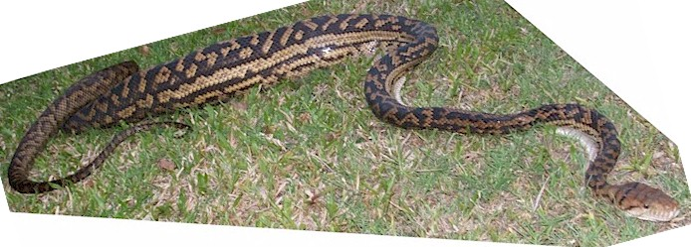
Additional Things to Consider When Preparing an NSF Proposal
Keep the broader intellectual context clear
  Explore broader theory and relevant literature
  Ground focal questions in a theoretical framework
  Specify scientifically sound research plan
  Discuss how expected results will contribute to enhanced theory and broader impacts
Don't start with
and maintain focus
on the specific case

Slide 39
What Expenses Should Be Listed in a Budget?
For every possible expenditure, ask yourself:
  Is this expenditure necessary at this level to complete the project? -- or --
  Would the research be diminished substantially if this expenditure is not made or is significantly reduced?
If you answer “Yes” to these questions,
include the expenditure in the budget
If you answer “No,” leave the item out
or reduce it to reasonable levels
Be cognizant of overall funding limits for awards and for a program

Slide 40
Take Data Management Seriously
  The types of data, samples, physical collections, software, curriculum materials, and other materials to be produced in the course of the project
  The standards to be used for data and metadata format and content (where existing standards are absent or deemed inadequate, this should be documented along with any proposed solutions or remedies)
  Policies for access and sharing including provisions for appropriate protection of privacy, confidentiality, security, intellectual property, or other rights or requirements
  Policies and provisions for re-use, re-distribution, and the production of derivatives
  Plans for archiving data, samples, and other research products, and for preservation of access to them
  Provide long-term access from institutionally managed databases for all data and other products that can be made accessible to others
  Note that accessible data constitutes a broader impact

Slide 41
What If Your
Proposal Is Declined?
Pause a while to let the pain subside somewhat
Evaluate the reviews
  If criticisms focus on correctable points, revise and resubmit the proposal
  If criticisms are more general, consider other funding sources or other lines of inquiry
If you have questions or want additional information, contact the program officer

Slide 42
Speaking of Time… A Suggested Timeline for Developing Proposals
3 months before the deadline | Develop prospectus for proposal and share it with colleagues as well as relevant agency program officers.
1 month before the deadline | Complete what you think is a very solid first draft of the entire proposal. Share it with colleagues and ask for honest, constructive advice.
2 weeks before the deadline | Use comments from colleagues to revise the proposal one or two more times.
1 week before the deadline | Forward the proposal to your sponsored projects office so that they can complete their work and submit the proposal a day or two before the deadline
5 months after the deadline | Politely ask the managing program officer when a decision might be made about your proposal (if you haven’t heard about its status already).

Slide 43

Above All Else, Be Persistent!
Remember the words of Christopher Morley:
"Big shots are just little shots
who keep shooting!"

Slide 44

The NSF Staff Is at Your Service
It’s not quite
that easy, but we will
provide whatever info
we can to help you make
the strongest possible
case for your project.
E-mail or call!

Slide 45
Contact Information
Thomas Baerwald
  tbaerwal@nsf.gov
  703-292-7301
Directorate for Social, Behavioral, and Economic Sciences
National Science Foundation
2415 Eisenhower Ave
Alexandria VA 22314 U.S.A.
Consult the NSF web site to identify program
officers for other programs or competitions.

