Slide 1
Graduate Student Council Research Grants
Jason Hale
January 9, 2019

Slide 2
Topics for Today
Overview
Timeframe
Solicitation
Application
Rules and Policies
Review and Competition
Awards

Slide 3
Overview
Competitive program to develop graduate student culture, skills, and experience in competitive grantsmanship
Open to enrolled UM graduate students in any discipline
Meant to support projects that would not be possible with the use of departmental funds alone
$1,000 per award
Up to 20 awards per year
GSC acts as interface with the applicants
Grad School and ORSP: Provide funds; Coordinate reviews

Slide 4
Overview
One graduate student per award (not collaborative)
One application per graduate student
Previous GSC awardees ARE eligible
Ineligible:
Graduate students on academic probation
Graduate students graduating Spring or Summer 2019

Slide 5
Timeframe
Solicitation, December 3, 2018
Workshops: Jan 9 (Webinar), Jan 24 (Library)
Applications Due, February 4, 2019
ORSP will conduct compliance review in February
Grad School & ORSP will coordinate reviews Feb/March
Winners announced Week of March 2019
Project periods May or May 2019 – April 2020

Slide 6
Solicitation: Part 1 Overview Information
Proposals requesting more than $1,000 will not be funded (or reviewed – GSC will screen these out)
Project costs over $1,000 in direct costs
Request up to $1,000 from GSC grant
Show where remaining funds will come from
Proposals that do not show how the entire project will be funded will not be funded

Slide 7
Solicitation: Examples of Eligible Funding Items
Eligible Costs include:
Research supplies, such as chemicals, sample bags, software, etc.
Presentation supplies and contracted expenses (e.g., poster-board, printing charges)
Travel expenses related for field work
Upgrades to existing university computers (memory, graphics cards, etc.)
Gift cards as incentives for research participants

Slide 8
Solicitation: Examples of Eligible Funding Items
Eligible Costs include:
Equipment that will become part or UM’s inventory
Participation support costs (incentives for participating in research experiments)
Gift cards
Participant honoraria
Etc.

Slide 9
Solicitation: Examples of Ineligible Funding Items
Educational expenses (workshops, for-credit courses)
Travel to professional meetings/conferences
Self-education projects/programs
Food for persons
Child care to enable you to work on your research

Slide 10
Solicitation: Eligible Funding
All university policies are in place
If a proposed activity or expense is eligible under the GSC guidelines, but ineligible per University policy, then University Policy prevails
If a proposed activity or expense is not prohibited by University policy, but is prohibited by GSC guidelines, then GSC guidelines prevail.
In short, the most restrictive policy or guideline is in effect.

Slide 11
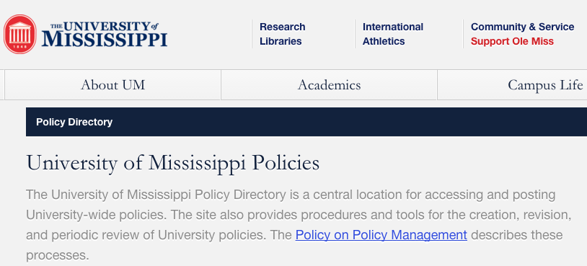
University Policies
https://secure4.olemiss.edu/umpolicyopen/index.jsp

Slide 12
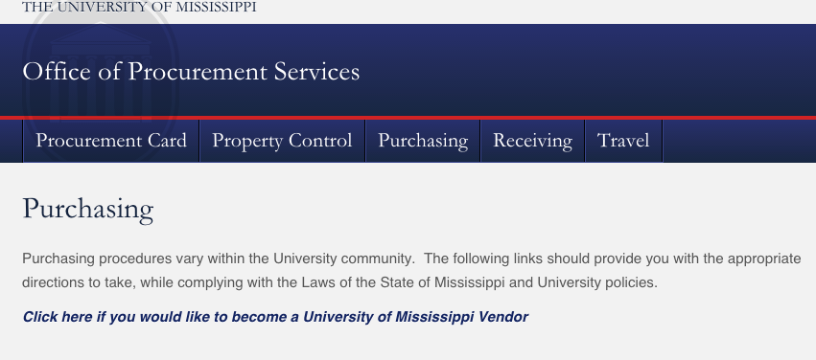
Procurement
http://procurement.olemiss.edu/purchasing/

Slide 13
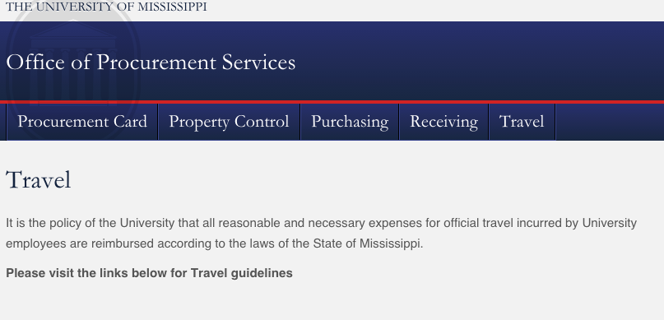
Travel
http://procurement.olemiss.edu/travel/
Travel authorizations required 5+ days before travel

Slide 14
Application: General Rules
Incomplete applications will NOT be considered.
Late applications will NOT be considered.
Incorrect or plagiarized proposals will not be considered.
Use Times New Roman or Arial, font size 12 for the application (smaller, legible size OK for tables and graphics)
Proposals should have (at least) 1 inch margins on all sides

Slide 15
Application: Research Summary
1 Page
The summary should consist of three clearly labeled sections:
Overview (1-4 sentences summarizing summarizing who you are, including graduate program and your standing and year in the program, and what you are going to do in your GSC project)
Intellectual Merit (summarizing why this work is important to the field itself, and any methods to be used), and
External Opportunity (summarizing the external opportunity that you will apply to, including sponsor name, program name, and application due date, and how it will benefit your academic career)
Remember, reviewers may have generally relevant knowledge, but will rarely be experts in your particular field. Write in a way that is understandable to those in other disciplines, define terms where necessary, explain issues clearly, and proofread carefully.

Slide 16
Application: GSC Project Research Strategy (4 pages max)
Describe the research project. You may wish to include such information as: the overall goal of the larger work, the one to three specific objectives or aims for this project, the methodology to be employed, any activities to be undertaken, the significance and relevance to the field and to your academic career, the novelty of the approach, the plan for dissemination of results, risks and mitigation strategies, and/or any anticipated broader impact to society or UM.
Briefly list any relevant facilities, equipment or other resources you will have at your disposal (and intend to use).

Slide 17
Application: GSC Project Research Strategy (cont.)
Understandable by reviewers in your BROAD field of:
Arts, humanities, journalism, & new media
Social sciences and education
Business, Law, and Accounting
Physical and life sciences, or
Math, computer science, and engineering

Slide 18
Application: Other Components
GSC Project Deliverables and Timeline: 1 page max
Budget and Budget Justification: 1 page max, including:
Detailed Budget
List supplies, commodities, travel, and other research related expenses you are requesting and the estimated cost of each. Pay careful attention to ensure all proposed expenses are compliant with this RFA and with the University’s spending and reimbursement policies.
Budget Justification
Include a paragraph describing why these costs are necessary for the project.
Current and Pending Support
Detail all sources of current or committed funding (including graduate assistantships) to conduct this project. For proposed projects whose total cost exceeds $1,000, tell where the rest will be coming from.

Slide 19
Application: Other Components
References Cited: (no page limit)
Use the citation style that us customary in your discipline (APA, MLA, etc.) and be consistent.
Biographical Sketch: (2 pages maximum)
Include an NSF-style biographical sketch, including Professional Preparation, Appointments (including graduate assistantships), Products (including publications), and Synergistic Activities.
If you use a non-NSF format, tell us whose format:(e.g., NIH…)
See NSF PAPPG 17 for further instructions on Biographical Sketch https://www.nsf.gov/publications/pub_summ.jsp?ods_key=gpg

Slide 20
Application: External Opportunity Overview
1 – 2 pages
Describe the external opportunity that you plan to apply for, or have very recently applied for. This could be a scholarship, a graduate or post-graduate fellowship, or some other type of grant to the institution that will result in an opportunity for you, perhaps through a graduate assistantship. Be sure to include all of the following information, where applicable: sponsor name, program name, due date, type of funding (e.g., scholarship, fellowship, grant, etc.), maximum amount of award (and how much you plan to ask for), eligible costs (for what you are allowed to use the money), who receives the award (the student or the institution), who submits the application (the student or the institution), eligibility requirements, anticipated duration of the award (start and end dates), review criteria, anticipated number of awards, and any other relevant information we should be aware of. Please provide a URL link to the opportunity, and also tell us how you learned about the external opportunity.

Slide 21
Application: External Opportunity Plan
1 – 3 pages
Describe your plan for competing for this opportunity. If you have already submitted an application but have not yet learned the result, you can count that—tell us what you proposed. You may wish to include such information as: an overview of the project or theme of your proposal/application (which may or may not be directly related to the proposed GSC Research Project); a timeline for developing and submitting your proposal; a draft plan for how you will spend the award money, in accordance with the opportunity guidelines; and how this opportunity, if funded, will impact your own academic or career trajectory, whether at University of Mississippi, some other institution, or beyond. Who will serve as your project graduate advisor?

Slide 22
Application: Submission
Use Ole Miss InfoReady Review Portal
https://olemiss.infoready4.com/
Register for an Account
Use Chrome to verify your account
Competition is called: “Graduate Student Council Research Grants 2019”
Submit two documents:
Signed Terms of Agreement Form
PDF with all other Proposal Components

Slide 23
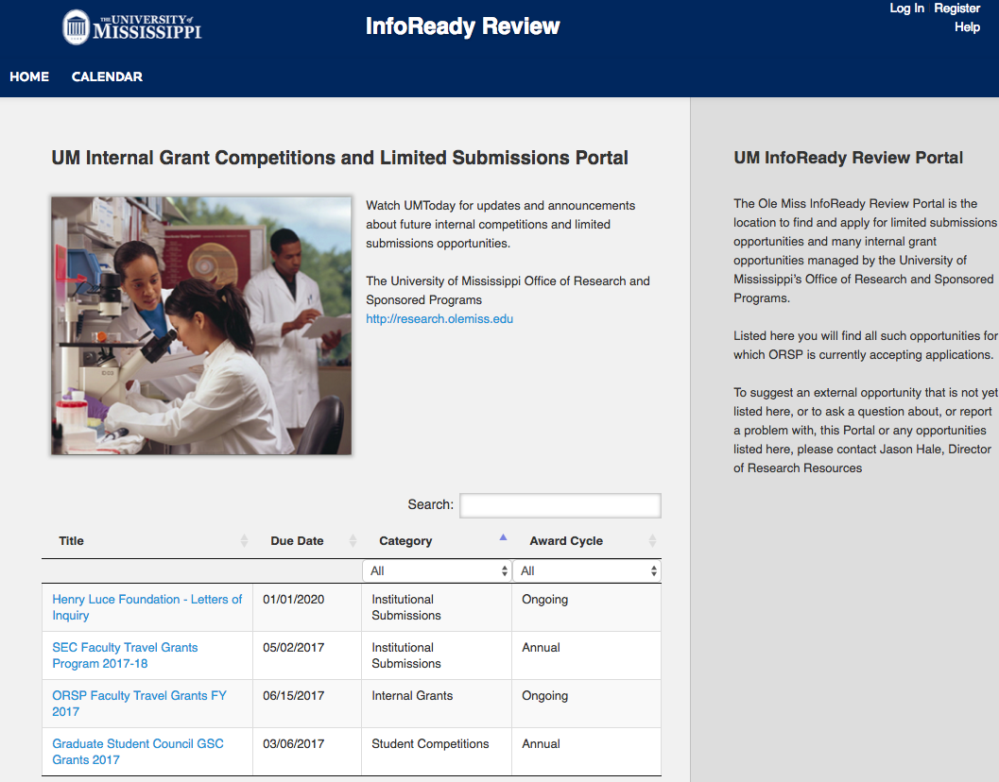
Application: Submission

Slide 24
Review & Competition
ORSP will pre-review all applications and disqualify those that are not compliant with the instructions
ORSP and Graduate School will enlist reviewers from faculty and staff from around campus

Slide 25
Review & Competition
Review Categories
Arts and humanities
Social sciences and education
Physical and life sciences
Math, computer science, and engineering
Each application will be reviewed by at least two reviewers
ORSP will notify submitters of results (chosen or not)
Reviewer comments and scores will be made available through the InfoReady Portal

Slide 26
Review Criteria (50 points maximum)
GSC Research Project: Merit (10 points)
Does the narrative make a compelling case, understandable to a reader from a related but different discipline, that the proposed work will advance knowledge and understanding in a way that compliments, or fills a gap in, work that has come before?
What is the novelty or originality of the proposed work or approach?

Slide 27
Review Criteria (50 points maximum)
GSC Research Project: Soundness of Plan (10 points)
Does the narrative make a compelling case that the project will be completed as proposed within the project period, using the resources available?
Are potential risks identified, and are contingencies in
place to mitigate those risks?

Slide 28
Review Criteria (50 points maximum)
Biosketch (5 points)
Is it clear what format the applicant was writing their biosketch in? Is it appropriate for the external funding opportunity being targeted? How compliant does the biosketch appear to be with the prescribed format? How complete and compelling is the biosketch?
Overall Clarity (10 points) Is the proposal compelling, easy to understand, and grammatically correct?

Slide 29
Review Criteria (50 points maximum)
External Opportunity: Merit (5 points)
Is it clear that the applicant has researched and understands all the key requirements of the external opportunity? Is the opportunity appropriate for the student’s stage and program of study?
External Opportunity: Soundness of Plan (10 points)
Given what was written, how likely does it seem that the student will be able to develop and submit an on-time, compliant application or proposal? How competitive is the proposal likely to be?

Slide 30
Award and Requirements
Awardees will sign an award agreement with ORSP
Funds will be transferred to a Departmental Account under the control of the Advisor or Dept. Point of Contact
Awardees will present at the Graduate School 3M Thesis Competition in Fall 2019
Awardees will present a poster at the GSC poster symposium in Spring 2020
Awardees will submit mid-term (December) and final (May) reports to GSC

Slide 31
Finding External Opportunities
UM’s COS/Pivot Subscription

Slide 32
Finding External Ops: Things to Look For
Who is the sponsor?
When and where is the award?
How much $$ are the awards for?
What can you (and can’t you) spend the money on?
Who is the check made out to—the student, or the University?
Is U.S. citizenship or permanent residency required?
When is application deadline and process?
What all components are required in the application?

Slide 33
Finding External Ops: Things to Look For (cont.)
Is there a prescribed budget format?
Is tuition allowed?
How many awards are expected?
What is the expected funding rate?
What/who has been funded in the past?
What are the performance requirements if awarded?
What reporting requirements?
Income tax implications?
Required format for resume or biosketch

Slide 34
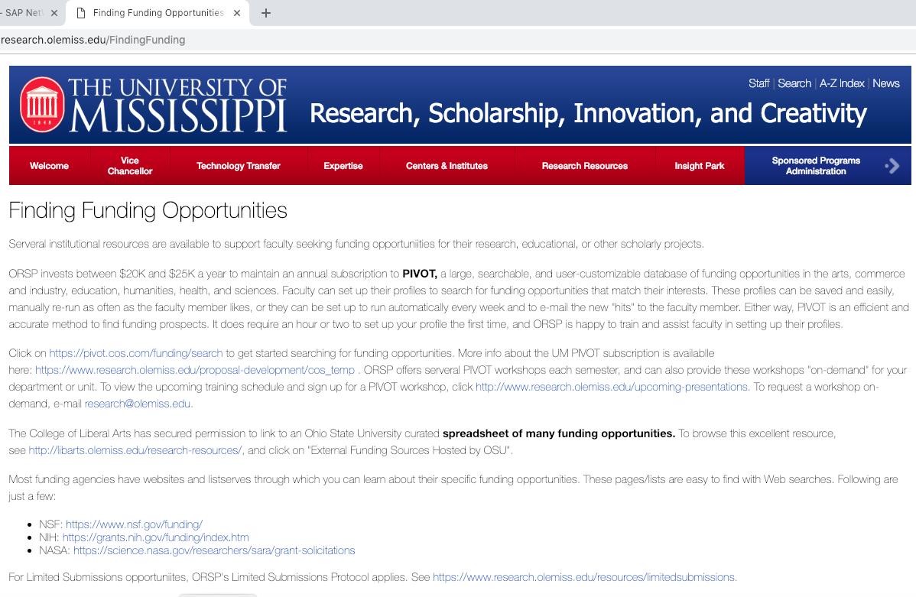
COS/Pivot Demonstration

Slide 35
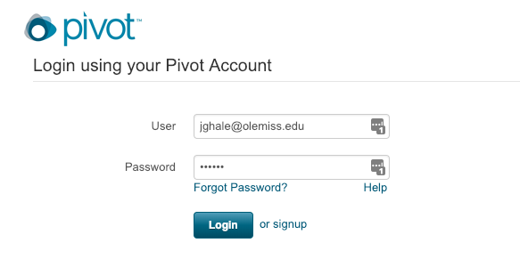
COS/Pivot Demonstration
The first time click “signup” to sign up for your account
Use your @go.olemiss.edu e-mail address
Select a password—this is NOT the same as your WebId password

Slide 36
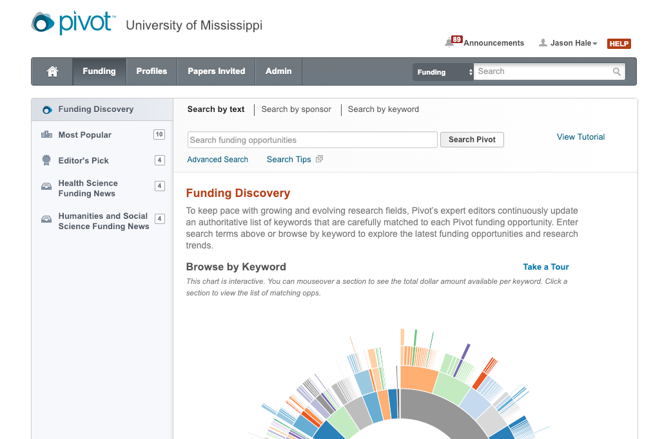
COS/Pivot Demonstration
Add search terms and click Search Pivot
Or Click Advanced Search to specify different parameters

Slide 37
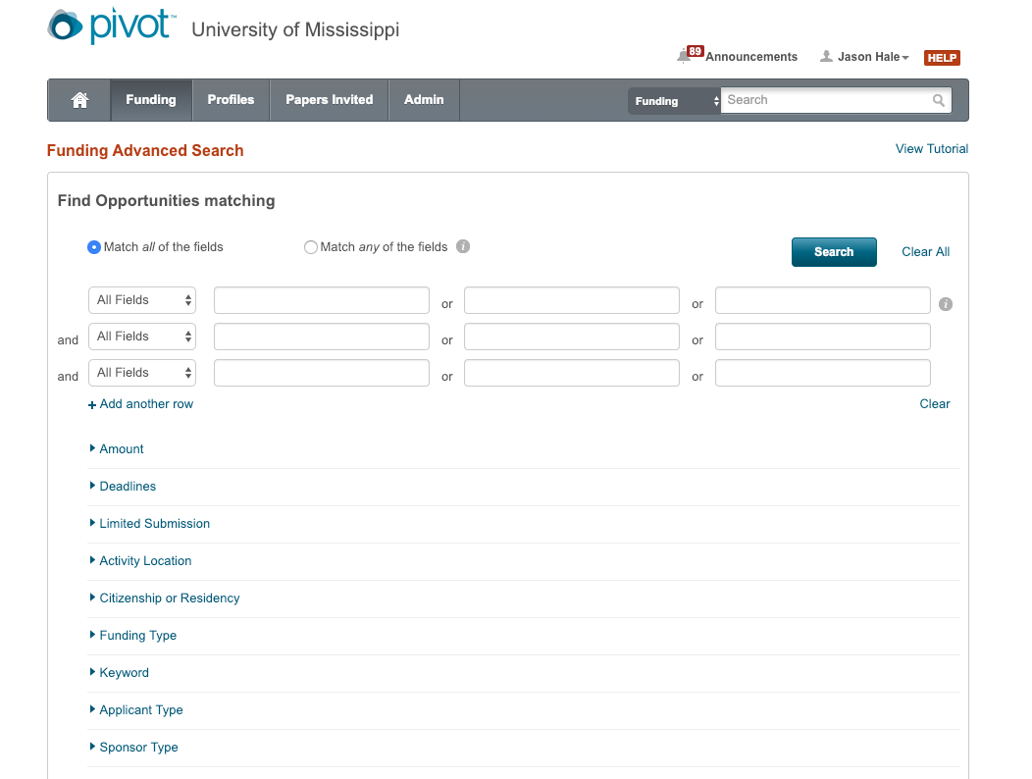
COS/Pivot Demonstration: Advanced Search

Slide 38
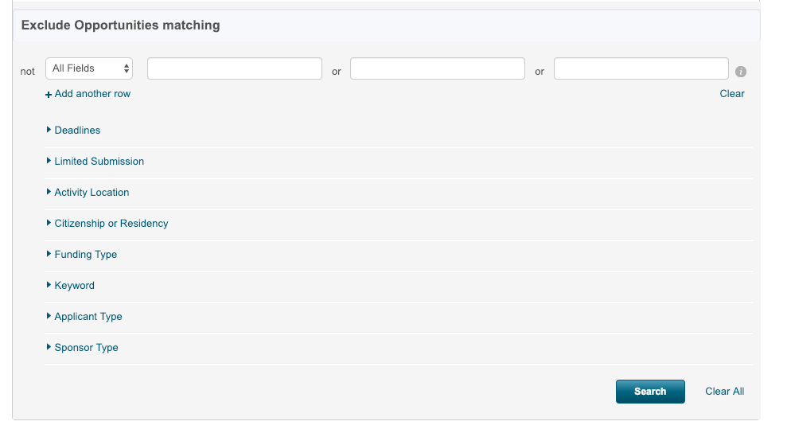
COS/Pivot Demonstration: Advanced Search

Slide 39
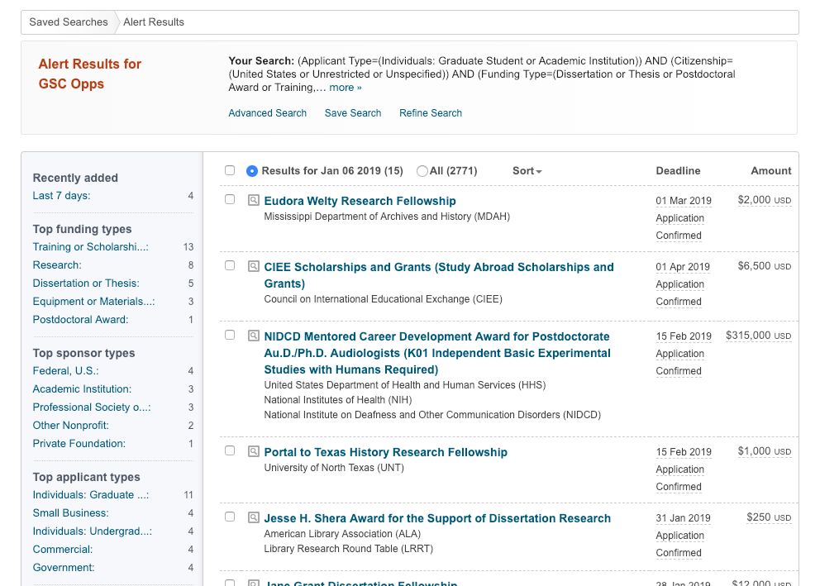
COS/Pivot Demonstration

Slide 40
Example Opportunities
The following are just a FEW examples of funding opportunities that graduate students can apply for—just to give you an idea.

Slide 41
Graduate Research Fellowship Program
Sponsor: National Science Foundation (NSF)
Amount: $34,000/year stipend plus $12,000/year institutional allocation
Number of Awards: 2,000/year!
Length: Up to 3 years
Application Due Date: October
Citizen or Residency: United States
Applicant Type: Blah
Eligibility: Acceptance into a STEM or STEM Education graduate program by award start date
PIVOT: https://pivot.cos.com/funding_opps/10135
Website: https://www.nsf.gov/funding/pgm_summ.jsp?pims_id=6201

Slide 42
Graduate Research Fellowship Program (cont.)
Abstract
The purpose of the NSF Graduate Research Fellowship Program (GRFP) is to help ensure the vitality and diversity of the scientific and engineering workforce of the United States. The program recognizes and supports outstanding graduate students who are pursuing research-based master's and doctoral degrees in science, technology, engineering, and mathematics (STEM) or in STEM education. The GRFP provides three years of support for the graduate education of individuals who have demonstrated their potential for significant research achievements in STEM or STEM education. NSF especially encourages women, members of underrepresented minority groups, persons with disabilities, veterans, and undergraduate seniors to apply.

Slide 43
2019 Dissertation Proposal Workshop
Sponsor: Univ. of Wisconsin, Madison, Institute for Research on Poverty (IRP)
Amount: The workshop will be held May 19-25, 2019. Funding for travel, meals, and lodging at Howard University
Citizen or Residency: United States
Applicant Type: Graduate Student
Eligibility: Applicants must be pre-dissertation proposal doctoral students studying at U.S. universities from at least one of the following underrepresented racial or ethnic populations: (a) African American or Black; [others listed….]Preference will be given to those who are also of the first generation college students.
PIVOT: https://pivot.cos.com/funding_opps/186916
Website: https://www.irp.wisc.edu/2019-dissertation-proposal-workshop-call-for-applications-due-2-1-2019/

Slide 44
2019 Dissertation Proposal Workshop (cont.)
Howard University's Center on Race and Wealth (CRW) and the Institute for Research on Poverty (IRP) at the University of Wisconsin-Madison seek applications for the third annual Dissertation Proposal Workshop. This week-long workshop, held at Howard University in Washington, D.C., is aimed at pre-proposal doctoral students in the social sciences from underrepresented racial and ethnic populations who are studying topics related to poverty or inequality in the United States. The workshop is designed to help provide students the skills, knowledge, and resources needed to prepare a dissertation proposal. Funding is provided by the Office of the Assistant Secretary for Planning and Evaluation, U.S. Department of Health and Human Services, as part of IRP's National Poverty Research Center award.

Slide 45
Dissertation Fieldwork Grants
Sponsor: Wenner-Gren Foundation for Anthropological Research, Inc.
Amount: $20,000; Application Deadlines: May 1 and November 1
Citizen or Residency: Unrestricted
Applicant Type: Graduate Students
Eligibility: Applicants must be currently enrolled for a doctoral degree. Application must be made jointly with a dissertation supervisor or other scholar who will undertake responsibility for supervising the project.
PIVOT: https://pivot.cos.com/funding_opps/1928
Website: http://www.wennergren.org/programs/dissertation-fieldwork-grants

Slide 46
Dissertation Fieldwork Grants (cont.)
The Grants are awarded to aid doctoral or thesis research. The program contributes to the Foundation's overall mission to support basic research in anthropology and to ensure that the discipline continues to be a source of vibrant and significant work that furthers our understanding of humanity's cultural and biological origins, development, and variation. The Foundation supports research that demonstrates a clear link to anthropological theory and debates, and promises to make a solid contribution to advancing these ideas. There is no preference for any methodology, research location, or subfield. The Foundation particularly welcomes proposals that employ a comparative perspective, can generate innovative approaches or ideas, and/or integrate two or more subfields.
There is no preference for particular geographic areas or topics.

Slide 47
Art History Fellowships
Sponsor: Metropolitan Museum of Art (The Met)
Amount: $42,000 stipend plus $6,000 for travel
Length: 12 months, 9/1/2020 to 8/31/2021
Citizen or Residency: Unrestricted;
Applicant Type: Graduate Student
Eligibility: The minimum education requirement is PhD candidacy.
PIVOT: https://pivot.cos.com/funding_opps/24741
Website: http://www.metmuseum.org/about-the-met/fellowships/art-history-fellowships

Slide 48
Art History Fellowships (cont.)
Fellowships at The Met are an opportunity for scholars from around the world to use the Museum as a place for exchange, research, and professional advancement. Fellows are fully integrated into the life of the Museum and are given unique access to the inner workings of The Met through a rich program of tours, roundtable discussions, and workshops.
Fellows are given a workspace and access to libraries, collections, research facilities, labs, and the time and space to think. Applicants submit a specific, independent research proposal that makes use of the Museum's collection and resources. Accepted fellows spend the majority of their time working on their proposed project.

Slide 49
Ruth L. Kirschstein National Research Service Award (NRSA) Individual Predoctoral Fellowship to Promote Diversity in Health-Related Research (Parent F31)
Sponsor: National Institutes of Health
Amount: Award budgets are composed of stipends, tuition and fees, and institutional allowance.
Length: up to 5 years
Deadlines: Various dates depending on focus area
Citizen or Residency: Unrestricted
Applicant Type: For dissertation grants, the applicant organization must be an accredited doctoral granting institution at which the student is registered and matriculating. Individuals cannot apply directly.
Eligibility: Academic Institution
PIVOT: https://pivot.proquest.com/funding_opps/119942
Website: https://grants.nih.gov/grants/guide/pa-files/PA-18-765.html

Slide 50
Ruth L. Kirschstein National Research Service Award (NRSA) Individual Predoctoral Fellowship to Promote Diversity in Health-Related Research (Parent F31)
The purpose of this Ruth L. Kirschstein National Research Service Award (NRSA) Individual Predoctoral Fellowship to Promote Diversity in Health-Related Research award is to enhance the diversity of the health-related research workforce by supporting the research training of predoctoral students from population groups that have been shown to be underrepresented in the biomedical, behavioral, or clinical research workforce, including underrepresented racial and ethnic groups and those with disabilities. Through this award program, promising predoctoral students will obtain individualized, mentored research training from outstanding faculty sponsors while conducting well-defined research projects in scientific health-related fields relevant to the missions of the participating NIH Institutes and Centers. The proposed mentored research training is expected to clearly enhance the individual's potential to develop into a productive, independent research scientist.

Slide 51
Ruth L. Kirschstein National Research Service Award (NRSA) Individual Predoctoral Fellowship to Promote Diversity in Health-Related Research (Parent F31)
Eligible Individuals (Program Director/Principal Investigator)
Any individual(s) at the dissertation stage of training with the skills, knowledge, and resources necessary to carry out the proposed research as the Program Director/Principal Investigator (PD/PI) is invited to work with his/her organization to develop an application for support. Individuals from underrepresented racial and ethnic groups as well as individuals with disabilities are always encouraged to apply for AHRQ support.
The PD/PI is also referred to in this PA as a "Candidate."
Are U.S. citizens, non-citizen nationals, or permanent residents by the time of the grant award; Are full-time students (as defined by the student's institution) in good standing, who are enrolled in an accredited research doctoral program in such fields as behavioral sciences, health services research, nursing, social sciences, epidemiology, biostatistics, health policy, health informatics, engineering, economics and mathematics; Will have completed all non-dissertation requirements for their doctoral degree by the time of submission of the application, including completion of their qualifying exams. The only exception allowed will be the completion of required clinical internships that follow completion of the dissertation;
Do not have more than part-time employment (defined as greater than twenty hours per week) in addition to the requirements of their current, full-time academic student appointment at the time the award is made; and

Slide 52
Ruth L. Kirschstein National Research Service Award (NRSA) Individual Predoctoral Fellowship to Promote Diversity in Health-Related Research (Parent F31)
Eligible Individuals (Program Director/Principal Investigator)
Are U.S. citizens, non-citizen nationals, or permanent residents by the time of the grant award; Are full-time students (as defined by the student's institution) in good standing, who are enrolled in an accredited research doctoral program in such fields as behavioral sciences, health services research, nursing, social sciences, epidemiology, biostatistics, health policy, health informatics, engineering, economics and mathematics; Will have completed all non-dissertation requirements for their doctoral degree by the time of submission of the application, including completion of their qualifying exams. The only exception allowed will be the completion of required clinical internships that follow completion of the dissertation;Do not have more than part-time employment (defined as greater than twenty hours per week) in addition to the requirements of their current, full-time academic student appointment at the time the award is made; and….

Slide 53
AHRQ Grants for Health Services Research Dissertation Program (R36)
Sponsor: United States Department of Health and Human Services (HHS)
Agency for Healthcare Research and Quality (AHRQ)
Amount: Up to $40,000 direct costs plus 8% F&A
Length: 9 to 17 months
Deadlines: Aug 1, Nov 1, Feb 1, May 1, each year
Citizen or Residency: United States
Applicant Type: Institution
Eligibility: For dissertation grants, the applicant organization must be an accredited doctoral granting institution at which the student is registered and matriculating. Individuals cannot apply directly
PIVOT: https://pivot.proquest.com/funding_opps/119942
Website: https://grants.nih.gov/grants/guide/pa-files/PA-18-765.html

Slide 54
AHRQ Grants for Health Services Research Dissertation Program (R36) continued
Candidates must conduct dissertation projects which focus on health care delivery in the United States.
AHRQ welcomes any area of health services research relevant to AHRQ's priority areas as a dissertation project topic. Candidates are encouraged to address health services research issues critical to AHRQ priority populations, including: individuals living in inner city or rural (including frontier) areas; low-income and minority groups; women, children, the elderly; and individuals with special health care needs, including those with disabilities and those who need chronic or end-of-life health care.

Slide 55
Art History Fellowships (cont.)
Fellowships at The Met are an opportunity for scholars from around the world to use the Museum as a place for exchange, research, and professional advancement. Fellows are fully integrated into the life of the Museum and are given unique access to the inner workings of The Met through a rich program of tours, roundtable discussions, and workshops.
Fellows are given a workspace and access to libraries, collections, research facilities, labs, and the time and space to think. Applicants submit a specific, independent research proposal that makes use of the Museum's collection and resources. Accepted fellows spend the majority of their time working on their proposed project.

Slide 56
Neuroscience Scholars Program
Sponsor: Society for Neuroscience Amount: Blah; Expected Number of Awards: 18.
Length: Blah; Deadline: May 23;
Citizen or Residency: Required
Applicant Type: Individual
Eligibility: A member of an underrepresented group (minority or disabled person) enrolled in a graduate degree-granting program.
PIVOT: https://pivot.cos.com/funding_opps/93222
Website: https://www.sfn.org/careers-and-training/diversity-programs/neuroscience-scholars-program

Slide 57
Neuroscience Scholars Program
The Neuroscience Scholars Program is a two-year training program open to underrepresented graduate students and postdoctoral researchers. Building on the 30 year history of NSP, the program supports annual travel awards, mentoring, and the professional development of up to 15 candidates known as NSP Fellows.
In addition, all eligible applicants will be invited to become NSP Associates, including those selected as NSP Fellows. The extensive two-year training program provides live events and webinars, a rich library of educational resources, and an online diversity affinity group of for seeking career connections and guidance. Events, webinars, and resources will focus on career advancement issues, topics related to research process, and cutting edge scientific content.

Slide 58
Summer Internships in Biomedical Research (SIP)
Sponsor: National Institutes of Health
Amount: Stipend
Length: 8 week internship in Washington D.C.
Number of Awards Annually: 800+
Citizen or Residency: United States
Applicant Type: Individual
Eligibility: graduate, college, or high school students
PIVOT: https://pivot.cos.com/funding_opps/66937
Website: https://www.training.nih.gov/programs/sip

Slide 59
Summer Internships in Biomedical Research
Summer programs at the National Institutes of Health (NIH) provide an opportunity to spend a summer working at the NIH side-by-side with some of the leading scientists in the world, in an environment devoted exclusively to biomedical research (At the NIH "biomedical sciences" includes everything from behavioral and social sciences, through biology and chemistry, to physics, mathematical modeling, computational biology, and biostatistics).
Internships cover a minimum of eight weeks, with students generally arriving at the NIH in May or June. The NIH Institutes/Centers and the Office of Intramural Training & Education (OITE) sponsor a wide range of summer activities including an orientation to help interns get off to a good start, lectures featuring distinguished NIH investigators, career/professional development workshops, and Summer Poster Day.

Slide 60
Student and Postdoctoral Research Grants: Mathematical Geosciences Student Awards (MG)
Sponsor: International Association for Mathematical Geosciences (IAMG)
Amount: $2,500; Proposals Due: May 31st each year
Length: one year
Citizen or Residency: unrestricted
Applicant Type: Graduate Student
Eligibility: Eligible candidates are those currently undertaking Masters or Ph.D. studies who wish to use the award to conduct a period of research related to their thesis
PIVOT: https://pivot.cos.com/funding_opps/137744
Website: https://iamg.org/student-affairs/student-and-postdoctoral-research-grants.html

Slide 61
What is Next?
Read that Request for Applications (RFA) carefully
Identify a GSC Research Project to Propose
Consult with your graduate advisor
Identify an External Opportunity
Search online sources (e.g., COS/Pivot)
Find candidate opportunities of interest
Carefully read the rules and guidelines
Select the opportunity you will go for

Slide 62
What is Next?
Write your Proposal
Write GSC Project Research Strategy & Other Components
Write the Funding Opportunity Sections
Comply with the RFA
If RFA and this PPT are inconsistent, RFA rules
Don’t let your application get returned without review!
Submit your application by the due date
Comply with award conditions if awarded
Refer questions gscsecretary.olemiss@gmail.com or Jason Hale at jghale@olemiss.edu

Slide 63
Access this presentation online
http://www.research.olemiss.edu/presentations

