Slide 1
Listing and Finding UM Resources
with the Research Resources Directory (R2D1)
Mickey McLaurin
October 13, 2016

Slide 2
What We will Do
Introduce the UM Research Resources Directory (R2D1)
Learn to find resources with R2D1
Learn to list/edit resources with R2D1

Slide 3
What is the Research Resources Directory (R2D1)?
A centralized listing of both centrally and locally administered resources of potential interest to a broad community of UM researcher/scholars, and internal and external stakeholders.
Provides a common/standardized interface with only the basic information about resources. Entries point users to “Web pages of record” or human points of contact for detailed info.

Slide 4
Why Has the R2D1 Directory Been Created?
Called for in the UM2020 Strategic Plan.
To facilitate cross-disciplinary collaboration, inter-institutional collaboration, and sharing and utilization of resources.
To allow UM administrators and researchers to respond quickly, efficiently, accurately, and consistently to external opportunities and requests.
To facilitate the development of more complete, accurate, and competitive grant proposals.

Slide 5
What R2D1 is NOT
NOT a physical property control system.
NOT a replication of information in Faculty Activity Report.
NOT something that faculty will be required to use, get credit for using, or be punished for not using.
NOT a replacement for, or replication of, departmental/local Web sites (rather, it is a central, standardized directory of pointers to those pages)

Slide 6
What Kinds of Resources Should Be Listed?
Resources that others outside of your department might want (to requests/negotiate) access to
Services that others might want access to
Capabilities that others might need to know about
Any capability that you would want to be considered for inclusion in institutional responses to outside inquiries
Anything that is unique (such as a unique interdisciplinary course)
Capabilities that could lead to enhanced collaboration

Slide 7
What Kinds of Resources Should NOT Be Listed
Commodities and supplies
Common or standard office or lab equipment (printers, desktop computers, administrative departmental servers, golf carts)
Courses that are only offered to students in your own department
Resources that are too specialized or un-accessible to be of interest to others

Slide 8
Glossary of Terms
Entries are records/listings in the R2D1 Directory.
Each R2D1 Entry represents a corresponding real-world resource.
Each real-world Resource should be represented by only 1 directory Entry.
An Entry may have a 1 or 2 Categories that tell the what TYPE the real-world resource is. (e.g., Instrumentation, Program).
An Entry may have zero or many Applications that tell what kinds of problems the corresponding real-world resource can address (e.g., Energy Development, Space Exploration, Environmental Protection/Remediation, etc.)

Slide 9
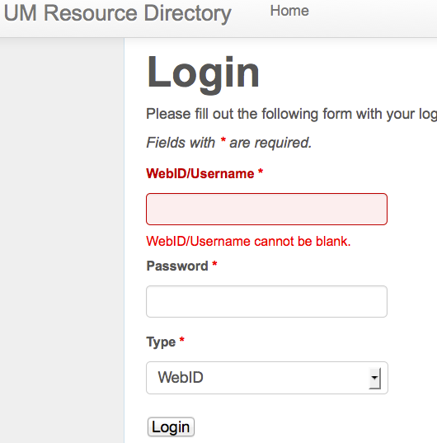
How to Log In
www.research.olemiss.edu/R2D1

Slide 10

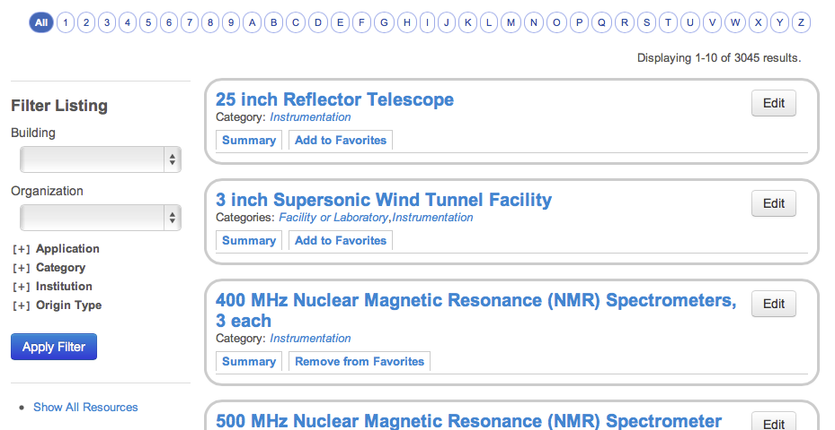
View All Resources

Slide 11
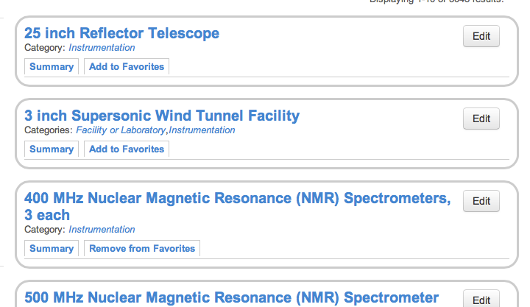
View Summary of a Resource

Slide 12
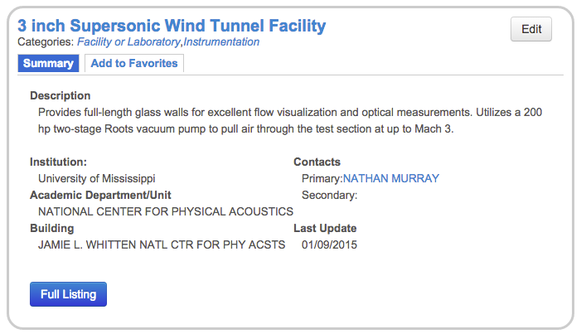
View Summary of a Resource

Slide 13
View Summary of a Resource

Slide 14
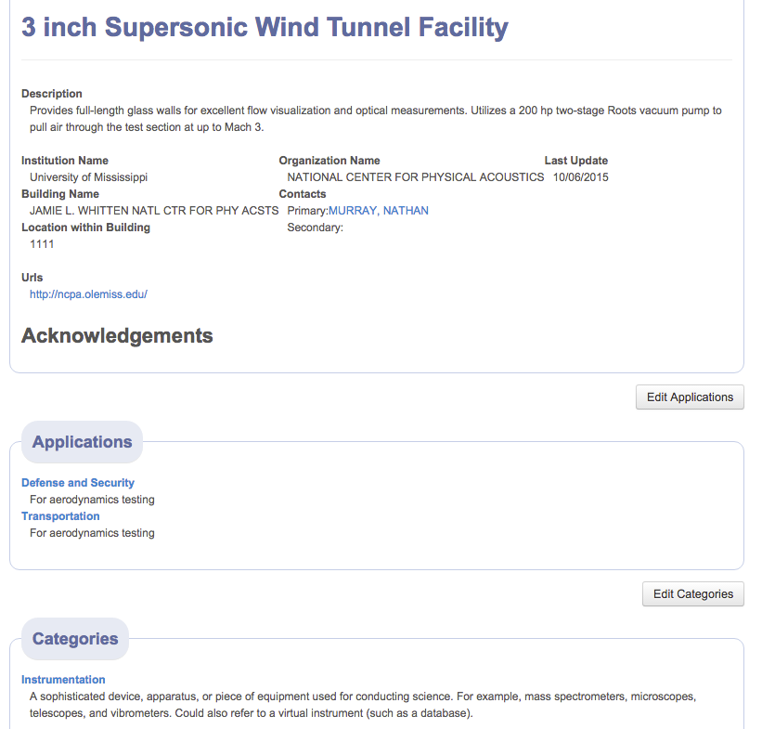
View Full Listing of a Resource

Slide 15
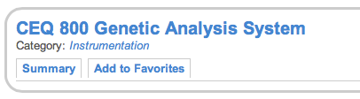
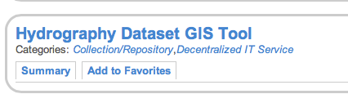
Categories
An Entry may be associated with Categories
A Category is the fundamental TYPE of a resource
Most resources will have only 1 Category; some may have 2 or 3.

Slide 16
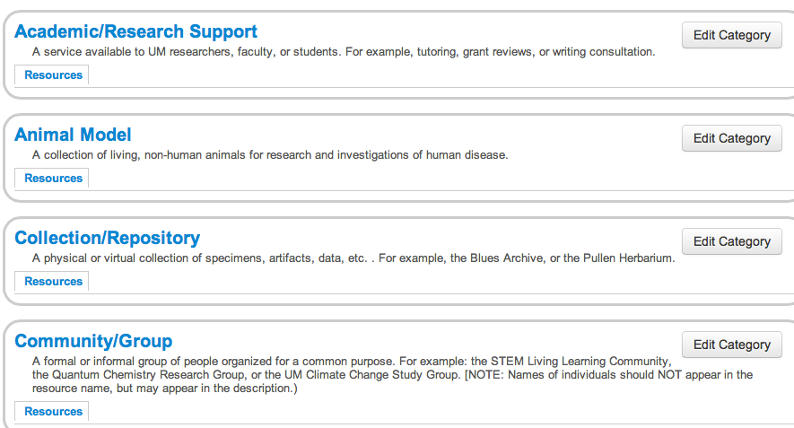
Categories
23 categories are defined in R2D1. Contact your Research Advocate or the R2D1 Super Administrators to suggest categories be added or merged.

Slide 17
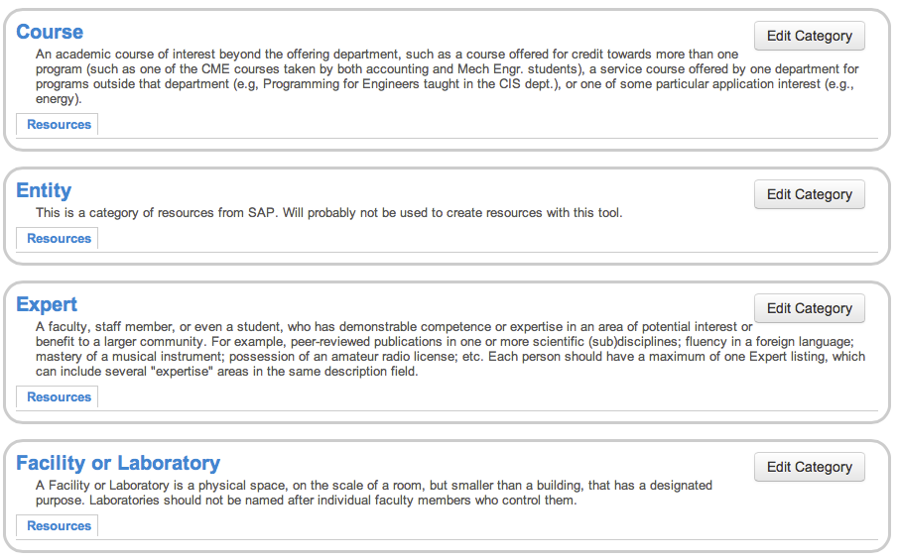
Categories (continued)

Slide 18
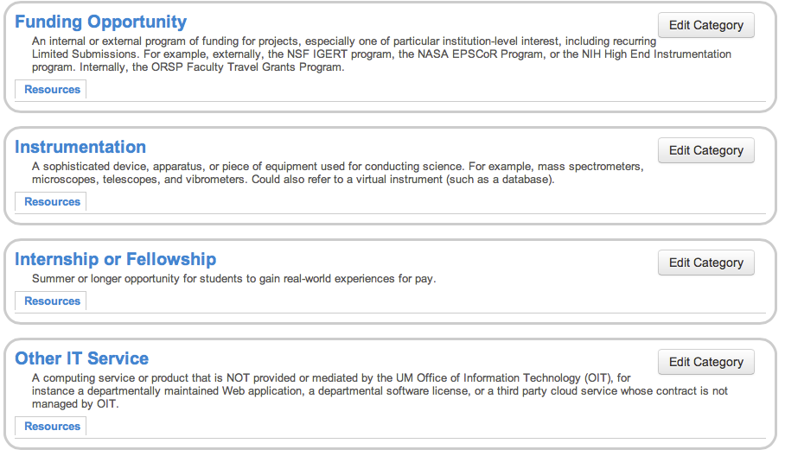
Categories (continued)

Slide 19
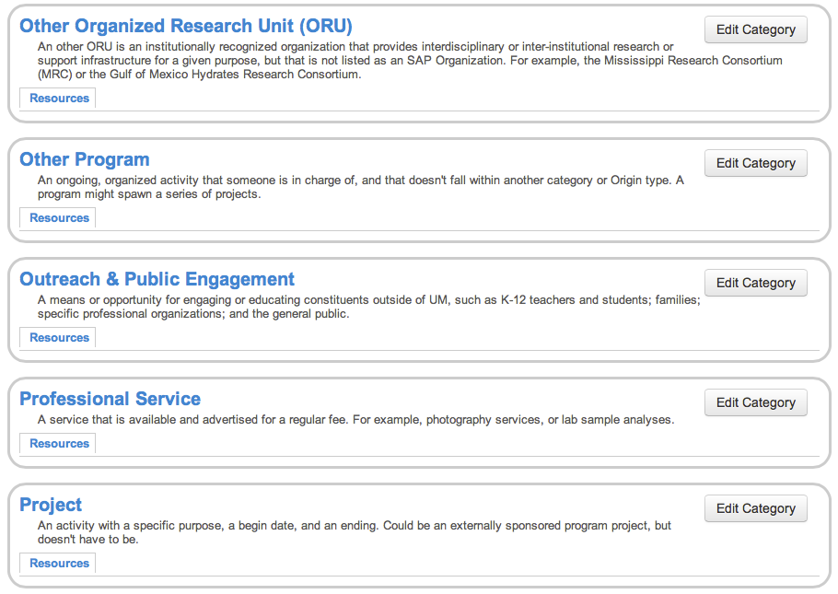
Categories (continued)

Slide 20
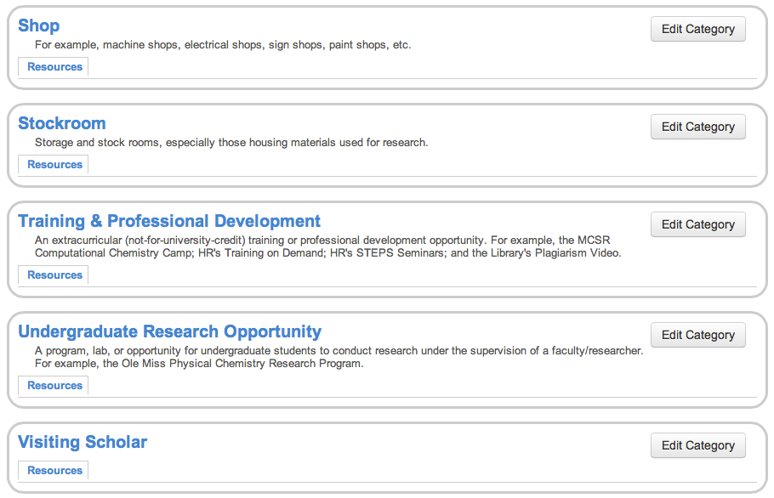
Categories (continued)

Slide 21
Applications
An Application is a societal problem, challenge, or interest area to which a resource may be applied.
Each Entry may be associated with zero to many Applications
Associating an Entry with an Application allows:
  ORSP and other central entities to quickly identify all resources/capabilities associated with an interest area
  UM researches to find and collaborate with one another to address interdisciplinary challenges, and to organize and respond quickly to problem-based funding opportunities and current events (e.g., disasters)
  Resources to be listed once, but described in customized, institutionally vetted/standardized ways to diverse stakeholders (economic developers, media, etc.)

Slide 22
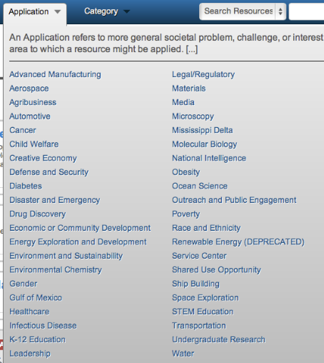
Applications
42 Applications are defined
in R2D1.
Contact your Research Advocate
or the R2D1 Super Administrators
to suggest new Applications.

Slide 23
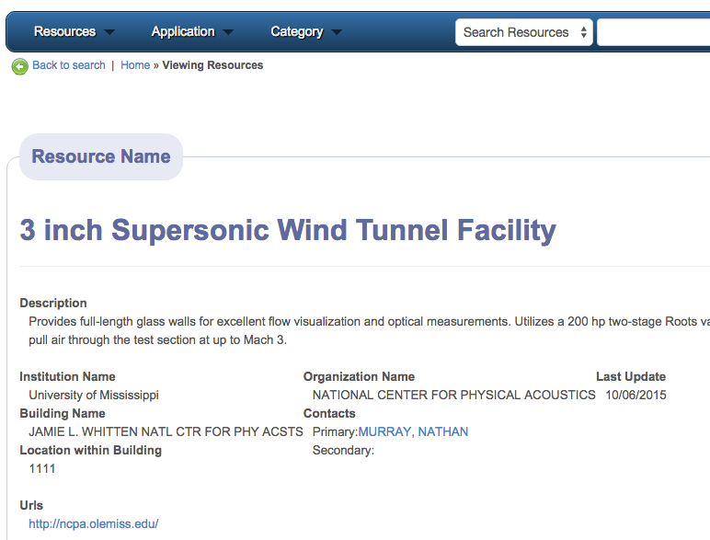
To Go Back to Resource Listing: Back to Search

Slide 24
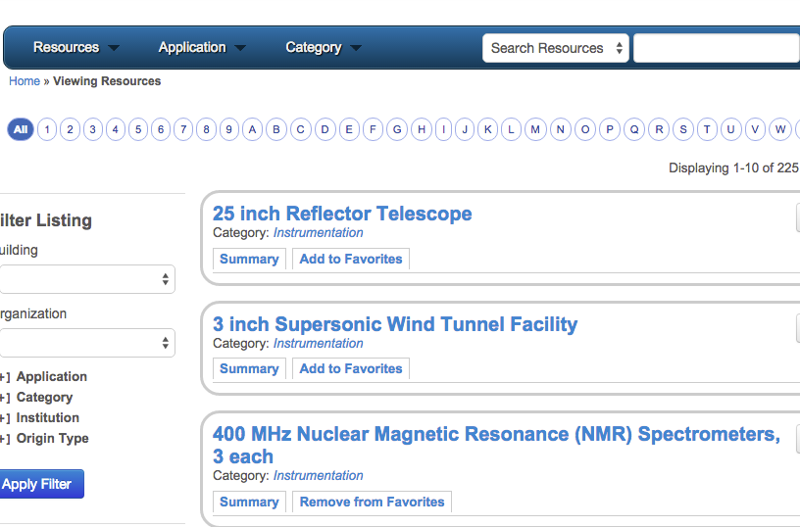
Back to Search
Takes you back to the listing you were viewing before you viewed the full listing.

Slide 25
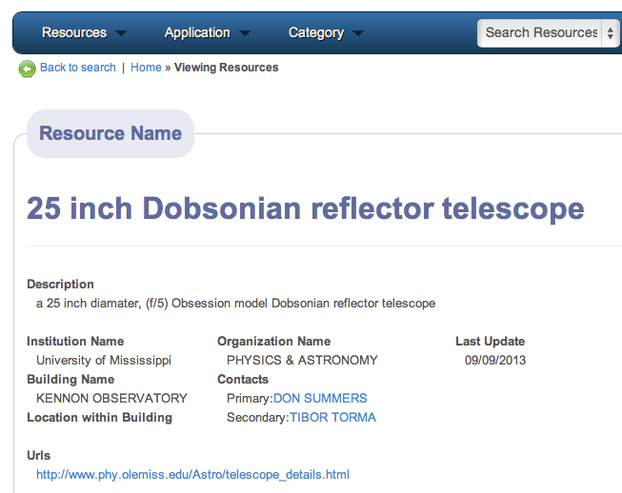
To Start Over: Home

Slide 26
Home
Forgets the listing you were looking at; takes you back to home page to view ALL RESOURCES, as if you just logged in.

Slide 27
Where Do Resource Directory Entries Originate?
Some entries are manually entered by R2D1 Users.
Individual Faculty or Researchers who request admin accounts may enter/maintain entries for resources they control (such as an instrument or an outreach capability) or for which they are listed as primary or secondary points of contact.
Designated Representatives employees on behalf of their departments, schools, centers, or administrative offices. For example, an assistant dean may enter resources on behalf of a school, or an admin. assistant may do so for a department. These designated representatives will often be listed as points of contact.
ORSP Research Advocates ORSP Program Development Specialists may create/edit directory resource entries on behalf of, or in consultation with, their clients
ORSP Management Team Director of Research Resources and Director of Sponsored Programs Administration can create/edit all entries.

Slide 28
Where Do Resource Directory Entries Originate?
Many entries are pre-imported from SAP.
Organizations Ex. Career Center; Center for Excellence in Teaching & Learning; Media & Public Relation; Staff Council. 289 Organizations
Committees Ex. Accessibility; Graduate Council; Library Council; 236 Committees
Buildings Ex. Barnard Hall; Data Center; Paris-Yates Chapel. 203 Buildings
UM IT Services Ex. Analytics Reporting; Anti-Virus Software; Course Registration; myOleMiss; SPSS; Supercomputer Accounts; 168 Services.
Expertise (from Faculty Experts Guide)
Other Entities Ex. Allies; Elsie M. Hood Award; Green Initiative. 357 entities.
R2D1 administrative users may assign categories, applications, and other attributes to SAP-originated entries.

Slide 29
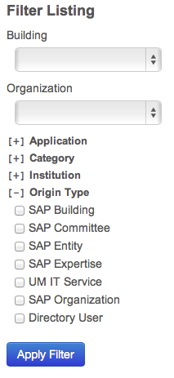
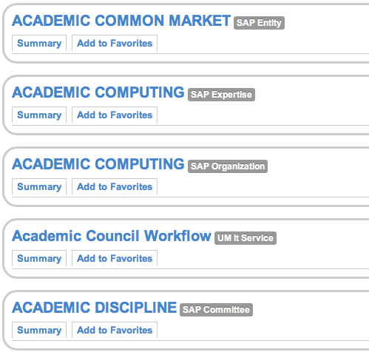

Origin Type: SAP

Slide 30
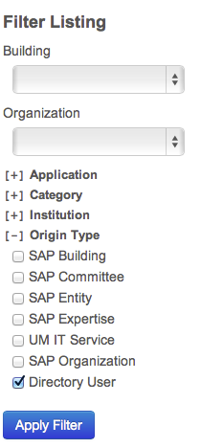
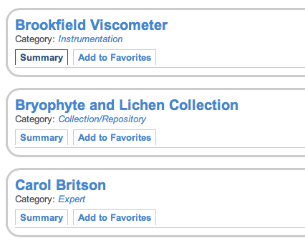
Origin Type: Directory User

Slide 31
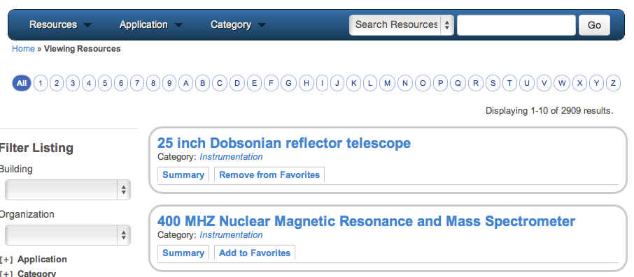
View Resources Staring with a Given Letter….
Click the letter if interest along the top row.

Slide 32
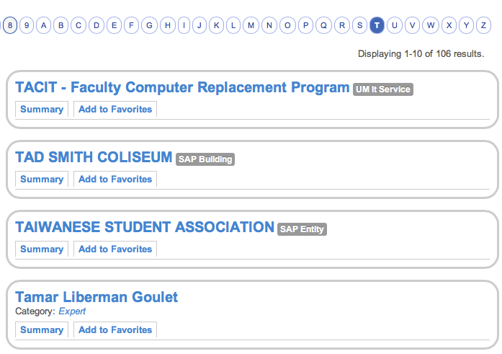
View Resources Staring with a Given Letter….
Click the letter if interest along the top row.

Slide 33
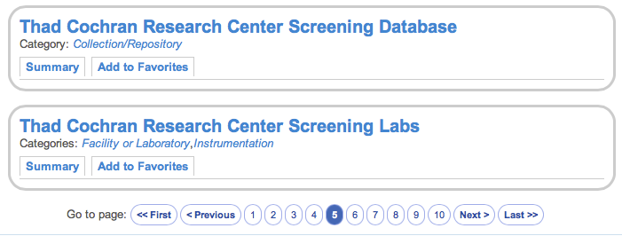
To Browse Forward or Backward within a Listing
Scroll to bottom of screen, and click the numbers or arrows.

Slide 34
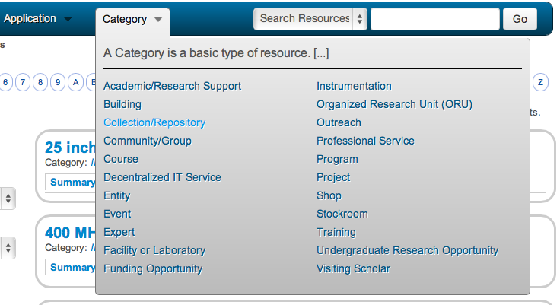
View Resources by Category
Selected the desired Category from the Category Drop-down

Slide 35
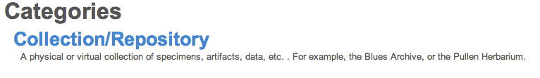
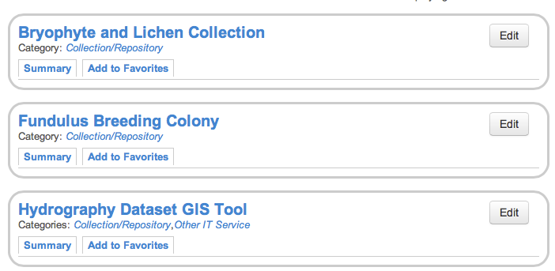
View Resources by Category
List will only include user-originated resource entries in that category (e.g. Collection/Repository).

Slide 36
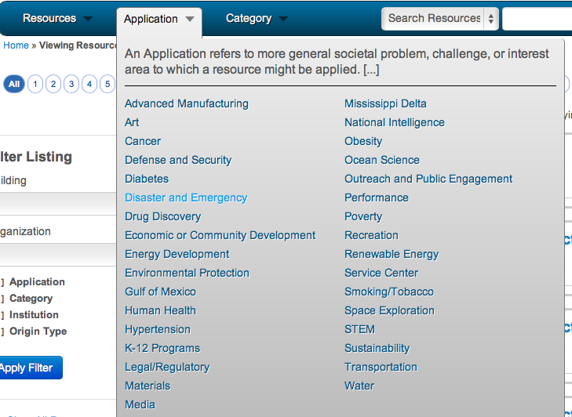
View Resources by Application
Select the desired Application from the Application Drop-Down

Slide 37
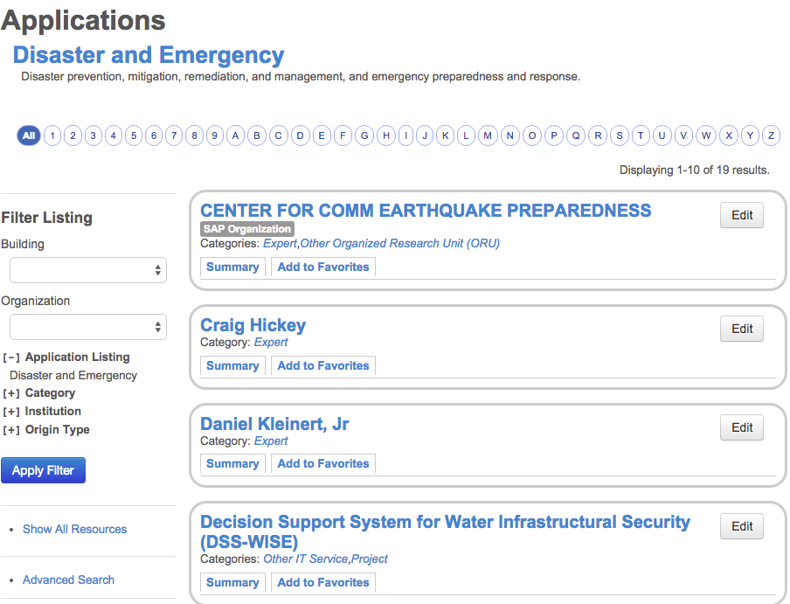
View Resources by Application
Only resource entries with the selected application will be listed.

Slide 38
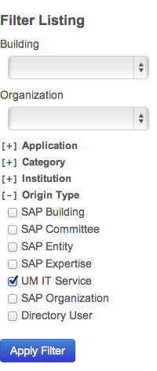
View Resources by Origin Type
Find the Filter Listing section on the left.
Click the + beside Origin Type to see choices.
Select the Origin Type(s) to include in list.
Select Apply Filter.

Slide 39
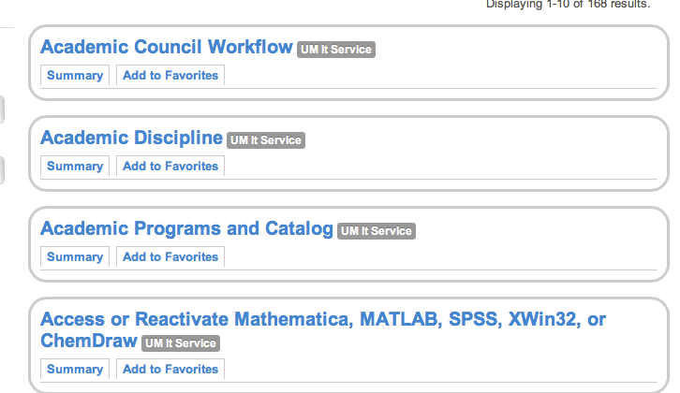
View Resources by Origin Type
Only resource entries with the selected Origin will be listed.

Slide 40
Exercise Using Filters to Narrow the Listing
Assignment: View all resource entries in the
Instrumentation category
that have an
Environmental Chemistry application

Slide 41
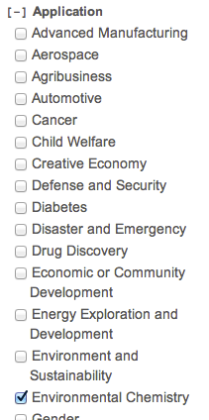
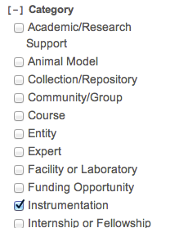
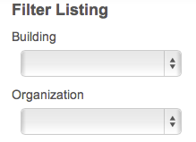

Exercise Using Filters to Narrow the Listing

Slide 42
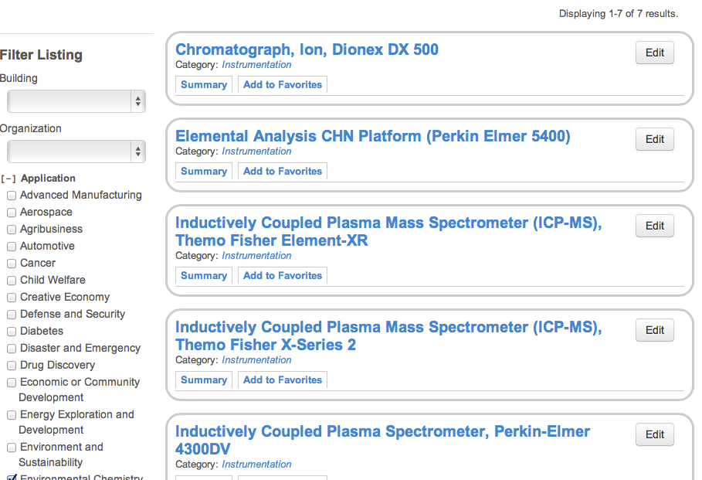
Exercise Using Filters to Narrow the Listing: Results

Slide 43
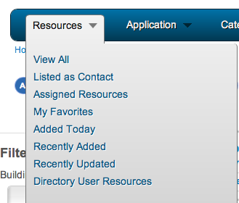
View Directory User Originated Resources
From the Resources Drop-down
Select Directory User Resources

Slide 44
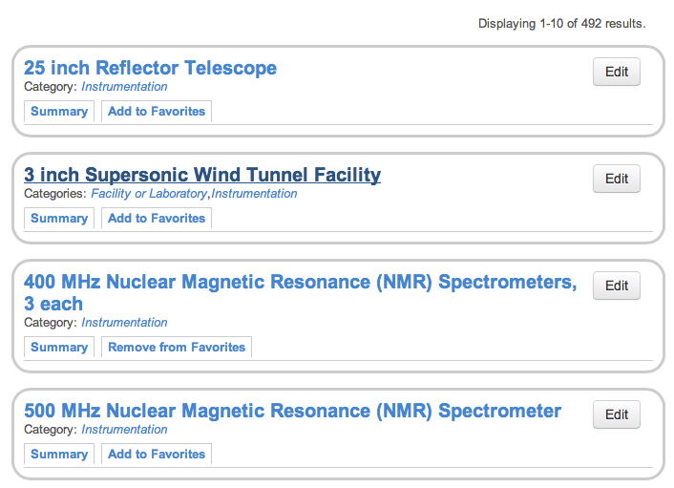
View Directory User Originated Resources
Only resource entries that have been created by R2D1 users will be listed (not SAP-originated entries.)

Slide 45
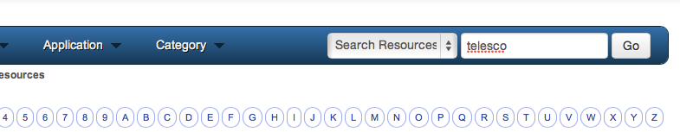
Search Directory for Resources
Type the search string in the text box beside the “Search Resources” drop-down, then click “Go”.
Search algorithm finds exact text matches, not concept matches.
So, to find listings with the word “telescope”, “telescopes”, or “telescopy”, jus type the string with characters that are common to all three words: “telesco”

Slide 46
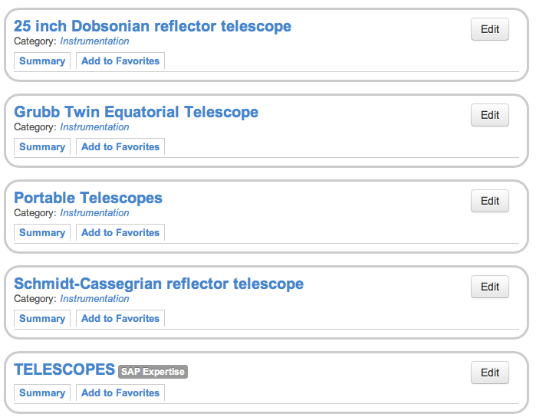
Search Directory for Resources
Only resource entries that match the search criteria will be listed.

Slide 47
Search Directory for Resources: Exercise
Search for yourself in the directory.
Click Home to view all entries.
Type your last name in the search field.
Click Go.
Did you find yourself? If so, edit your entry.
If not, add a Resource.

Slide 48
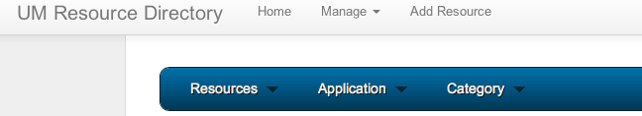
Add a New Resource
Select “Add Resource”
If you don’t see an “Add Resource” link near the “Home” link, contact your ORSP Research Advocate and request to have your WebId/account authorized as an R2D1 Administrators.

Slide 49
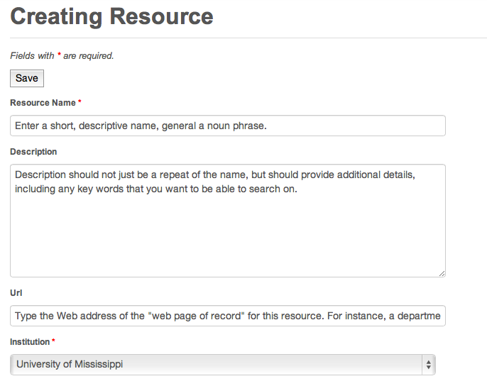
Add a New Resource

Slide 50
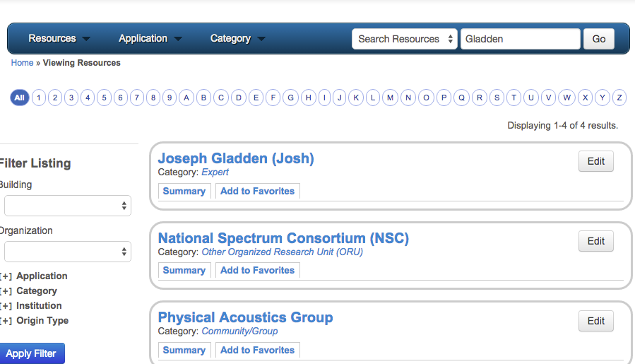
Edit an Existing Resource
Search to find the resource in the listing and click “Edit”

Slide 51
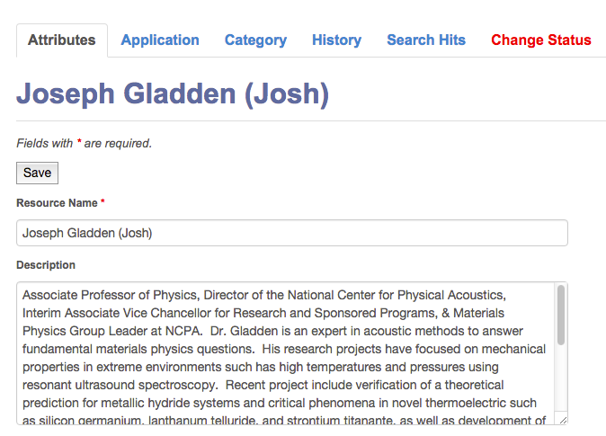
Edit a Resource

Slide 52
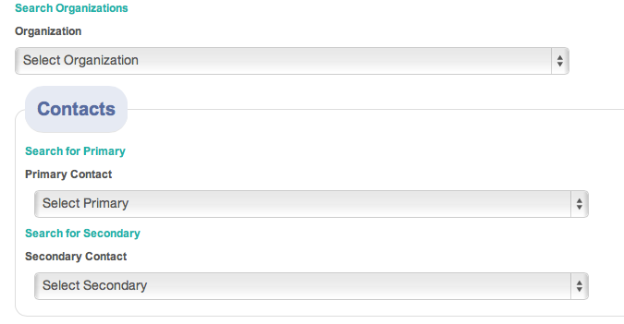
Add/Edit a Resource: Entering attributes
Select the department, school, center, or office
that is in charge of this resource.
Contacts are the people who should be contacted to
inquire about or request access to the resource.
They will also have edit privileges for this resource in R2D1.
Primary will often be the faculty member or administrator most
directly responsible for the resource.
Secondary will often be a staff member or administrative support
person who has been authorized and designated to edit resources
behalf of an entire department, center, or school.
Contacts are listed alphabetically by last name. If the contact you are looking for is not there, contact your ORSP Research Advocate and request that they be added.

Slide 53
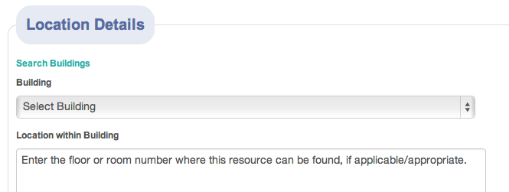
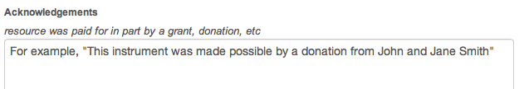

Add/Edit a Resource: Entering attributes
If applicable, select the building where this resource, or
the person/unit responsible for it, resides.
Remember to click Save.

Slide 54
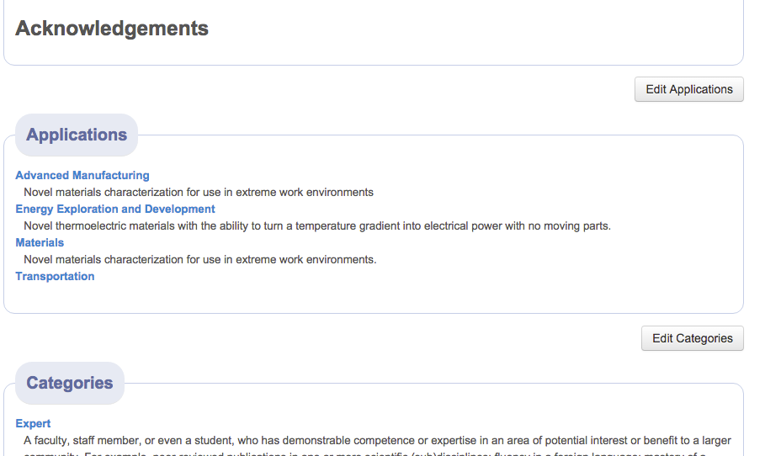
Add/Edit a Resource: Editing applications

Slide 55
Applications
Applications are a way of associating resources with a variety of societal problems, challenges, or broad (interdisciplinary) interest areas they might contribute to.
Applications may be used to:
Institutional respond to external requests about capabilities:
Ex. “Please tell us all of UM’s capabilities related to Oil Spill research and remediation”.
Organize institutional responses to proactive approaches to cross-cutting issues:
Ex. Putting together a team and/or proposal to investigative innovative approaches to treating depression, cancer, obesity, etc.

Slide 56
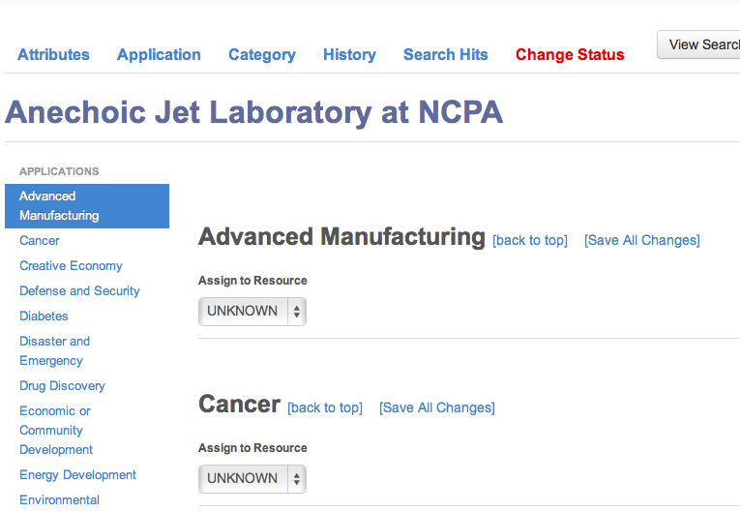
Edit a Resource: Selecting applications

Slide 57
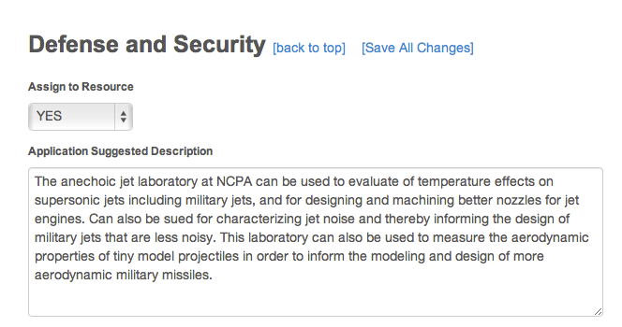
Edit a Resource: Selecting applications

Slide 58
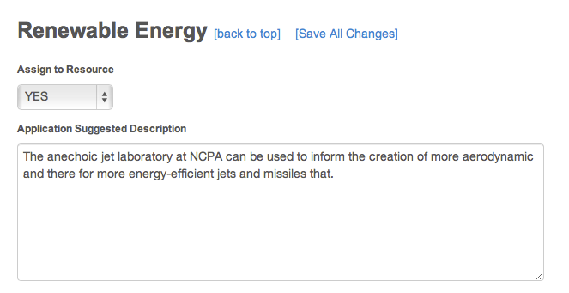
Edit a Resources: Selecting applications: saving

Slide 59
Applications
Applications should be chosen thoughtfully and descriptions composed using language that will be understandable by the target audience/community.
For Expert entries, you might want to list a few recent publications/products relevant to the Application .
ORSP administrators will review and collaboratively edit the suggested language to ensure that:
It is understandable to a non-technical audience
It uses terms recognizable by those knowledgeable about the issues
It is technically accurate
Includes 7 Target Industries of the Mississippi Development Authority (MDA)
Advanced Manufacturing
Aerospace
Agribusiness
Automotive
Energy
Healthcare
Shipbuilding

Slide 60
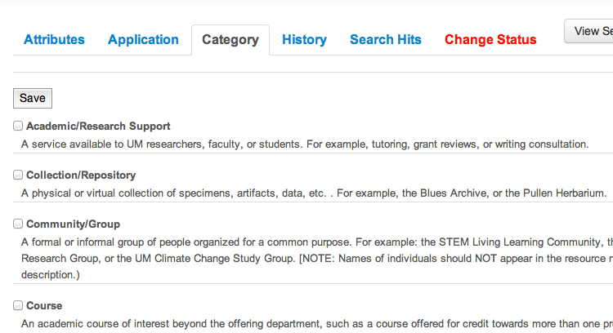
Edit a Resource: Editing categories

Slide 61

Add a New Resource: Selecting categories
Remember to click Save.

Slide 62

Z-Resources
Resources entries whose names begin with the letter “z” have names, descriptions, attributes, categories, or applications have been entered by an R2D1 novice and need to be “approved” by an R2D1 “expert”

Slide 63

Example
Reuters news article on 2/24 says GE plans to spend another $10B on energy research by 2020 to advance waterless fracking and gas turbine efficiency.
http://www.reuters.com/article/2014/02/24/us-ge-spending-idUSBREA1N0JA20140224

Slide 64

Example #2

Slide 65
Example of Using R2D1
waterless fracking
GE wants to explore how to use economically use CO2 (or propane) instead of water for fracking
  collect CO2 at the wellhead, recycle it, frack again, and repeat
  A key challenge will be to help the CO2 carry proppant, a type of sand that holds open the cracks in rock so oil and natural gas can escape, much like water does in current methods.
gas turbine efficiency
GE also wants to boost the efficiency of its natural gas-powered turbines to 65 percent from today's 62 percent.
The company believes its existing research into jet engine efficiency could help significantly reach this goal
The company plans to study how to make wind turbine blades cheaper and more efficient through the use of different composite materials

Slide 66
Use
Look for resources from your area. If they are not there, create them (or contact your ORSP Research Advocate/Program Development Specialist). If they are wrong/incomplete, fix them, or contact your Research Advocate.
E-mail Jason Hale (jghale@olemiss.edu) to:
Report bugs
Request enhancements
Ask questions

