Slide 1

The University of Mississippi
NSF EPSCoR Track-2
ORSP Information Session
November 15, 2017
CME Boardroom
Notes:
Jason Hale to Start

Slide 2
Very Brief Introductions
  ORSP
  UM Attendees; then UMMC Attendees
    Please Stand Up
    Name, Rank, and Department
    Any prior NSF proposal experience/success?
    Any experience with EPSCoR? Track-2?
Notes:
JASON HALE

Slide 3
Theme: Understanding the Relationship between Genome and Phenome
Page 6 of solicitation (PDF)
Central Challenge: understanding relationships between the genotype and the set of phenotypic characteristics displayed by an organism.
Better understanding would have implications for
“medicine, agriculture, biotechnology, ecology, evolution, and other fields.”
Notes:
JASON HALE

Slide 4
Theme: Understanding the Relationship between Genome and Phenome
Page 6 of solicitation (PDF)
“Proposers should pursue innovative, inter-disciplinary approaches toward understanding the factors and features that produce particular phenotypes in individuals and/or populations
including but not limited to genomic, transcriptomic, epigenetic, and environmental
Notes:
JASON HALE

Slide 5
Theme: Understanding the Relationship between Genome and Phenome
Page 6 of solicitation (PDF)
“teams that are using relevant technologies/tools that address multiple levels of organization from genome-cellular-organismal and population are encouraged.”
“These efforts may include the work of biologists, physicists, chemists, engineers, informaticians, and other scientists.”
Notes:
JASON HALE

Slide 6
Theme: Understanding the Relationship between Genome and Phenome
Page 6 of solicitation (PDF)
“Proposals may use any combination of experimental, computational, and/or theoretical approaches with any appropriate species. ”
Notes:
JASON HALE

Slide 7
Funding
  Up to 5 awards may be made
  Projects can be up to 4 years.
  Up to $1M/year (for 2-juriscition projects—
  Mississippi plus one)
  Up to $1.5M/year (for 3 or more jurisdiction projects– MS plus two or more)
  Prime award to lead institution; subcontracts to partners
  Available Direct Costs are considerably less
    UM’s on-campus research F&A Rate is 46% of Modified Total Direct Costs for on-campus projects
    Each sub-recipient would use its own F&A rate
Notes:
JASON HALE

Slide 8
Eligibility
  Mississippi is an EPSCoR Jurisdiction.
  Each institution in an EPSCoR jurisdiction can submit one proposal as the lead institution (no limit to number of non-lead participations)
  UM and UMMC could each submit an application as lead
  Other EPSCoR states: See page XX of solicitation
  Each proposal: one PI and up to 4 co-PIs
  Each collaborating institution will have at least one co-PI
  Any individual can only be a PI or co-PI on one EPSCoR RII Track-2 award at any given time
  Can have multiple other senior personnel (not co-PIs)
Notes:
JASON HALE

Slide 9
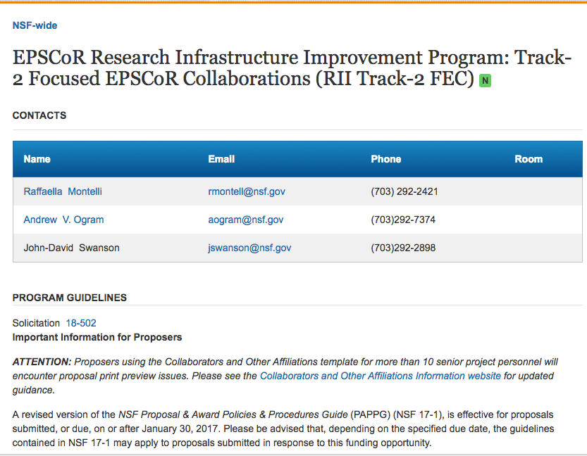
NSF EPSCoR Track-2 Page
  https://www.nsf.gov/funding/pgm_summ.jsp?pims_id=505263
Notes:
JASON HALE

Slide 10
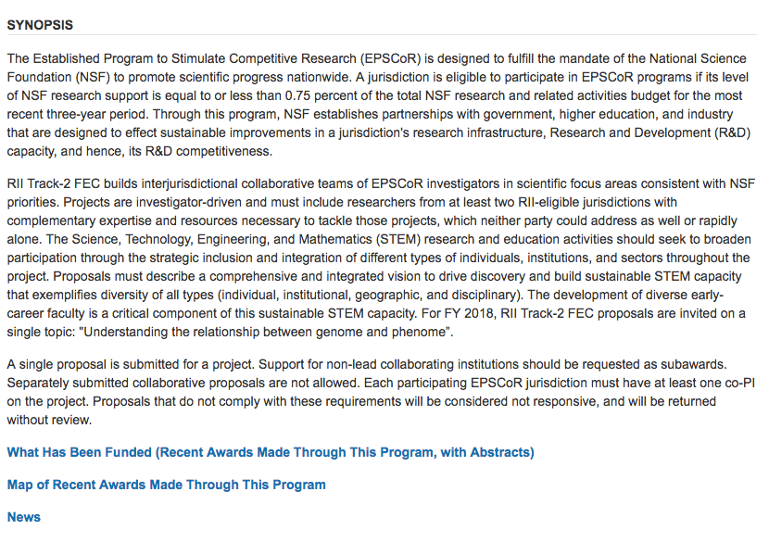
NSF EPSCoR Track-2 Page
  https://www.nsf.gov/funding/pgm_summ.jsp?pims_id=505263
Notes:
JASON HALE

Slide 11
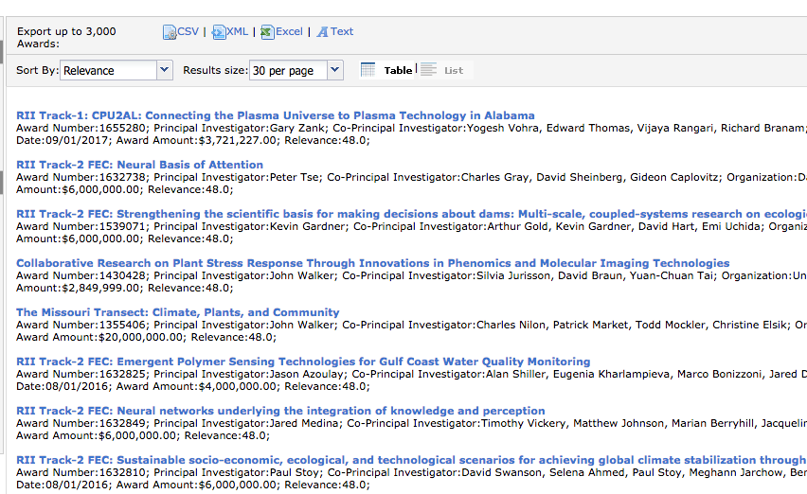
NSF EPSCoR Track-2 Page
  https://www.nsf.gov/funding/pgm_summ.jsp?pims_id=505263
Notes:
JASON HALE

Slide 12
About EPSCoR
  JUNK
Notes:
JASON HALE

Slide 13
Proposing to NSF
  NSF PAPPG 17.1 – Proposal & Award Policies Procedure Guide: https://www.nsf.gov/pubs/policydocs/pappg17_1/index.jsp
  Part II: Proposal Preparation Instructions
    II.C: Proposal Contents
      II.C.2: Sections of the Proposal
  Specifics Solicitation overrides to PAPPG:
    20 page project description (rather than standard 15 for NSF)
      Very Detailed instructions on what sections to include
    No letters of Collaboration
    Up to 4 letters of support
    See solicitation pages 8-11 of Track-2 solicitation
Notes:
JASON HALE

Slide 14
NSF Merit Review Criteria
  Standard NSF (see page 11-12 of solicitation)
    Intellectual Merit
    Broader Impacts
  EPSCoR Track-2 Specific (see pages 12-13)
    Research Capacity
    Interjurisdictional Collaboration
    Workforce Development
    Jurisdictional Impacts
    Integration of Project Elements
Notes:
JASON HALE

Slide 15
UM (Oxford) Selection Process
  Stage 1: Non-binding 1-page (max) internal notice of intent to ORSP by 11/16/17 – tomorrow
      Abbreviated Project Summary; List Known Collaborators/Institutions
      Submit via InfoReady Review Portal: https://olemiss.infoready4.com/
  Stage 2: (2-5 pages) by 11/21 – Tuesday
      NSF-Style Project Summary (1 page)
      Confirmed Collaborators (with proof)
      Extremely Abbreviated NSF Project Description
        Try to address all/most sections listed in the Solicitation
  ORSP will announce internal “winner” by 11/22
  ORSP will submit LOI by 11/27 (Monday after T’Giving)
Notes:
JASON HALE

Slide 16
Nathan Hammer
  Observations and Suggestions
  Q/A
  Others in the room with Track-2 Experience weigh in?
Notes:
JASON HALE

Slide 17
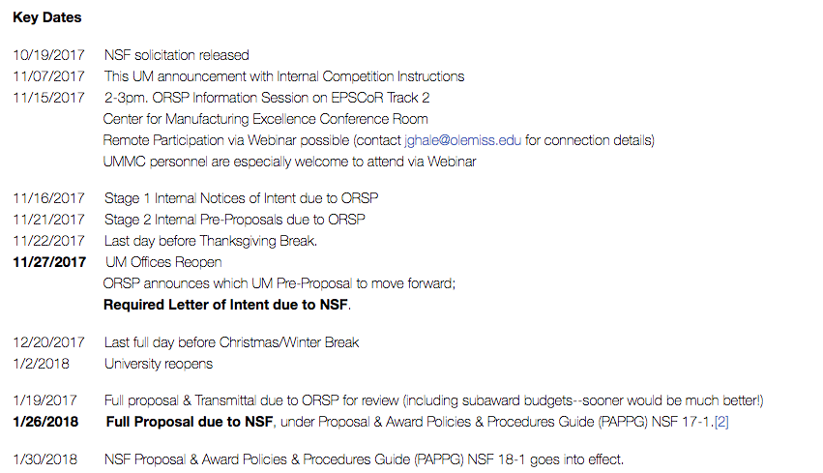
Key Dates
Notes:
JASON HALE

Slide 18
Letter of Intent
  Submitted by ORSP for UM (Oxford) by Mon 11/27
  NOT SEEN by REVIEWERS/PANELISTS
  NOT USED to JUDGE MERIT of PROPOSED RESEARCH
  Synopsis: 2,500 characters max
  Other Comments: 2,500 characters max
  Name participating EPSCoR Jurisdictions
  Anticipated PI (one)
  Up to four other participating personnel (co-PIs from UM, UMMC, or other jurisdictions) – this can be changed or deferred, but suggest nailing this now if possible.
Notes:
JASON HALE

Slide 19
ORSP Services Available
  Enhanced Review of drafts of Project Summary and Proj. Description
  Mentoring from Research Development Fellows
    Nathan Hammer in particular has EPSCoR Track-2 experience
  Glimpse at previous funded proposals
  Assistance with budget and budget justification
  Other special services would need to be negotiated early and will depend on time and resources
    E.g., reviewing Collaborators documents and Biosketches
Notes:
JASON HALE

Slide 20
Research Development Fellows
  ORSP Research Development Fellows
    Greg Easson, Professor of Geological Engineering, Director of Mississippi Mineral Resources Institute
    Christian Sellar, Associate Professor of Public Policy Leadership
    Nathan Hammer, Associate Professor of Chemistry & Biochemistry
  Mission is to help faculty be more competitive for grant proposals, including but not exclusively interdisciplinary proposals)
  Available for discussions, enhanced reviews of CAREER proposal ideas, draft proposals, and full proposals
  E-mail researchfellows@olemiss.edu
Notes:
JASON HALE

Slide 21
Questions?
Notes:
JASON HALE

