Slide 1

The University of Mississippi
NSF EPSCoR RII Track-4
EPSCoR Fellows
ORSP Information Sessions
Winter 2019
Jan 23, 11AM: Weir 107
Jan 25, 3pm: Weir 107
jan 30, 3pm: Weir 107
Notes:
Jason Hale to Start

Slide 2
Brief Introductions
  Attendees:
    Name, Title, and Department
    First NSF Track-4 Proposal?
    Any prior NSF proposal experience/success?
Notes:
JASON HALE

Slide 3
What is NSF EPSCoR
Experimental Established Program to Stimulate Competitive Research
See solicitation page 4 (I.A.) for EPSCoR Goals

Slide 4
Key Points
Spend extended periods of time at research premier research facilities
Far enough away that temporary relocation is necessary
Have a major impact on career trajectory
Up to 6 months total over 2 years

Slide 5
Host Site
Host sites for fellowship projects must be located within the United States, its territories, or possessions.
Host sites may be:
  a government laboratory
  a Federally Funded Research and Development Center (FFRDC)
  a commercial or non-profit research center, or
  an academic institution.
Host site for UM fellows should probably NOT be in Miss.
  But, if at least 4 hours drive away, then maybe (e.g., Gulf Coast)

Slide 6
Eligible Expenses
$300k Max Budget
  Including Direct and Indirect Costs
  But most projects won’t come close to this!
Up to 6 months salary plus fringes for the PI and one additional trainee-level researcher
  (typically a graduate student or postdoctoral fellow);
expenses (up to $75K) for PI &1 trainee-level researcher:
  to travel to the host site (up to $20,000 for both)
  Living expenses at host site (up to $50,000 for both)
  Other related travel (up to $5,000 for both)
Up to $10K in other direct costs related to host site activities:
  supplies, shipping equipment, publication costs, facility use fees, etc.
Indirect costs calculated on Modified Total Direct Costs
  (UM’s off-campus rate for research projects applies: 30%)
No sub-awards

Slide 7
Eligibility
Solicitation I.B (page 4)
Mississippi is an EPSCoR state
Non-tenured faculty (at time of submission)
“PIs employed by degree-granting institutions of higher education must hold a non-tenured faculty appointment.
This may be in the form of a pre-tenure tenure-track position or a long-term non-tenure-track position.
Persons holding non-faculty research staff positions or transitional (< 3 years) fixed-term postdoctoral appointments are not eligible.”

Slide 8
Eligibility
Persons who hold non-tenured faculty positions at institutions of higher education within EPSCoR jurisdictions may participate in RII Track-4. It is anticipated that most proposals will be submitted by PIs who hold tenure-track appointments but have not yet received tenure as of the proposal deadline date. However, faculty members at degree-granting institutions who hold long-term positions outside of the tenure track are also explicitly eligible for consideration, regardless of their position title or rank. Proposals will also be accepted from employees of eligible non-degree-granting organizations who, as of the proposal deadline date, hold an early-career career-track position that includes a significant independent research component. However, persons who hold transitional (less than three years) fixed-term postdoctoral appointments are not eligible to apply, even if their organizations classify such appointments as ‘faculty’ for administrative purposes. In all cases, the required Letter of Support from the PI’s supervisory administrator should verify the PI’s eligibility relative to these criteria. Questions regarding PI eligibility for RII Track-4 should be directed toward the cognizant Program Officers listed above.

Slide 9
Who can serve as a principal investigator on an externally sponsored UM project?
.
https://policies.olemiss.edu/ShowDetails.jsp?istatPara=1&policyObjidPara=10874763
Policy: Definition of a Principal Investigator (10000651)
“The PI/PD of an externally sponsored project must be a permanent employee (faculty member or staff member) of the University at the time of sponsored program award acceptance and project execution. S/He must also be a permanent employee of the University at the time of proposal submission; however, the Department Head and Dean may request a waiver for such individuals that do not meet this requirement, such as newly hired faculty or staff. Approval by the Vice Chancellor for Research and Sponsored Programs is required.”

Slide 10
Standard NSF Review Criteria
Intellectual Merit: Potential to advance, if not transform, the frontiers of knowledge; assessment based on appropriate metrics
Broader Impacts: potential to benefit society and contribute to the achievement of specific, desired societal outcomes.
Review elements:
  1. What is the potential for the proposed activity to: a. advance knowledge b. benefit society
  2. To what extent do the proposed activities suggest and explore creative, original, or potentially transformative concepts?
  3. Is the plan for carrying out the proposed activities well-reasoned, with a mechanism to assess success?
  4. How well qualified is the PI and team?
  5. Are there adequate resources available to the PI?

Slide 11
Special NSF Criteria for Track-4
Evidence of outcomes achievability, in fellowship timeframe at host site
Likely impact on faculty’s research career trajectory
  during award and long lasting post-award
Tangible benefits to the home institution/jurisdiction
  Beyond just to the PI
Home and Host resources availability and commitment for project success

Slide 12
Track 4: IM & BI
  Intellectual Merit
  describe the project's research-focused activities
  how these activities will enhance the PI's individual research capacity beyond the duration of the fellowship period
  Broader Impacts
  Minimum:
    Benefits to home institution and jurisdiction (Mississippi)
  Additional:
    Any other benefits under NSF’s Broader Impacts umbrella
      (See next slide)
Notes:
JASON HALE

Slide 13
Broader Impacts (general NSF)
Broader impacts may be accomplished through the research itself, through the activities that are directly related to specific research projects, or through activities that are supported by, but are complementary to, the project. NSF values the advancement of scientific knowledge and activities that contribute to achievement of societally relevant outcomes.
Such outcomes include, but are not limited to: full participation of women, persons with disabilities, and underrepresented minorities in science, technology, engineering, and mathematics (STEM); improved STEM education and educator development at any level; increased public scientific literacy and public engagement with science and technology; improved well-being of individuals in society; development of a diverse, globally competitive STEM workforce; increased partnerships between academia, industry, and others; improved national security; increased economic competitiveness of the United States; and enhanced infrastructure for research and education.

Slide 14
UM Track 4 Past Winners
  2 UM Faculty Members have been awarded NSF CAREER grants
  https://news.olemiss.edu/two-um-faculty-win-inaugural-national-science-foundation-fellowships/
    Ryan Garrick, 2017 Biology
    $110,000 to go to Ohio State
    Sasha Kocic Mathematics
    $161,000 to go to UC Urvine
    included a graduate student as well
Notes:
JASON HALE

Slide 15
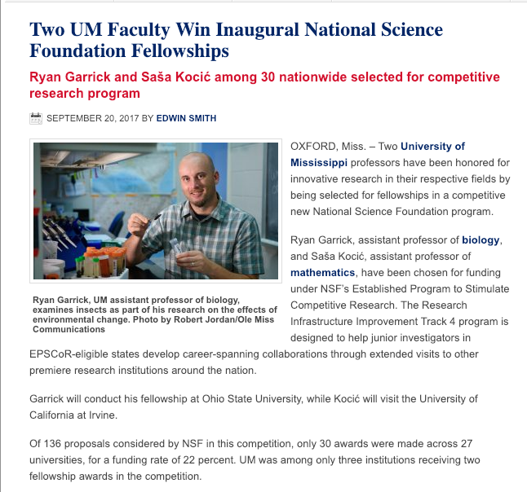
UM Track 4 Past Winners
Notes:
JASON HALE

Slide 16
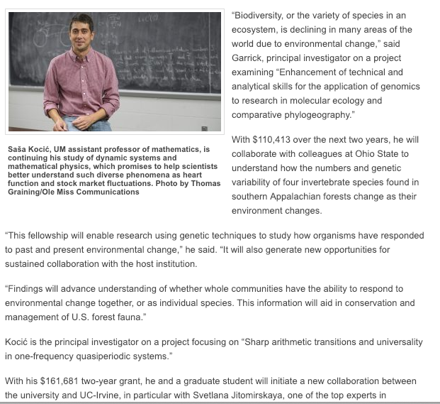
UM Track 4 Past Winners
Notes:
JASON HALE

Slide 17
Key Dates, 2019 Competition
  12/14/2017 NSF solicitation released
  1/23,25,30/2019 ORSP Information Sessions
  1/29/2019 PAPPG NSF 19-1 effective.
  2/11/2019 Internal Pre-Proposals due to ORSP
  2/19/2019 3 UM Pre-Proposals selected
  3/5/2019 Proposal & Transmittal due to ORSP
  3/12/2019 Full proposal due to NSF
Notes:
JASON HALE

Slide 18
UM Internal Proposals
  (1) Project Summary: 1-page NSF-style Project Summary, including working title.
  (2) Abbreviated Project Description: (3-5 pages)
  (3) Preliminary Letter of Support from Primary Research Collaborator (does not have to be the final, complete letter that would be submitted with the proposal to NSF, but should make it clear to UM internal reviewers that the collaborator is willing to host the PI at their institution.)
Notes:
JASON HALE

Slide 19
UM Internal Proposals
  (4) Letter of Support from Administrative Supervisor of PI (e.g., Department Chair). This one as well need not be final, but should make it clear that the supervisor thinks the fellowship will only help, and not in anyway hurt, the PI’s career trajectory, and that, if selected, the PI would be allowed to conduct the fellowship during the time indicated.
  (5) NSF-Style Biographical Sketch (should be compliant and largely complete)
Notes:
JASON HALE

Slide 20
Project Description
  The goals and objectives for the fellowship project should be clearly stated, and the research plan for achieving the goals and objectives should be presented in sufficient detail to allow reviewers to judge the proposal fairly. The project description should specify the expected outcomes from the fellowship, and should include a timeline for meeting the project goals and objectives. It is crucial that the project description explain clearly how the PI will specifically benefit from the unique opportunities provided by the RII Track-4 fellowship. It should also detail both the role of the host site in achieving the research goals and objectives and how the benefits to the PI’s research career will be sustained beyond the award period.
Notes:
JASON HALE

Slide 21
UM Internal Review Criteria
  Intellectual Merit
    How clearly/thoroughly are research activities described?
      Will knowledge be advanced (or transformed)?
      Metrics based assessment built in?
      Use language understandable by a general technical audience (will not be reviewed by expert in your field)
    Likely impact on faculty’s research career trajectory?
      What is your current research career trajectory, and how will that be altered by this fellowship
      How will your individual research capacity be sustainably enhanced??
Notes:
JASON HALE

Slide 22
UM Internal Review Criteria
  Broader Impacts
    Tangible benefits to UM (beyond just the PI)?
    Tangible benefits Mississippi?
    Benefits to society?
Notes:
JASON HALE

Slide 23
UM Internal Review Criteria
  Other considerations
    Clarity of Writing
    Degree of Specificity
    Strength of Proposed Partnership
      Obvious benefit? (Why do you need to go there?)
      Clear host support of idea & commitment to success?
  Sufficiency of Letter from Administrative Supervisor
    Clear eligibility? Clear support of supervisor?
  Non-Duplicative of other funded work
  Evidence of outcomes achievability in fellowship timeframe
Notes:
JASON HALE

Slide 24
Non-Duplicative Effort
  EPSCoR support of a RII Track-4 activity should not duplicate support from any other available federal, jurisdictional, or institutional resources. The support should contribute to both the PI’s research capacity and to the improvement of their institution’s scientific competitiveness more broadly.
Notes:
JASON HALE

Slide 25
ORSP UM Grant Mentors Program
  Proposer: Identify a potential UM Mentor for a funding opportunity
    UM faculty member with recent success in extramural funding competitions
    ORSP can assist in identifying/vetting mentors
  Mentor and Proposer: Agree to work together on the proposal
    Complete a Mentor Agreement Form
    Obtain sign-off from Chair and Dean of Mentor and Proposer
    Upload the signed form to the online transmittal (TSS)
  Develop and submit proposal
    Mentor receives $500 in extra pay for extra work (from Proposer’s dept./school)
    If proposal is funded, mentor receives $500 award pay from ORSP
Notes:
JASON HALE

Slide 26
Research Development Fellows
  ORSP Research Development Fellows
    Greg Easson, Professor of Geological Engineering, Director of Mississippi Mineral Resources Institute
    Christian Sellar, Associate Professor of Public Policy Leadership
    Nathan Hammer, Associate Professor of Chemistry & Biochemistry
  Mission is to help faculty be more competitive for grant proposals, including but not exclusively interdisciplinary proposals)
  Available for discussions, enhanced reviews of CAREER proposal ideas, draft proposals, and full proposals
  E-mail researchfellows@olemiss.edu
Notes:
JASON HALE

Slide 27
Questions/Discussion
Notes:
JASON HALE

