Slide 1

The University of Mississippi
NSF CAREER
ORSP Information Sessions
Fall 2017
Oct 9, 2pm: Brevard 2nd Floor
Oct 12, 3pm: Lyceum 308
Oct 16, 2pm: Brevard 319
Oct 18, 2pm: Brevard 209
Oct 19, 3pm: Lyceum 308
Notes:
Jason Hale to Start

Slide 2
Brief Introductions
  Previous Awardees Present:
    Name, Rank, Department, Year, and Amount of CAREER Award
    Number of Attempts before CAREER Award
  Attendees:
    Name, Rank, and Department
    First NSF CAREER Proposal?
    Planning for Summer 2018?
    Any prior NSF proposal experience/success?
    Ever attended an NSF CAREER proposal writing workshop?
  Research Development Fellows
    Name, Rank, Department
  ORSP Personnel
Notes:
JASON HALE

Slide 3
Today
  Introductions
  Brief Summary of NSF CAREER Program
  Vision for the CAREER Faculty Development Group
  Grant Mentors Program
  Perspectives from Previous NSF Awardees
  Research Development Fellows
  Next Steps
  Questions/Discussion
Notes:
JASON HALE

Slide 4
What is NSF CAREER
Faculty Early-Career Development (CAREER) Program
  Most prestigious awards to help a junior faculty member develop activities that can effectively integrate research and education within the context of his/her organization
  Education component as important as research

Slide 5
Goals of NSF CAREER
Provide stable support for five years (≥400K in most Directorates – BIO, GEO/PLR, ENG are ≥500K) to allow the career development
Build a foundation for a lifetime of integrated contributions to research and education.
Integration of research and education.
Increase participation of those traditionally underrepresented in science and engineering

Slide 6
Eligibility
Hold a doctoral degree in any field supported by NSF by proposal deadline
Be untenured by Oct 1st following proposal deadline
Be employed in a tenure-track (or equivalent) position at an eligible institution as an Assistant Professor (by Oct 1st following deadline)
Have not previously received a CAREER award
Have not had more than two CAREER proposals reviewed

Slide 7
Merit Review across NSF Divisions
Ad hoc + Panel (with other proposals in the Program)
  most of GEO (AGS uses ad hoc only)
  BIO and SBE
Primarily dedicated CAREER Panels
  ENG, CISE, HER
  MPS varies by Division: AST : Panel only; CHE, DMR – Mix of ad hoc and panels; DMS – mostly panels (2 programs ad hoc only)

Slide 8
Standard NSF Review Criteria
Merit criteria: Potential to advance, if not transform, the frontiers of knowledge; assessment based on appropriate metrics
Broader Impact: potential to benefit society and contribute to the achievement of specific, desired societal outcomes.
Review elements:
  1. What is the potential for the proposed activity to: a. advance knowledge b. benefit society
  2. To what extent do the proposed activities suggest and explore creative, original, or potentially transformative concepts?
  3. Is the plan for carrying out the proposed activities well-reasoned, with a mechanism to assess success?
  4. How well qualified is the PI and team?
  5. Are there adequate resources available to the PI?

Slide 9
Special Criteria for CAREER
A compelling research plan
An innovative but feasible education plan
A plan for the effective integration of both sets of activities (evaluation plan is a big plus)
Departmental Letter
Letters of Collaboration if appropriate
A budget that is consistent with the scope of the research and education activities

Slide 10
NSF CAREER: UM Recent History & Goals
  In last 10 years, 9 UM faculty have received CAREER awards
  In 2016: UM submitted 6 NSF CAREER proposals (a record)
  In 2017: UM submitted 10 NSF CAREER proposals
    5 from the School of Engineering
    1 from Sociology and Anthropology
    1 from Modern Languages
    1 from Mathematics
    1 from Chemistry/Biochemistry
    1 from Physics/Astronomy
  ORSP Goal for 2018: 20 submissions
  ORSP Goal: 5 CAREER Awards/year
Notes:
JASON HALE

Slide 11
NSF CAREER Development Group
Why Participate?
  Learn from those with NSF CAREER experiences
      UM CAREER Awardees (8 total)
      UM Reviewers on NSF CAREER Panels
  Get a look at funded NSF CAREER proposals
  Get feedback from peers and iteratively improve your proposal
  Learn about available resources here at UM to strengthen your proposal/project
  Access extra travel funds from ORSP
  Give and receive encouragement with other CAREER aspirants
Notes:
JASON HALE

Slide 12
NSF CAREER Development Group: How it Works
  Access to UM NSF CAREER proposal bank
    UM Box Folder
    Hardcopies in ORSP offices
  Monthly Group Meetings
    To be scheduled based on greatest availability
    A different topic each month, with guest presenters
    Learn about available UM resources to strengthen proposal
  Monthly Writing Assignments
    Share with Research Fellows for feedback (encouraged and optional)
    Share with one another for feedback (encouraged and optional)
  Result: a Complete, vetted NSF CAREER proposal by Summer
Notes:
JASON HALE

Slide 13
NSF CAREER Development Group: Tentative Schedule
  October: Overview/Information Sessions/ Sign Up
  November: Project Summaries
  December: Education Plans and Broader Impacts
  January: Research Plans
  February: Budget and Budget Justification
  March: Departmental Letter; Other Letters
  April: Biosketches, Collaborators and Other Affiliations,
  Current and Pending, Results of Prior NSF Support
  May: Data Management Plans, Postdoc Mentoring Plans, Facilities, Equipment, & Other Resources
  June: Presentation, Feedback, and Editing
  July: Submit to NSF
Notes:
JASON HALE

Slide 14
NSF CAREER Development Group: Recognition Event
  In August or September, everyone who submitted and NSF CAREER proposal will be recognized at a reception or dinner.
  Chancellor, Provost, and/or Vice Chancellor for Research.
  Deans and Chairs of submitting PIs
  Previous CAREER Award Winners
Notes:
JASON HALE

Slide 15
ORSP UM Grant Mentors Program
  Proposer: Identify a potential UM Mentor for a funding opportunity
    UM faculty member with recent success in extramural funding competitions
    ORSP can assist in identifying/vetting mentors
  Mentor and Proposer: Agree to work together on the proposal
    Complete a Mentor Agreement Form
    Obtain sign-off from Chair and Dean of Mentor and Proposer
    Upload the signed form to the online transmittal (TSS)
  Develop and submit proposal
    Mentor receives $500 in extra pay for extra work (from Proposer’s dept./school)
    If proposal is funded, mentor receives $500 award pay from ORSP
Notes:
JASON HALE

Slide 16
Meet the UM CAREER Holders
  9 UM Faculty Members have been awarded NSF CAREER grants
  8 of them are still at UM
    Tammy Goulet, 2008 Biology
    Nathan Hammer, 2010 Chemistry & Biochemistry
    Emanuele Berti, 2011 Physics & Astronomy
    Amal Dass, 2013 Chemistry & Biochemistry
    Sarah Liljegren, 2015 Biology
    Jared Delcamp, 2016 Chemistry & Biochemistry
    Patrick Curtis, 2016 Biology
    Davita Watkins, 2017 Chemistry & Biochemistry
Notes:
JASON HALE

Slide 17
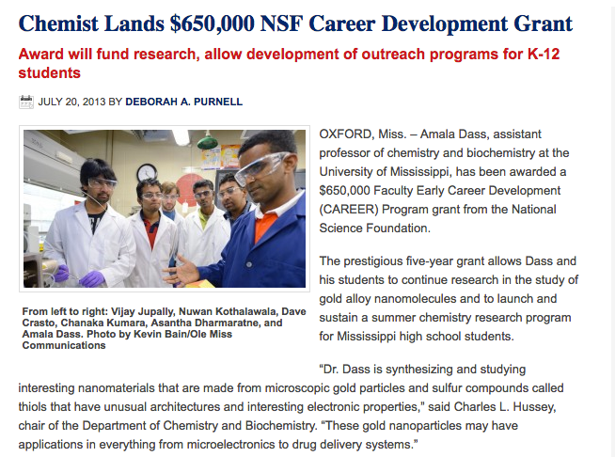
https://news.olemiss.edu/chemist-lands-650000-nsf-career-development-grant/

Slide 18
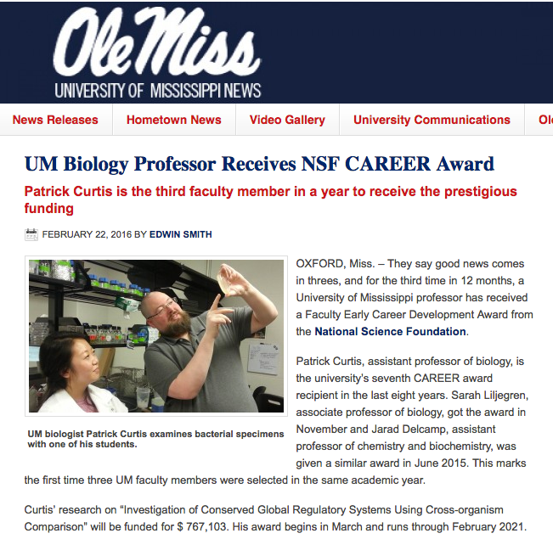
https://news.olemiss.edu/third-um-professor-this-year-receives-nsf-career-award/

Slide 19
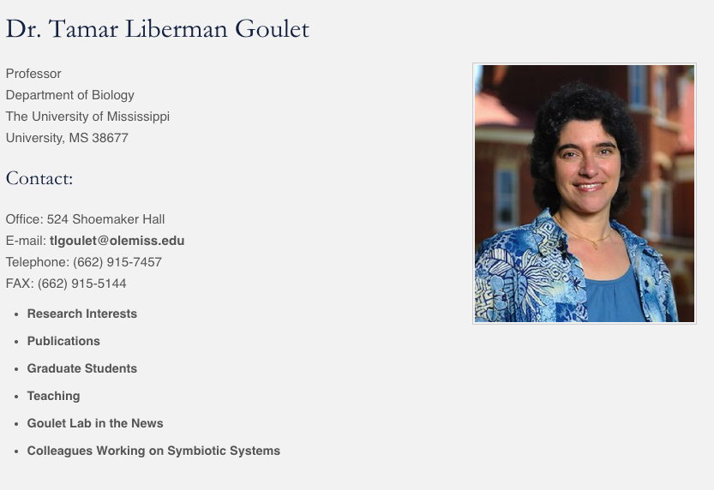
Dr. Goulet
received an
NSF CAREER
award in 2008.

Slide 20
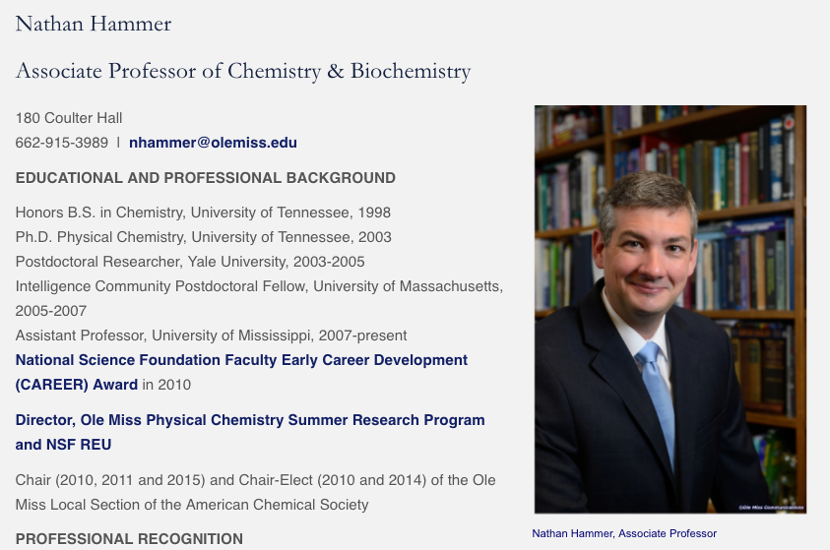
Dr. Hammer received an
NSF CAREER award in 2010.

Slide 21
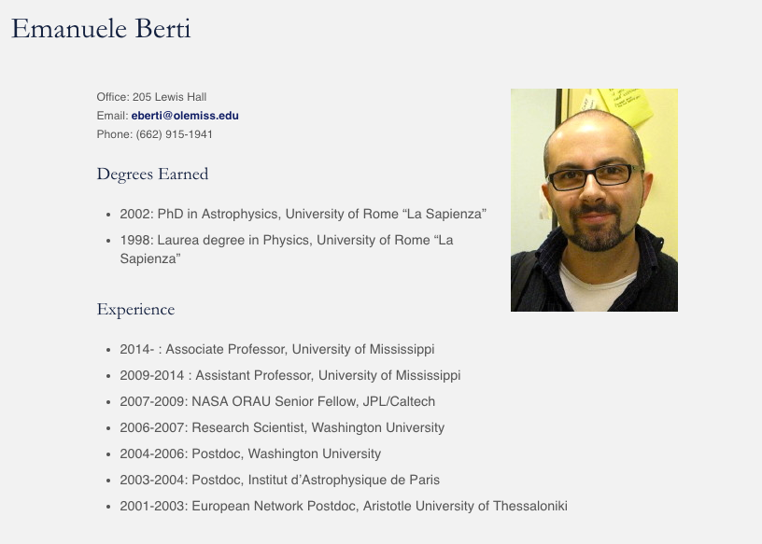
Dr. Berti received an
NSF CAREER award in 2011.
https://www.nsf.gov/awardsearch/showAward?AWD_ID=1055103

Slide 22
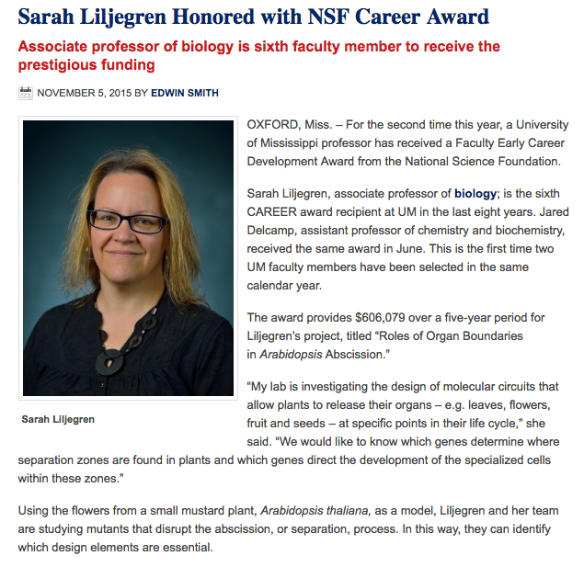
https://news.olemiss.edu/sarah-liljegren-honored-nsf-career-award/

Slide 23
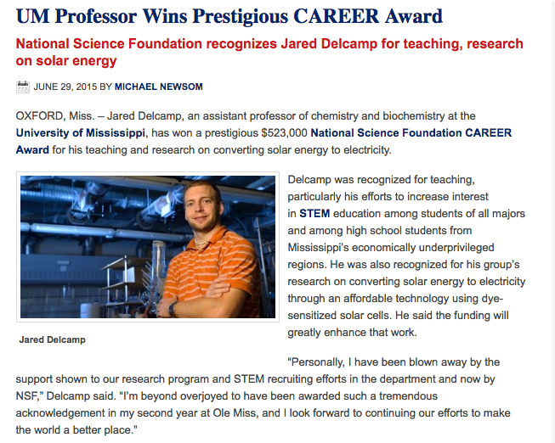
https://news.olemiss.edu/um-professor-wins-prestigious-career-award//

Slide 24
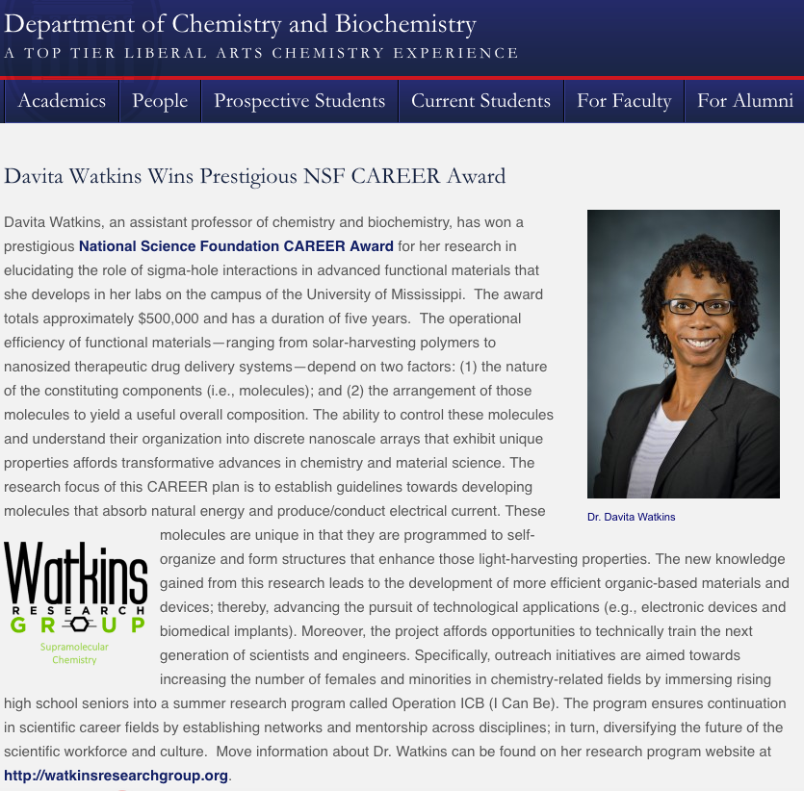

Slide 25
Research Development Fellows
  ORSP Research Development Fellows
    Greg Easson, Professor of Geological Engineering, Director of Mississippi Mineral Resources Institute
    Christian Sellar, Associate Professor of Public Policy Leadership
    Nathan Hammer, Associate Professor of Chemistry & Biochemistry
  Mission is to help faculty be more competitive for grant proposals, including but not exclusively interdisciplinary proposals)
  Available for discussions, enhanced reviews of CAREER proposal ideas, draft proposals, and full proposals
  E-mail researchfellows@olemiss.edu
Notes:
JASON HALE

Slide 26
Next Steps
  Let ORSP know if you want to be a part of the NSF CAREER Development Group, 2018 Cohort
  Consider pairing up with mentor under the ORSP Grant Mentors Program
  Schedule Times for Monthly Meetings
  E-mail List and Shared Box Folder Access
  Monthly Meetings and Regular E-mail Discussions
Notes:
JASON HALE

Slide 27
1st Month’s Assignment
  Answer Doodle Poll on Available Meeting times
  Access Mailing List and Shared Box Folder
  Read the NSF 2017 CAREER Solicitation
  Look at NSF Website and read abstracts of all CAREER proposals have been funded in your discipline last 5 yrs
  Google to see if any NSF Career Development Workshops have been scheduled that you might attend
  Write first draft Project Summary; e-mail it by 10/31 to:
    Share with ORSP: jghale@olemiss.edu
    Share with Research Fellows?? researchfellows@olemiss.edu
    Share with CAREER Dev Group ??? nsfcareer2018@olemiss.edu
Notes:
JASON HALE

Slide 28
Questions/Discussion
Notes:
JASON HALE

Slide 29
NSF CAREER
The Following Slides Taken from NSF CAREER Slides at https://www.nsf.gov/mps/dms/career_and_pecase_information/career_webinar_slides_2017.pdf.

Slide 30
NSF CAREER
Faculty Early-Career Development (CAREER) Program
  Most prestigious awards to help a junior faculty member develop
activities that can effectively integrate research and education within the context of his/her organization
  Education component as important as research

Slide 31
Goals
Provide stable support for five years (≥400K in most Directorates – BIO, GEO/PLR, ENG are ≥500K) to allow the career development
Build a foundation for a lifetime of integrated contributions to research and education.
Integration of research and education.
Increase participation of those traditionally underrepresented in science and engineering.

Slide 32
Eligibility
Hold a doctoral degree in any field supported by NSF by proposal deadline
Be untenured by Oct 1st following proposal deadline
Be employed in a tenure-track (or equivalent) position at an eligible institution as an Assistant Professor (by Oct 1st following deadline)
Have not previously received a CAREER award
Have not had more than two CAREER proposals reviewed
Untenured Associate Professors are NOT eligible

Slide 33
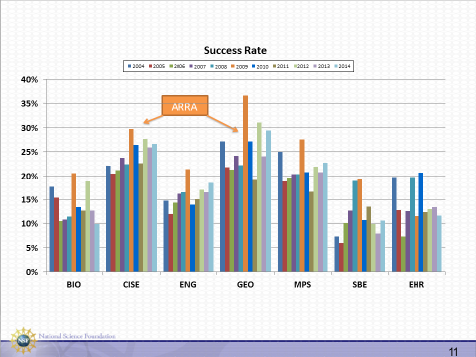
Success Rate

Slide 34
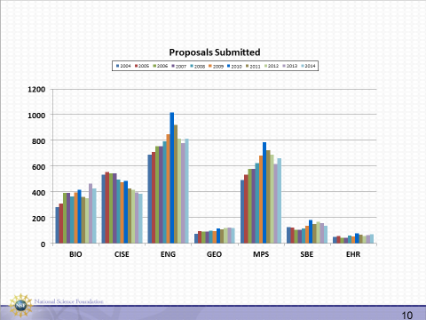
Proposals Submitted

Slide 35
Special Procedures
CAREER proposals are submitted to, and reviewed by one or more of the disciplinary programs
Expectations for scope of research and education activities varies with community norms
Talk to Division Contact(s) for additional information (http://www.nsf.gov/crssprgm/career/contacts.jsp)
For interdisciplinary proposals, contact all relevant Program Directors or Division Contacts

Slide 36
Questions?
Notes:
JASON HALE

