Slide 1

The University of Mississippi
NSF CAREER
ORSP Information Session
APRIL 10, 2017
APRIL 18, 2017
Notes:
Jason Hale to Start

Slide 2
WELCOME
Nathan Hammer
Associate Professor of Chemistry & Biochemistry
ORSP Research Development Fellow
Notes:
Strum

Slide 3
Brief Introductions
  Panelists:
    Name, Rank, Department, and Year of CAREER Award
    Number of Attempts before CAREER Award
  Attendees
    Please Stand Up
    Name, Rank, and Department
    First NSF CAREER Proposal?
    Planning for Summer 2017 or 2018?
    Any prior NSF proposal experience/success?
    Ever attended an NSF CAREER proposal writing workshop?
  ORSP and Research Development Fellows
    Name, title, and role
Notes:
JASON HALE

Slide 4
Overview of
NSF Faculty Early Career Development Program
Jason Hale
Office of Research
Notes:
Strum

Slide 5
NSF CAREER
The Following Slides Taken from NSF CAREER Slides at https://www.nsf.gov/mps/dms/career_and_pecase_information/career_webinar_slides_2017.pdf.

Slide 6
NSF CAREER
Faculty Early-Career Development (CAREER) Program
  Most prestigious awards to help a junior faculty member develop
activities that can effectively integrate research and education within the context of his/her organization
  Education component as important as research

Slide 7
Goals
Provide stable support for five years (≥400K in most Directorates – BIO, GEO/PLR, ENG are ≥500K) to allow the career development
Build a foundation for a lifetime of integrated contributions to research and education.
Integration of research and education.
Increase participation of those traditionally underrepresented in science and engineering.

Slide 8
Eligibility
Hold a doctoral degree in any field supported by NSF by proposal deadline
Be untenured by Oct 1st following proposal deadline
Be employed in a tenure-track (or equivalent) position at an eligible institution as an Assistant Professor (by Oct 1st following deadline)
Have not previously received a CAREER award
Have not had more than two CAREER proposals reviewed
Untenured Associate Professors are NOT eligible

Slide 9
Standard NSF review criteria
Merit criteria: Potential to advance, if not transform, the frontiers of knowledge; assessment based on appropriate metrics
Broader Impacts: potential to benefit society and contribute to the achievement of specific, desired societal outcomes.
Review elements:
  1. What is the potential for the proposed activity to: a. advance knowledge b. benefit society
  2. To what extent do the proposed activities suggest and explore creative, original, or potentially transformative concepts?
  3. Is the plan for carrying out the proposed activities well-reasoned, with a mechanism to assess success?
  4. How well qualified is the PI and team?
  5. Are there adequate resources available to the PI?

Slide 10
Special criteria for CAREER
A compelling research plan
An innovative but feasible education plan
A plan for the effective integration of both sets of activities (evaluation plan is a big plus)
Departmental Letter
Letters of Collaboration if appropriate
A budget that is consistent with the scope of the research and education activities

Slide 11
Basis for decision
Peer Review – Content of the review is more important than rating – Program Officer analyzes: Fairness and substance of the reviews; any technical issues raised (can they be resolved swiftly and easily); reviewer’s enthusiasm for the project; any additional feedback from reviewers/panels or other program officers; sometimes also clarification from the PI if needed
Portfolio Balance – Research and education topics and their integration; potential for transformative impact in both; priority or timeliness of the area of research and systems; demographics of the PI population and diversity of institution types; stage of the career development of the PI; international partnerships

Slide 12
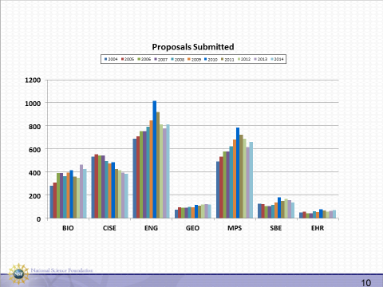

Slide 13
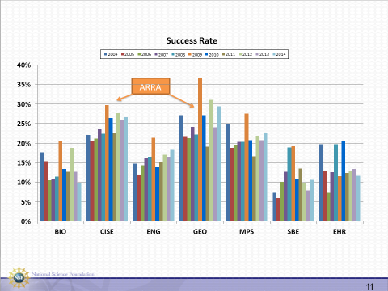

Slide 15
Merit review across NSF divisions
Ad hoc + Panel (with other proposals in the Program)
  most of GEO (AGS uses ad hoc only)
  BIO and SBE •
Primarily dedicated CAREER Panels
  ENG, CISE, HER
  MPS varies by Division: AST : Panel only; CHE, DMR – Mix of ad hoc and panels; DMS – mostly panels (2 programs ad hoc only)

Slide 16
Previous UM CAREER Awardees
  April 10 Information Session
    Emanuele Berti, Associate Professor of Physics and Astronomy
    (link to proposal in Box to be shared)
    Nathan Hammer, Associate Professor of Chemistry and Biochemistry
    Tammy Goulet, Professor of Biology
  April 18 Information Session
    Patrick Curtis, Assistant Professor of Biology
    Sarah Liljegren, Associate Professor of Biology
    Nathan Hammer, Associate Professor of Chemistry and Biochemistry
  Other Awardees
    Jared Delcamp, Assistant Professor of Chemistry and Biochemistry
    (those interested in seeing Dr. Delcamp’s proposal can e-mail delcamp@olemiss.edu)
    Amal Dass, Associate Professor of Chemistry and Biochemistry
    Davita Watkins, Assistant Professor of Chemistry and Biochemistry
Notes:
JASON HALE

Slide 17
Previous UM CAREER Awardees
  What has the CAREER Award meant to your career?
  How many tries did it take to be successful?
  What were the keys to your proposals success?
  Anything you’ve learned as a NSF CAREER Reviewer?
  Other advice?
Notes:
JASON HALE

Slide 18
Changes Since 2016 Solicitation
  Support for senior personnel other than the PI that is commensurate with a limited collaborative role in the project is now allowed in
  PAPPG NSF 17-1 is now in effect
Notes:
JASON HALE

Slide 19
Research Development Fellows
  ORSP Research Development Fellows
    Greg Easson, Professor of Geological Engineering, Director of Mississippi Mineral Resources Institute
    Christian Sellar, Associate Professor of Public Policy Leadership
    Nathan Hammer, Associate Professor of Chemistry & Biochemistry
  Mission is to help faculty be more competitive for grant proposals, including but not exclusively interdisciplinary proposals)
  Available for discussions, enhanced reviews of CAREER proposal ideas, draft proposals, and full proposals
  E-mail researchfellows@olemiss.edu
Notes:
JASON HALE

Slide 20
Next Steps
  Read the full CAREER Solicitation and FAQ:
  https://www.nsf.gov/funding/pgm_summ.jsp?pims_id=503214
  Due Dates for 2016:
    July 19, 2017 – BIO, CISE, EHR
    • July 20, 2017 – ENG
    • July 21, 2017 – GEO, MPS, SBE
  View full NSF CAREER Slides at https://www.nsf.gov/mps/dms/career_and_pecase_information/career_webinar_slides_2017.pdf
  NSF CAREER Webinar May 22, noon – 2pm CDT
  https://www.nsf.gov/events/event_summ.jsp?cntn_id=191332
    Some may let you see their proposals and/or reviews
Notes:
JASON HALE

Slide 21
Next Steps
  Let your ORSP Program Development Specialist know if you are thinking about submitting in 2016
  Discuss your idea with peers/mentors (including Research Development Fellows and/or CAREER Award holders at UM or other institutions)
  Discuss your idea with Program Officer? (ORSP Faculty Travel Program – CFreePO funds available)
  Watch for nation-wide NSF sponsored CAREER Development Workshops (ORSP Travel Funds)
  E-mail researchfellows@olemiss.edu for assistance from an ORSP Research Development Fellow (Do this early).
Notes:
JASON HALE

Slide 22
Next Steps
  Chair’s Letter should be started early
  Proposal should be complete and transmittal submitted to ORSP at least five working days before Sponsor’s Due Date
  At least 15 working days advanced notice requested for ORSP ENHANCED REVIEW service (MORE if you want mentoring from ORSP Research Development Fellows)
  PAPPG NSF 17-1 is now in effect
  SF Proposal & Award Policies & Procedures Guide
Notes:
JASON HALE

Slide 23
Questions?
Notes:
JASON HALE

