Slide 1

The University of Mississippi
NIH SEPA R25
Science Education Partnership Award
ORSP Information Sessions
Mar 19, 4pm: Brevard 209
Notes:
Jason Hale to Start

Slide 2
Brief Introductions
  Attendees:
    Name, Title, and Department
    Prospective Role on an NIH R25 Proposal:
      Proposer?
      Collaborator?
      Supporter?
    Any prior NIH SEPA R25 Experience?
Notes:
JASON HALE

Slide 3
Institutional Limitations
Only one application per institution is allowed.
Institutions are also limited to a single SEPA award.
UM does not currently have an SEPA award.
Organizations with a contractual fee for service or consortium partnership with an active SEPA award may submit a SEPA application if the proposed new project is independent of the existing SEPA contractual, fee for service or consortium partnership.

Slide 4
Purpose
Supports research education activities that complement and/or enhance the training of a workforce to meet the nation's biomedical, behavioral and clinical research needs.
Supports development of innovative educational activities for:
  pre-kindergarten to grade 12 (P-12) teachers
  pre-service and in-service teachers, and/or
  students from underserved communities
Focus can be:
  Courses for Skills Development
  Research Experiences
  Mentoring Activities
  Curriculum or Methods Development, and/or
  Outreach

Slide 5
Appropriateness of Projects
Applicants are strongly encouraged to consult with the SEPA Scientific/Research Contact to be advised on the appropriateness of the intended P-12 STEM or ISE project for SEPA program objectives and the priorities of the NIGMS.

Slide 6
PI Limitations
Any individual(s) with the skills, knowledge, and resources necessary to carry out the proposed research as the Program Director(s)/Principal Investigator(s) (PD(s)/PI(s))
The PD/PI should be:
  an established investigator in the scientific area in which the application is targeted and
  capable of providing both administrative and scientific leadership to the development and implementation of the proposed program.

Slide 7
Eligible Expenses
$250k/year Max Budget (Direct Costs) for 5 Year Projects
  Plus Indirect Costs at 8% of Modified Total Direct Costs (MTDC)
  MTDC = everything except equipment, and tuition & fees
Direct costs may include:
  Personnel costs (salary & fringes for person months devoted to program)
  Consultant costs
  Equipment
  Supplies
  Travel for key persons
  Other justifiable program-related expenses
    Payments to program participants should be listed as Other Direct Costs and justified

Slide 8
Scored Review Criteria
NIH Scored Review Criteria
Significance
Investigators
Innovation
Approach
Environment
See FOA for questions reviewers will consider per criterion.

Slide 9
Past UM Proposals & Awards
  UM has never submitted an NEH SEPA R25 proposal as a lead
Notes:
JASON HALE

Slide 10
Key Dates, 2019 Competition
  02/21/2019 ORSP Request for NOIs issued in UM Today
  03/06/2019 Internal Competition Announced via UM Today
  03/19/2019 This Information Session
  04/01/2019 Internal Pre-Proposals due to ORSP
  04/15/2019 ORSP announces winning UM Pre-Proposal
  06/01/2019 First draft of narrative due for enhanced review
  06/10/2019 Optional, non-binding Letter of Intent due to NIH
  06/27/2019 Transmittal due to ORSP for review & routing
  07/10/2019 Full proposal due to NIH
Notes:
JASON HALE

Slide 11
UM Internal Proposals
  Project Narrative: Three sentences on the relevance of the project to public health, in plain, easy-to-understand language.
  Specific Aims: (1 page)
Notes:
JASON HALE

Slide 12
UM Internal Proposals
  Abbreviated Research Education Program Plan. 5 pages total, briefly addressing the following:
    Proposed Research Education Program
    Program Director
    Program Faculty
    Program Participants
    Institutional Environment and Commitment
    Diversity Recruitment Plan
    Plan for Instruction in Responsible Conduct of Research
    Evaluation Plan
    Dissemination Plan
Notes:
JASON HALE

Slide 13
UM Internal Proposals
  Abbreviated Education Research Program
  Given the limited space provided in the pre-proposal, you are not expected to have each of these sections and plans fully fleshed out, but you should provide enough information to convince institutional reviewers that, if selected, you understand the requirements for, and will be able to produce a compelling Research Education Program Plan that fully and adequately addresses, each of these components.
Notes:
JASON HALE

Slide 14
UM Internal Proposals
  Preliminary Letter(s) of Support from Chair and Dean of PI/PD. This does not have to be the final, complete letter that would be submitted with the proposal to NIH, but should make it clear to UM internal reviewers that the PD has the full support of their supervisors to lead this proposed project, if selected.
  NIH-Style Biographical Sketch of PI/PDs. should be compliant and largely complete
Notes:
JASON HALE

Slide 15
UM Internal Proposals
  Signature Page(s).
    Signatures of any named co-investigators or named faculty at UM or at any collaborating institutions mentioned in proposal.
    These can be on separate pages, all on one page, or combination.
    The signed page(s) should affirm that the signatories are aware of this pre-proposal, and intend to collaborate on the full proposal if this ideas/pre-proposal is selected to move forward as UM’s sole proposal.
    NOTE: You can always add additional faculty/personnel later if internally selected.
Notes:
JASON HALE

Slide 16
UM Internal Proposals
  Submission
    Combine all docs into one PDF
    Submit via InfoReady Review Portal
    http://research.olemiss.edu/InfoReady
Notes:
JASON HALE

Slide 17
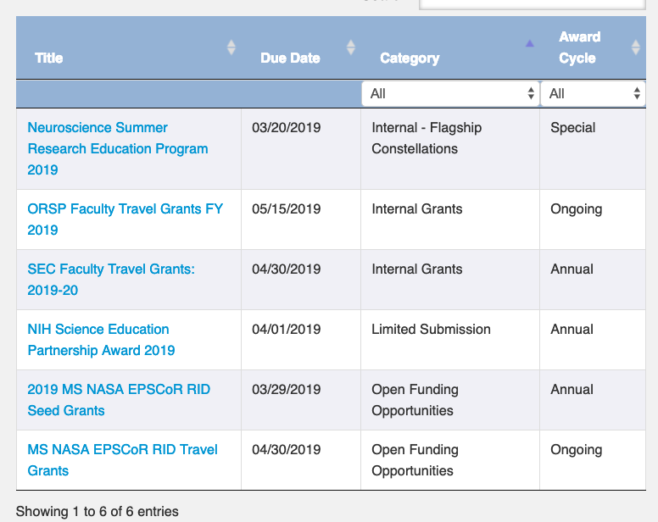
UM Internal Proposals
Notes:
JASON HALE

Slide 18
Internal Review
  ORSP will coordinate individual and/or panel reviews by some combination of:
    Internal (UM) Reviewers
      Nominated by Deans or ADRS
    External (non-UM) Reviewers
      Within TIG
  Goal is to choose the project with the best chance of being competitive in NIH competition
  Reviewers will consider the same 5 Scored Review Criteria that NIH uses
  Feedback provided to both winners and losers
Notes:
JASON HALE

Slide 19
TIG Enhanced Review
  TIG proposal consulting services will be made available to winning internal team
    Telephone discussion of internal ideas/strategies
    At least 2 iterative reviews of narrative drafts
      Grantsmanship reviews (2 iterations)
      Disciplinary review (1 iteration)
      $6,000 cost to be split 3 ways:
        Dean(s): 1/3, or $2,000
        Chair(s): 1/3, or $2,000
        ORSP: 1/3, or $2,000
Notes:
JASON HALE

Slide 20
Links
FOA: https://grants.nih.gov/grants/guide/pa-files/PAR-17-339.html
SF424 (R&R) Application Guide:
https://grants.nih.gov/grants/how-to-apply-application-guide.html
NIH Guide for Grants and Contracts: https://grants.nih.gov/funding/index.htm
Information on current SEPA projects can be found at:
  https://www.nigms.nih.gov/Research/crcb/sepa/Pages/default.aspx AND
  http://nihsepa.org
Engaging Students in Research Experiences at UM:
http://research.olemiss.edu/resources/students
  E-mail Jason Hale with questions
Notes:
JASON HALE

Slide 21

Center for Math & Science Education
MISSION: To improve mathematics and science education in Mississippi by fostering interaction between academic and K-12 education communities, supporting the implementation of research-based methods in the classroom and promoting interest in science, technology, engineering and mathematics (STEM) fields.
Notes:
JASON HALE

Slide 22

Center for Research Evaluation
Notes:
JASON HALE

Slide 23

Outreach and Continuing Education
Notes:
JASON HALE

Slide 24
Questions/Discussion
Notes:
JASON HALE

