Slide 1
ORSP: Challenging Assumptions
College of Liberal Arts Chairs Retreat
January 17, 2017

Slide 2
Challenging Assumptions About:
Developing and Submitting Proposals
F&A & Responsibility for Research Admin
Cost Share
Receiving and Managing Awards
Sponsored Programs Accounting
Managing Research Integrity & Compliance
Managing Intellectual Property
Policies for Research & Sponsored Programs
Mechanisms for Communication & Input
What You Expect from ORSP

Slide 3
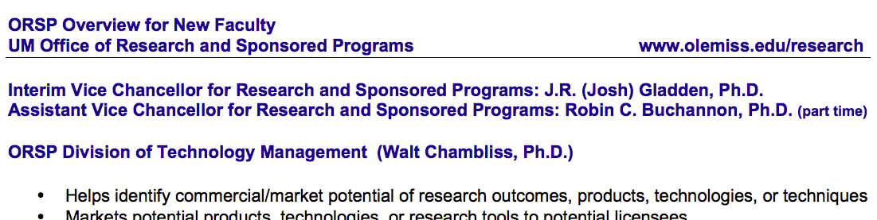
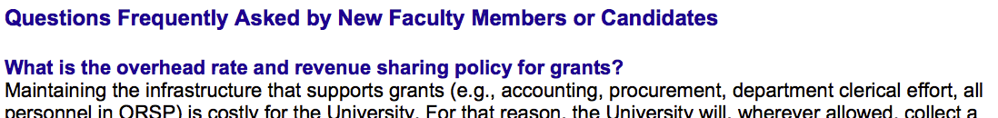
Handout:
ORSP Overview for New Faculty
Faculty Candidate Interviews
New Faculty Orientation
ORSP Org Structure & Leadership Team

Slide 4
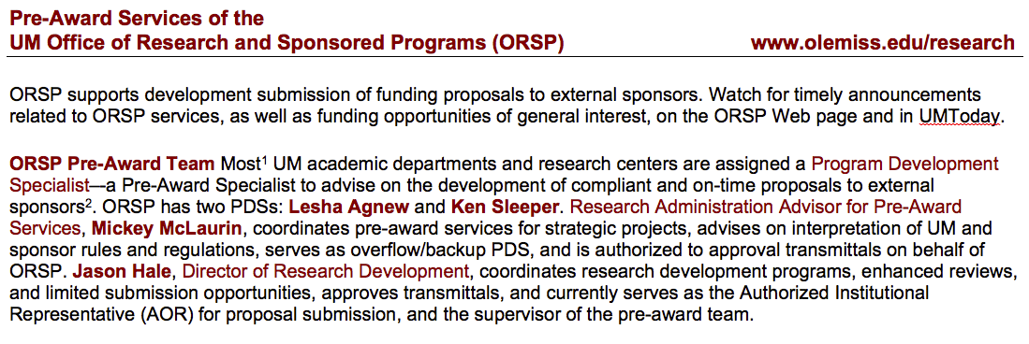
Handout:
Pre-Award Services of ORSP
Assumption: Everyone Knows 17 Pre-Award Services Offered
Assumption: Each academic unit knows its assigned Program Development Specialist (PDS): ORSP customer service representative & point of contact to access ORSP services
Assumption: Your PDS is standing by to drop everything to work on your last minute proposal/crisis

Slide 5
What You Should Know about:
Local Administrative Support for Research
Assumption: Research Support is primarily a Central Admin concern
Actually, providing local research support will help your faculty be more informed, compliant and competitive
  Associate Deans for Research
  Other research admin personnel
Example: Pilot Project with School of Pharmacy
  SoP has a business office that includes pre-award and post-award research admin personnel
  As of Fall 2016, SoP provides/funds its own “Program Development Specialists”
  These SoP pre-award specialists attend weekly ORSP pre-award meetings and communicate regularly with ORSP
  ORSP AORs (Jason or Mickey) still must approve the proposal/transmittal, but ORSP PDSes are no longer involved
  SoP pre-award specialists are delegated authority to “submit” AOR-approved proposals via sponsor’s portals just as ORSP PDSes do

Slide 6
What You Should Know about
DEVELOPING and SUBMITITING PROPOSALS
Assumption: Everyone knows that only VCRSP/ORSP can authorize institutional funding proposals to external sponsors.
  VCRSP delegates this authority to Authorized Organizational Representatives (AORs)
  Current AOR: Jason Hale (since Spring 2016)
  Authority also delegated to: Robin Buchannon, Mickey McLaurin, Anita Randle
  Transmittal Process for investigator/unit approvals
Proposals not approved by ORSP are not valid.

Slide 7
What You Should Know about
DEVELOPING and SUBMITITING PROPOSALS
Assumption: Everyone knows that only VCRSP/ORSP can authorize/sign award agreements with external sponsors.
  Post-Award team negotiates terms/conditions
  & authorizes Accounting to set up award accounts
  Approved transmittal is required before award
Sponsored Programs Agreements not signed by ORSP are not valid agreements.

Slide 8
What You Should Know about
DEVELOPING and SUBMITITING PROPOSALS
Role of Pre-Award Team in Proposals
  Guide proposer and answer questions
  Review for proposal for completeness
  Review for compliance with sponsor guidelines
  Review for institutional compliance
  Flag ambiguities or problems for resolution
  Route for institutional approvals
  Ensure on-time submission to sponsor
  Provide professional customer service at all times
Assumption: ORSP can write your budget & justification for you. Actually, a PI responsibility.

Slide 9
What You Should Know about
DEVELOPING and SUBMITITING PROPOSALS
Role of Faculty/Investigator/Units in Proposals
  Talk w/ORSP early/often about intentions & progress
  Read/understand sponsor guidelines & UM policies
  Submit transmittal for ORSP review 5+ working days prior to sponsor deadline, w/at least:
    Mature Scope of Work (not necessarily final)
    Final Budget and Budget Justification
  Keep proposal team and Chair informed
  Remember yours is not the only proposal (510 in FY16)
Assumption: If someone else (PI, ORSP) has approved the transmittal, everything must be OK for me to sign too.
Bystander Effect: The probability of help is inversely related to the number of bystanders.

Slide 10
What You Should Know about
DEVELOPING and SUBMITITING PROPOSALS
Finding Funding Opportunities & Collaborators
  Assumption: It is ORSP’s role to find funding ops for PIs.
  PIVOT
    Online subscription service for funding opportunities
    Customize your profile and receive individualized alerts
    Any UM employee can access, customize
    ORSP gives several workshops yearly on using PIVOT
    http://www.research.olemiss.edu/presentations
    ORSP will give this (or any) workshop to your department upon request
    ORSP Program Development Specialist assist individual faculty in learning to use and customize their profile

Slide 11
What You Should Know about
DEVELOPING and SUBMITITING PROPOSALS
Finding Collaborators: Current
  Assumption: It is ORSP’s role to find me collaborators.
  Research Resources Directory (R2D1)
    Centralized information repository
    Accessible/searchable by anyone with a UM WebId
    Editable by anyone who comes to ORSP workshop or otherwise requests edit access
    ORSP PreAward team members can edit for you
    Lists equipment, facilities, programs, & other resources
    Entries can be tagged with multiple applications
    Very underutilized!
    https://research.olemiss.edu/r2d1
    http://www.research.olemiss.edu/presentations

Slide 12
What You Should Know about
DEVELOPING and SUBMITITING PROPOSALS
Finding Collaborators: Future
  Subscription service populated from published sources (journals, conference proceedings, funding agencies, patents, etc.)
    Searchable by concept (not just keyword)
    Populated by automatically by algorithms, not manually by humans
    Mississippi Business Engagement Network:
    http://msben.com/ (“under construction”)
    Vendors such as Academic Analytics or SciVal
  Aspirational Model: Michigan Experts
  https://experts.umich.edu/

Slide 13


Slide 14
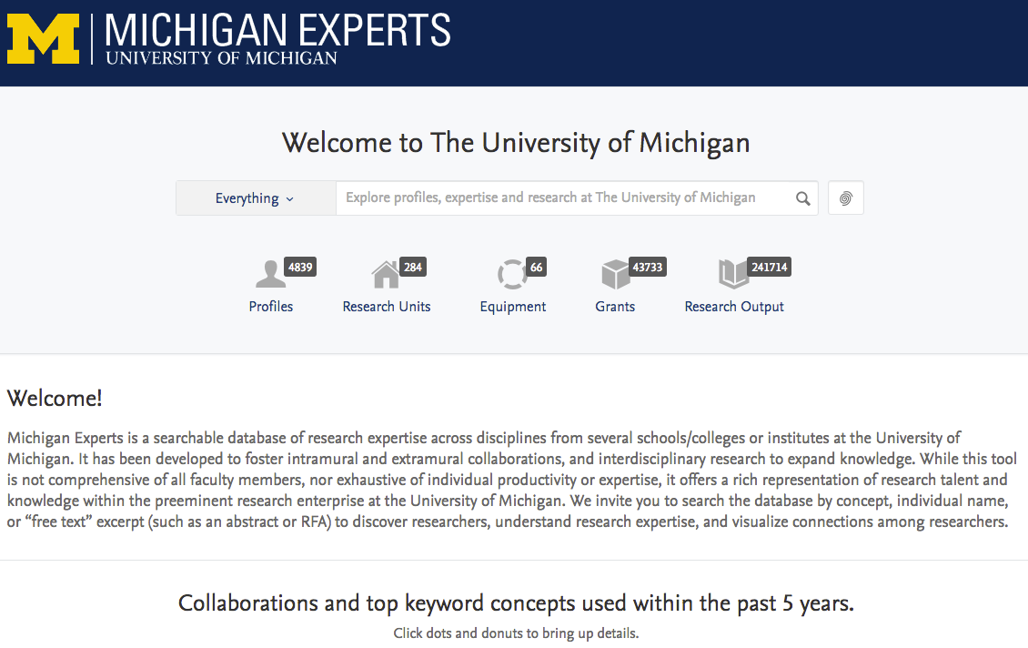

Slide 15
What You Should Know about
DEVLOPING and SUBMITTING PROPOSALS
Assumption: All faculty know that Enhanced Review is available
  Available w/ 15 days notice
  Review every word of the project narrative
  Review for responsiveness, readability, & effect
  Is NOT a technical review
  Grammar review/edits
  Ideal for non-native English speakers
  Even great writers have blind spots

Slide 16
What You Should Know about
FACILITIES & ADMINISTRATIVE COSTS (F&A)
  UM Policy is to collect full F&A (up to our federally negotiated rate) wherever allowed, to partially recoup the costs of supporting research
    Unless sponsor has an explicit policy limiting F&A
  45% is kept centrally (33.75% to ORSP, 11.25% to VCAF)
  55% returned to units. Typically, for COLA:
    10% to PIs; 35% to Chair/Department; 10% to Dean
  Assumption: If my sponsor contact says they won’t pay F&A, or if I don’t ask for it, then they don’t have to pay.
  Any proposed deviation from UM F&A Policy should be discussed in advance with VCRSP
  Investigators should consult w/ORSP spit balling project costs w/potential sponsors

Slide 17
What You Should Know about
COST SHARE
  Assumption: PIs/Units can commit voluntary cost share.
  Many feds prohibit committing voluntary cost share
  UM Policy prohibits committing voluntary cost share
    Cost share is allowed by UM only when REQUIRED or STRONGLY SUGGESTED by the sponsor
    VCRSP decides if STRONGLY SUGGESTED threshold is met
    Accounting determines what committed cost share includes
    Consult w/ORSP early on whether proposed institutional support represents allowable, committed cost share
    Where allowed, cost share is primarily proposing unit(s) responsibility; ORSP can help negotiate among multiple units
  Assumption: If Cost Share is Required, ORSP will provide it.
  Due to reduced F&A recoveries, ORSP rarely contributes cash cost share, and then only modestly

Slide 18
What You Should Know about
ORSP Research Development Fellows
RD Fellows are faculty who have applied and been selected by VCRSP, with approval of their Chair and Dean, to help other faculty members and teams develop competitive funding proposals—especially interdisciplinary ones
Fellows may qualify for merit-based additional compensation based on helping others win full F&A generating grants that UM would not have otherwise applied or been competitive for
The $$ for this merit pay comes from ORSP and benefiting stakeholder units who “opt-in” during the transmittal process

Slide 19
What You Should Know about
ORSP Research Development Fellows
Each RD Fellow will have a portfolio of departments
Fellows will reach out to faculty within departments in their portfolios, to learn about their capabilities and interests, to better help them link up with collaborators and be included on relevant funding opportunity discussions
Each fellow may also pursue special cross-cutting RD projects (e.g. helping faculty in all departments compete for NSF Early Career awards)

Slide 20
What You Should Know about
ORSP Research Development Fellows
2017 Research Development Fellows are:
Dr. Nathan Hammer
Associate Professor of Chemistry & Biochemistry
Dr. Christian Sellar
Associate Professor of Public Policy
Dr. Gregory Easson
Professor of Geological Engineering and
Director of the MS Mineral Resources Institute

Slide 21
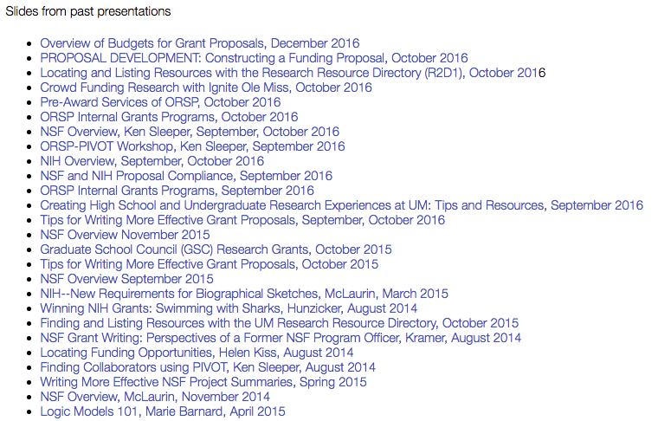
What You Should Know about
ORSP Training Workshops Available
Assumption: Everyone Reads UM Today and Knows About ORSP Training Workshops
http://www.research.olemiss.edu/presentations

Slide 22
What You Should Know about
ORSP Faculty Travel Grants
Assumption: Everyone knows about ORSP Travel Grants
Up to $500 for domestic, $1K for international
Up to 1 trip/year, PLUS
  An additional trip to visit a funding agency
  Up to 5 visits to the UMMC campus in Jackson
FY16: 86 grants totaling ~$47,000
  48 of these were to Liberal Arts faculty, including:
    Modern Languages: 12
    Music: 11
Applications reviewed by URB travel grant committee
http://research.olemiss.edu/resources/faculty-travel

Slide 23
What You Should Know about
SEC Faculty Travel Grants
Assumption: Everyone knows about SEC Faci;tu Travel Grants
Additional funds for visiting SEC campuses
Funds must be requested in late spring for visits the following fiscal/academic year
$10,000 available from SEC to distribute across as many trips as we want
http://research.olemiss.edu/SEC-FacultyTravel-2017

Slide 24
What You Should Know about
ORSP Investment Grants
Pilot seed grant program started in 2015.
In 2015, 10 ORSP-IG awards were made, ranging from $1,000 to $10,000.
In 2016, 36 proposals were received, resulting in 18 awards, totaling $51,286 (ORSP contributions) with $44,984 in co-funding from other units (Deans, Chairs, and Provost), for a grand total of $96,270 awarded.
Possible 2017 solicitation in mid-late Spring

Slide 25
What You Should Know about
RECEIVING & MANAGING AWARDS
Duties of ORSP Post-Award Team (A. Randle):
Negotiates award terms and conditions with sponsors and approves incoming awards on behalf of the University
Authorizes the Accounting Office to establish award accounts
Negotiates and prepares subawards from University to other institutions/organizations
Serves as University’s liaison with funding agencies on sponsored program awards
Coordinates the process of obtaining prior approval for modifications to award terms and conditions
Monitors payment of invoices to subrecipients
Coordinates submission of final non-fiscal reports
Provides grant administration training for PIs and Administrators

Slide 26
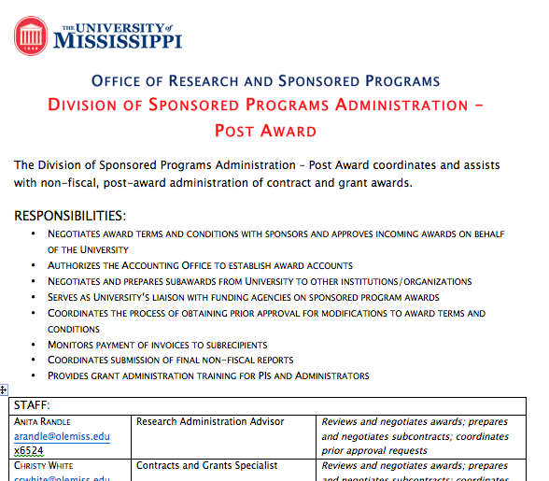
Handout:
Post Award Team

Slide 27
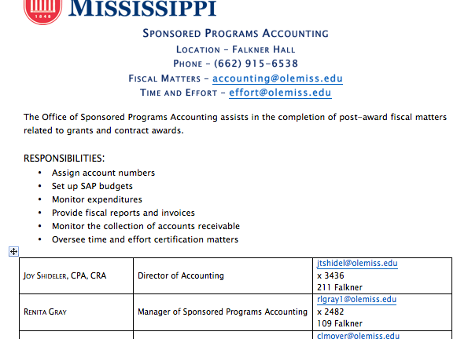
Handout:
SPONSORED PROGRAMS ACCOUNTING

Slide 28
What You Should Know about
SPONSORED PROGRAMS ACCOUNTING
Responsibilities
Assign Account Numbers
Set up SAP Budgets
Monitor Expenditures
Provide Fiscal Reports and Invoices
Monitor the Collection of Accounts Receivable
Oversee Time and Effort Certification

Slide 29
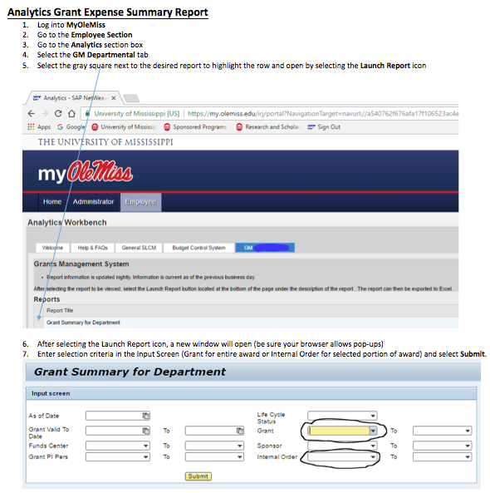

Slide 30
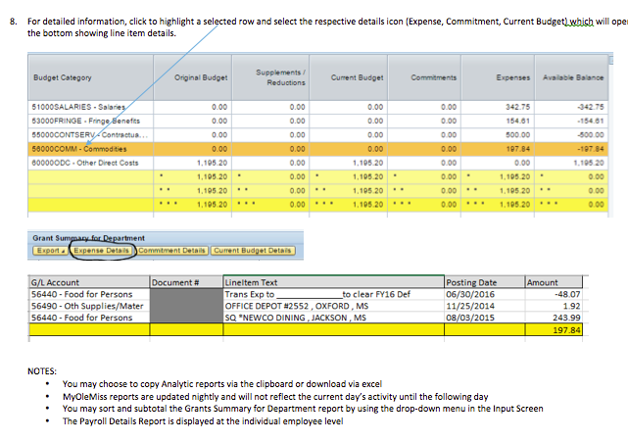

Slide 31
What You Should Know about
Research Integrity & Compliance (Gene Hines, Director)
Ensures compliance with and educates on policies & regulations regarding:
  Research with humans and animals
  Conflict of interest
  Research misconduct; Authorship credit
  Data management practices
  Mentoring of graduate and undergraduate students
Export control

Slide 32
What You Should Know about
INTELLECUTAL PROPERTY & TECHNOLOGY MANAGEMENT
Overall Mission
to stimulate, protect, manage and transfer intellectual property from the university to the private sector for commercialization
Primary Goals
to increase the number of technologies licensed to commercial partners and facilitate the formation of companies based on university technologies
to manage an efficient process that is not a burden on faculty and staff and ensures that research outcomes with commercial potential are protected and then transferred to the private sector

Slide 33
What You Should Know about
INTELLECUTAL PROPERTY & TECHNOLOGY MANAGEMENT
negotiate and execute non-disclosure, material transfer, memoranda of understanding, licensing and other agreements with external parties as appropriate to facilitate external collaborations, technology transfer and economic development
help faculty and staff identify commercial opportunities for intellectual property and prepare invention disclosures and other necessary documents
help faculty and staff who wish to start a company based on a technology owned by the university to obtain necessary approvals and establish contacts with appropriate resources
manage the intellectual property process to ensure that the university obtains protection for inventions with promising commercial potential
interface with licensees to ensure timely development of licensed technologies and fulfillment of financial obligations
support business development efforts of individual departments and centers/institutes on campus

Slide 34
What You Should Know about
COMMUNICATING with ORSP
Program Development Specialist: First Point of Contact
Communicate early and often about proposal intentions
Post-Proposal Customer Service Survey
Not happy with service? Please work with individual at point of service, then escalate to appropriate manager (Jason for pre-Award, Robin otherwise, Josh for overall)
Read UM Today at least weekly for important announcements
Dr. Hussey as liaison to ORSP/Jason
COLA Representatives to University Research Board (Greg Tschumper, Noell Wilson, Matthew Wilson)
COLA Representatives on Research Momentum Taskforce (Greg Tschumper, Craig Hickey)
COLA RD Fellows: Nathan Hammer and Christian Sellar

Slide 35
ASSUMPTION: PIs know about UM Policies Related to Research
UM POLICIES (ORSP RESPONSIBILITY)
IRB Post Approval Monitoring Program
Noncompliance with IRB Regulations
Research in Schools and Orgs w/o IRB
Use of Novel Compounds
Conflict of Interest and IRB Review
Definition of a Principal Investigator
Full Board Review Criteria for IRB
Student PIs in Human Subjects Research
Electronic Human Subject Data Security
Environmental Enrichment
IRB Waiver for Class Projects
Interests in University Corporations
Objectivity in Research
Regulatory Basis for Human Research
Research Misconduct
Certificates of Confidentiality
Education in Human Research Protection
FERPA-Covered Records Release
IRB Review of Deception Research
Researcher As Participant
Snowball Recruiting
Third Party Research
Use of Human Tissue and Human Cell Lines
Attending Veterinarian and Alternates
Classroom Use of Live Animals
Just In Time Submissions
Reporting Animal Research Concerns
Training for Research Animal Surgery
Use of Expired Medical Devices
Use of Non-Pharmaceutical Grade Drugs
Use of UM Holding Protocol
Adverse Events & Unanticipated Problems
Collaborative & Biomedical Research
Determination of Post-Approval Review
Exempt Human Research
Requiring Student Research Participation
Patents and Inventions - 2008
Institutional Animal Care Authority
Institutional Review Board Authority
Transmittal of External Funding Requests
IRB Review of QA/QI Research
Authority of External Funding Requests
Copyright (Intellectual Property)
Full Recover of F&A Costs Required
Responsible Conduct of Research
IACUC Amendment Review
Animal Acquisition/Unapproved Suppliers
IACUC Post-Approval Monitoring Program
IACUC Protocol Animal Adoptions
Photography in Laboratory Animal Areas
Use of IACU Designated Member Review
Visitors to Animal Research Areas
https://secure4.olemiss.edu/umpolicyopen/index.jsp

Slide 36
ASSUMPTION: PIs find info they need on ORSP Website
SELECTED INFORMATION RESOURCES
ORSP Proposal Development Guide: http://research.olemiss.edu/proposal-development
PDS Departmental Assignments: http://research.olemiss.edu/proposal-development
ORSP Travel Grants Program: http://research.olemiss.edu/resources/faculty-travel
Engaging Students in Research: http://research.olemiss.edu/resources/students
Research Resources Directory: https://research.olemiss.edu/r2d1
Upcoming ORSP Workshops/Presentations: http://www.research.olemiss.edu/upcoming-presentations
Slides from Past ORSP Training Workshops: http://www.research.olemiss.edu/presentations
PIVOT: http://pivot.cos.com/about_pivot
Uniform Guidance: http://research.olemiss.edu/uniform-guidance

Slide 37
Questions?
What Do You Want ORSP Know About College of Liberal Arts?
Priorities of Dean of COLA?
Research & Development Initiatives of COLA?
Chairs’ Issues, Concerns, Needs
Faculty Issues, Concerns, Needs
What Else?

