Slide 1

The University of Mississippi
UNDERGRADUATE RESEARCH @UM
ORSP Information Sessions
Winter 2020
Notes:
Jason Hale to Start

Slide 2
Today
  Introductions
  UM-SURE – Summer Undergraduate Research Experience
  UM Undergraduate Research Travel Grants
  Examples of UGR Programs on the Oxford Campus
  Finding UM Faculty Mentors for Undergraduate Research
  UM UG Research Journal
  Searching for External UGR Funding Opportunities with PIVOT
  Questions/Discussion
Notes:
JASON HALE

Slide 3
UM Call for Proposals
http://research.olemiss.edu/ugresearch2020
Track 1: Student Undergraduate Research Fellowship
  Student initiated, faculty mentored, summer research projects
Track 2: Summer Undergraduate Research Group Grants
  Faculty initiated pilot programs for mentored summer research experiences for undergraduates; should lead to a competitive external funding proposal for program expansion and sustainment.
Track 3: Undergraduate Travel Grants
  Student initiated grants to defray cost of UM students travelling to presenting results of UG research or creative scholarship.

Slide 4
Track 1: Summer Undergraduate
Research Fellowships (UM-SURF)
This track is for applications from undergraduate students to conduct mentored research or creative scholarship projects on the Oxford campus in Summer 2020.
Applications are sought from currently enrolled UM freshmen, sophomores, juniors, and not-yet-graduating seniors from a broad range of backgrounds, disciplines, and program affiliations.

Slide 5
Track 1: Summer Undergraduate
Research Fellowships (UM-SURF)
Competitive applications will propose an experience in which the student makes a substantial independent contribution, and that will produce a significant finished product for the student by December 2020.
For instance, authorship on a publishable manuscript, or the production or presentation of a creative work.

Slide 6
Track 1: Summer Undergraduate
Research Fellowships (UM-SURF)
SURF Fellows will conduct projects during a 10-week experience from May 26 to July 31, 2020, for which they will receive a taxable $3,000 participation stipend payable in five or six semi-monthly installments throughout the 10 weeks.
UM Faculty Mentors on 9-month contracts without other summer support may also receive a $1,000 mentorship stipend, if budgeted.
Applications may request up to $500 to cover additional expenses required to complete the project. Thus, the max budget for each application is $4,500: $3,000 + $1,000 + $500.

Slide 7
Track 1: Summer Undergraduate
Research Fellowships (UM-SURF)
SURF Applications should be developed and submitted by students in close consultation with their prospective faculty mentors,
and must include:
Student Name, E-mail Address, Phone Number, current Classification, Program
Faculty Mentor Name, Department, and E-mail.
Departmental Chair Name and E-mail.
Project Name

Slide 8
Track 1: Application Instructions
Project Description (max 1,000 words).
Describe the scholarly project and the activities in which the student will be engaged to carry out the project. If the summer project is related to a larger piece of work such as a senior thesis, the description should address the role of the summer component in the larger project.

Slide 9
Track 1: Application Instructions
Role of the Project in contributing to the student’s broader academic or professional goals, as well as in expanding and diversifying undergraduate research and creative scholarship at UM.
Timeline for completion of the summer project and the anticipated final product (e.g., publishable manuscript, conference presentation, creative piece or performance, etc.).
Budget A concise description of each anticipated project costs, and why each is needed.

Slide 10
Track 1: Faculty/Mentor Endorsement
Upon submission of the application by the student, the faculty/mentor will receive an e-mail prompt to fill out and submit, within one week, a confidential endorsement form via the portal. The endorsement form, downloadable from http://ugr.olemiss.edu/support/, will require:
A brief description of the scholarly project and both the mentor’s and the student’s roles in designing the project and in carrying it out.
An assessment of the student’s ability to complete the work.

Slide 11
Track 1: Faculty/Mentor Endorsement
A description of the nature of the mentoring relationship planned for the student during the funded period. If the mentor is already supervising the student, the endorsement should include a description of the mentoring activities to date, and plans to develop or continue these activities during the funded period.
A description of the final product of the scholarly activity (e.g., publishable manuscript, research presentation, creative piece or performance).
A comment on the expense budget—including a confirmation that the project can be completed within the 10-week timeframe with the estimated budget.

Slide 12
Track 1: Evaluation and Funding
SURF proposals will be evaluated by UM faculty volunteers recruited by ORSP, and scored based on the quality of the written proposal, the clarity of the plan/achievability of results, the student’s expected independent contribution, the strength of the faculty/mentor’s endorsement; and the extent to which the project will contribute to the program goal of expanding undergraduate participation in research and creative scholarship.
Funding decisions will be made based on the application scores, the diversity of disciplines represented, and the availability of funding.
We anticipate funding five Track 1 awards in 2020.

Slide 13
Track 1: Student Expectations
Students awarded these fellowships (SURF Fellows) are expected to be present and engaged in their projects for the full 10-week program period (except for weekends and university holidays) with their mentors also present to guide them on the project.
Each SURF Fellow may also have the opportunity to participate with other SURF Fellows in some UM-SURE programmatic activities (e.g., training sessions, networking sessions) to be scheduled during the summer.
All SURF Fellows are required to give a presentation on their project at the UM Summer Undergraduate Research Symposium on July 31, 2020.

Slide 14
Track 1: Student Expectations
At the conclusion of the fellowship, each SURF Fellow will complete the Survey of Undergraduate Research Experiences assessment (DOI: 10.1187/cbe.07–06–0039), and submit an initial program report by August 31, 2020, a subsequent program report by January 31, 2021, and a final program report by March 30, 2021.
In addition, SURF Fellows may be asked to participate in other on-campus research symposia, and/or news releases about the program or their individual projects.

Slide 15
Track 3: Undergraduate Travel Grants
Undergraduates may request up to $500 in funding to defray travel costs associated with presenting the products of their original research or creative scholarship at regional or national conferences.
These travel grants are designed to provide undergraduate students with the valuable opportunity to present their research and scholarship and more fully integrate with the community of scholars in their field.

Slide 16
Track 3: Funding
We anticipate awarding 15 undergraduate travel grants in 2020. Award decisions will be made within two weeks of application.
In order to ensure the broadest possible participation, a maximum of one award will be provided per undergraduate degree program in 2020.
Where multiple students are co-presenting the same paper, or are presenting different papers at the same conference, they may submit a combined application for up to $1,000 to be split among the presenting students.

Slide 17
Track 3: Applications
A detailed Travel Budget and Schedule
Evidence of Co-funding from other sources, if necessary, to cover any costs over the requested grant amount.
High-res Student(s) Head Shot Photo, to be used in UM news or web stories. If multiple students are traveling to co-present on this research, the photo should be of the group, and need not just be a head shot.
Short Student(s) Bio (< 125 words per student), suitable for displaying on a public-facing web page if awarded for the grant, including home town information.

Slide 18
Track 3: Application Components
Student Name, Program, Classification, E-mail, Phone Number.
Title of Accepted Paper
Conference or Meeting to attend
Presentation Abstract, in laymen’s terms
Full Citation Information of accepted paper (if known)
Date of Presentation
Confirmation of Acceptance of paper(s) at a research conference.
• A detailed Travel Budget and Schedule
• Evidence of Co-funding from other sources, if necessary, to cover any costs over the requested grant amount.
• High-res Student(s) Head Shot Photo, to be used in UM news or web stories. If multiple students are traveling to co-present on this research, the photo should be of the group, and need not just be a head shot.
• Short Student(s) Bio (< 125 words per student), suitable for displaying on a public-facing web page if awarded for the grant, including home town information.

Slide 19
Track 3: Application Components
Name and E-mail Address of UM Research Advisor/Mentor
Name and E-mail Address of the Chair of the student’s home department. Students with undeclared majors can instead provide the Chair of the department of their mentor.
Name and E-mail Address of Departmental Point of Contact—the person to advise student on navigating the UM travel authorization & reimbursement process and/or manage the student’s grand funds. This may or may not be Research Advisor/Mentor.
• A detailed Travel Budget and Schedule
• Evidence of Co-funding from other sources, if necessary, to cover any costs over the requested grant amount.
• High-res Student(s) Head Shot Photo, to be used in UM news or web stories. If multiple students are traveling to co-present on this research, the photo should be of the group, and need not just be a head shot.
• Short Student(s) Bio (< 125 words per student), suitable for displaying on a public-facing web page if awarded for the grant, including home town information.

Slide 20
Track 3: Application Components
A detailed Travel Budget and Schedule
Evidence of Co-funding from other sources, if necessary, to cover any costs over the requested grant amount.
High-res Student(s) Head Shot Photo, to be used in UM news or web stories. If multiple students are traveling to co-present on this research, the photo should be of the group, and need not just be a head shot.
Short Student(s) Bio (< 125 words per student), suitable for displaying on a public-facing web page if awarded for the grant, including home town information.

Slide 21
Track 3: Chair and FinAid
The faculty mentor, departmental point of contact (if different from mentor), and departmental chair will each receive an e-mail prompt from the InfoReady Review Portal to endorse the application before it will be considered for funding.
NOTE: Undergraduate Research Travel Grants will be reported to the UM Office of Financial Aid. Students already receiving financial aid should make an appointment with Ms. Cindy May in the UM Office of Financial Aid to discuss whether such a travel grant will jeopardize their total 2019-20 aid package.

Slide 22
FAQ
Q: Can UM professional students apply for Travel Grants?
A: Yes, if they were undergraduates at UM at the time they did the research.
Q: Are UM seniors eligible to apply for Summer Research Fellowships?
A: Yes, if they will not be graduating until at least Dec 18.
Q: For Track 1 or Track 2 proposals, can mentor’s stipend be used for something besides summer salary?
A: Yes, we will consider other uses for these funds.
Q: Can this program be used to fund existing programs?
A: To expand them or bridge them maybe. But not to replace other UM funding already available.
Notes:
JASON HALE

Slide 23
Example UM UGR programs
Notes:
JASON HALE

Slide 24
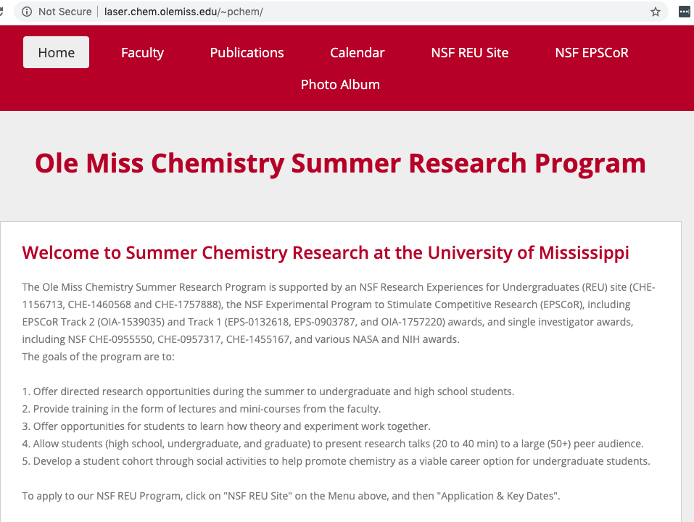

Slide 25
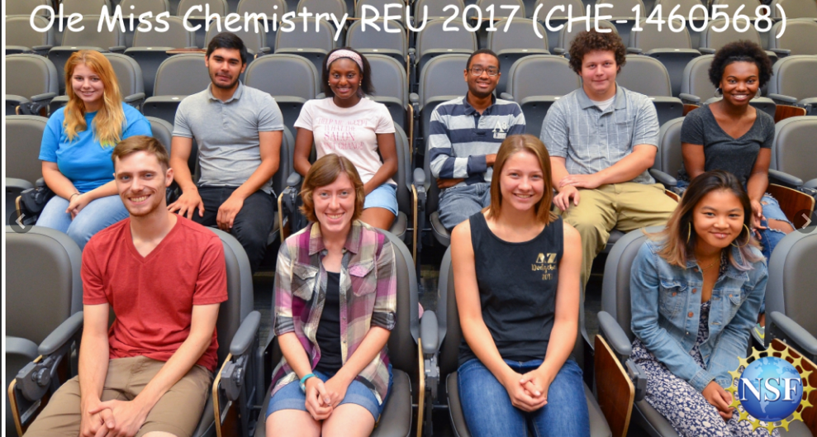
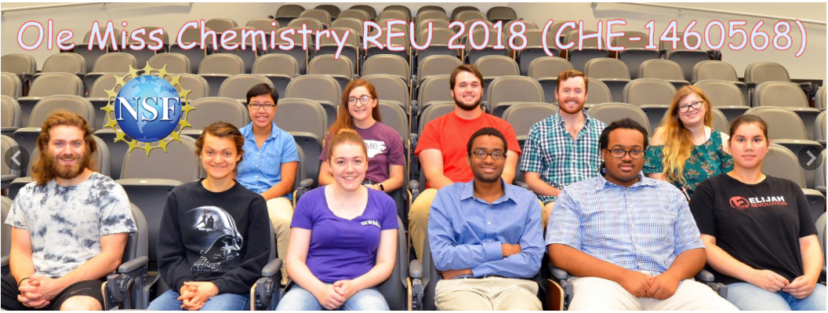

Slide 26
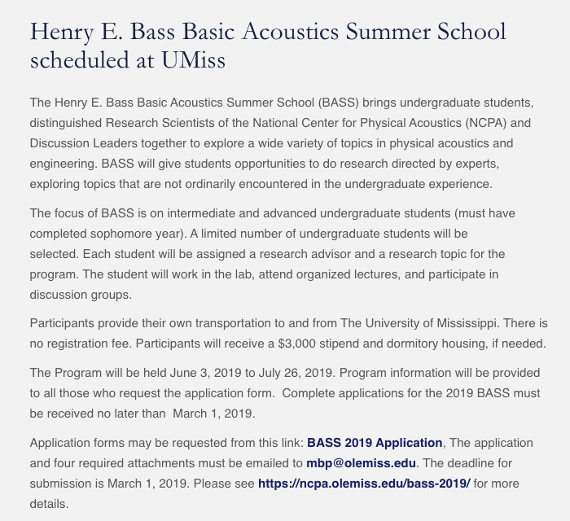

Slide 27
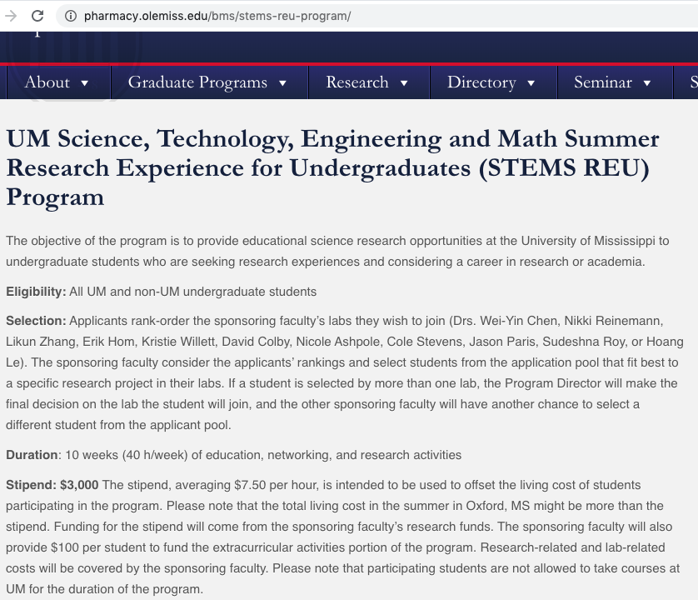

Slide 28
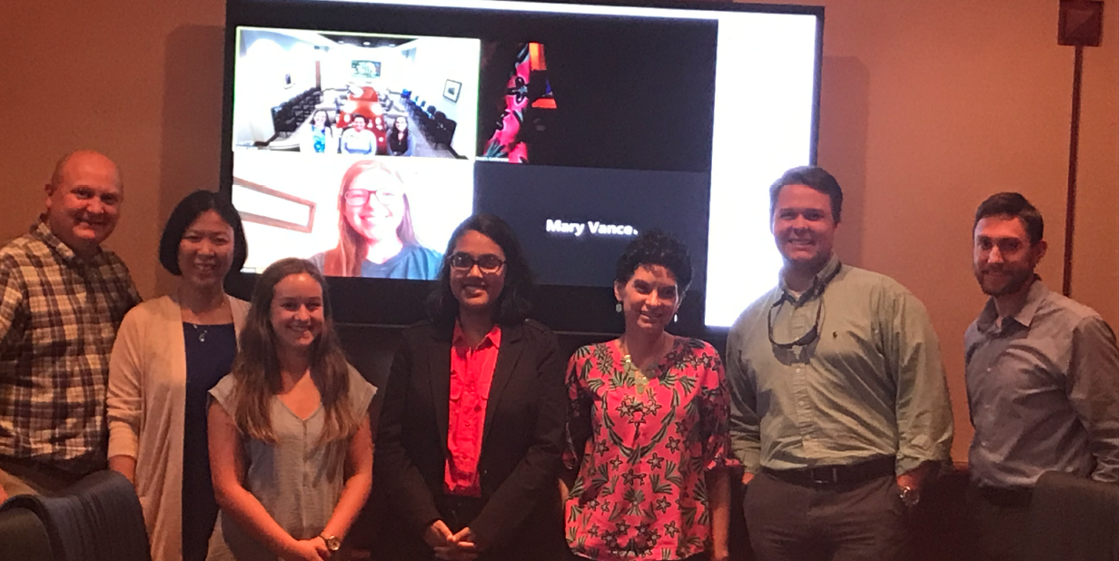
Pharmacy Summer Research
Fellowship Program
Contact: Dr. Kris Harrell (kharrell@olemiss.edu)
Notes:
JASON HALE

Slide 29
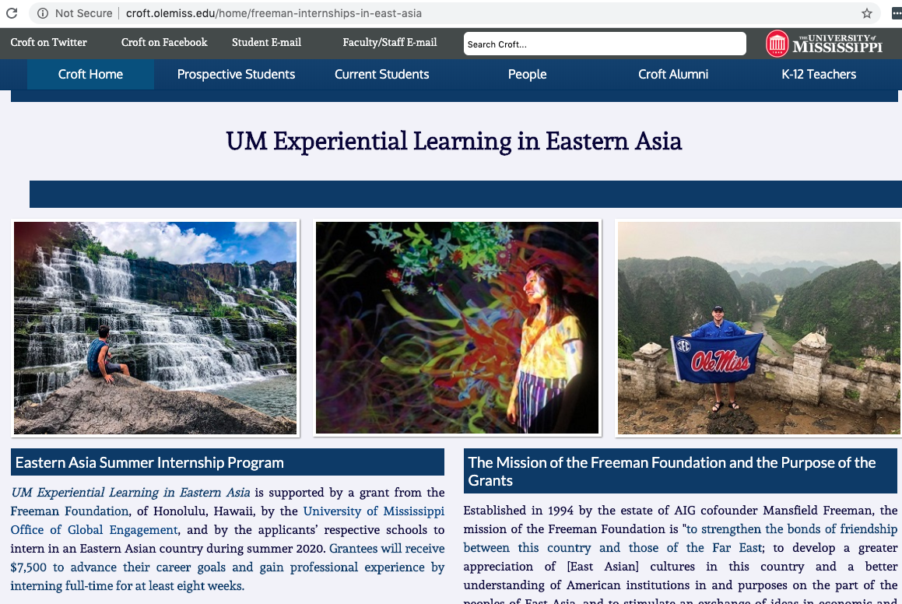

Slide 30
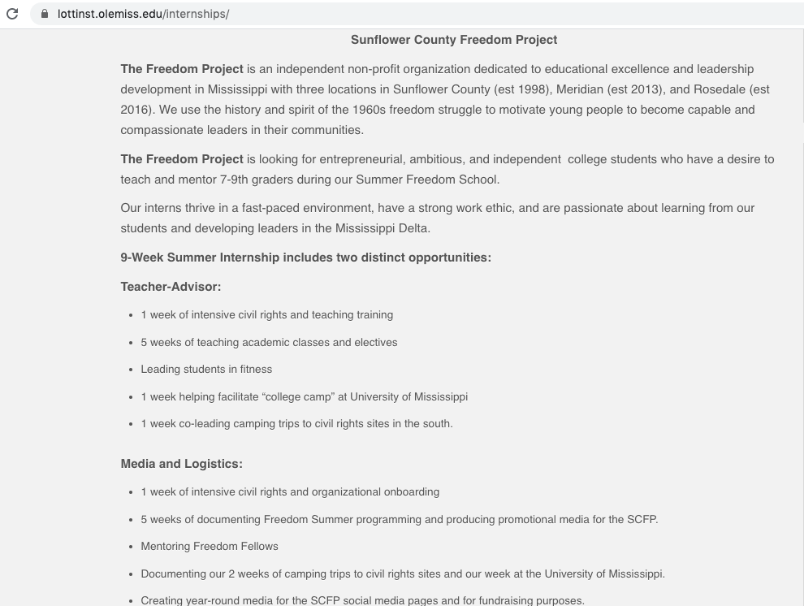

Slide 31
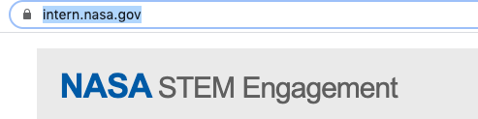
NASA Student Internships, Fellowships

Slide 32
Finding External Opportunities
UM’s COS/Pivot Subscription
https://pivot.proquest.com/

Slide 33
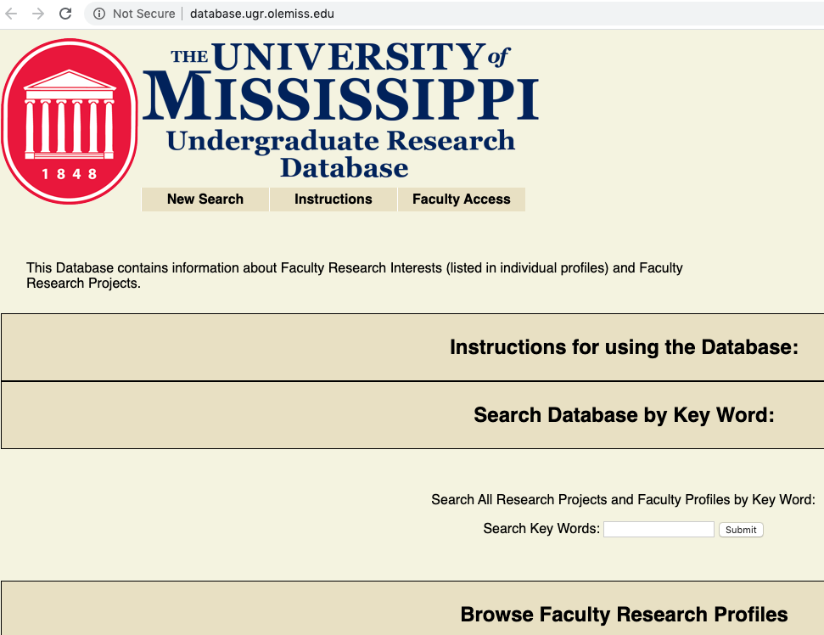
Finding UM Faculty Mentors for UGR

Slide 34
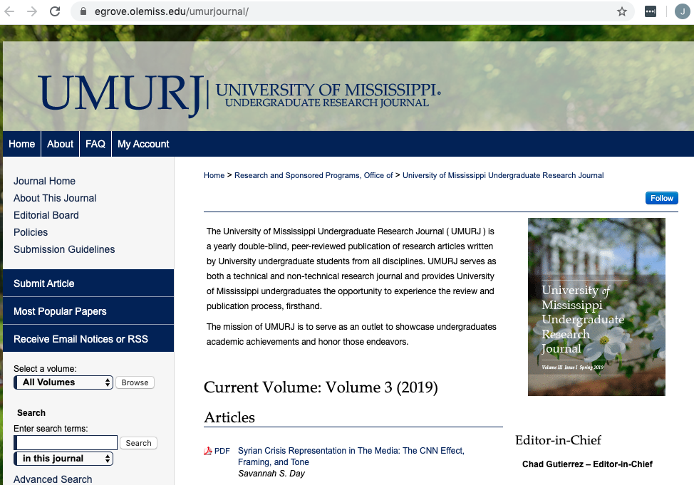

Slide 35
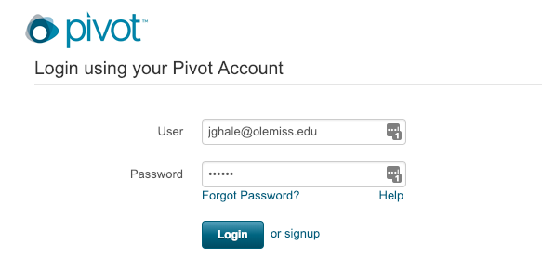
COS/Pivot Demonstration
The first time click “signup” to sign up for your account
Use your @go.olemiss.edu e-mail address
Select a password—this is NOT the same as your WebId password

Slide 36
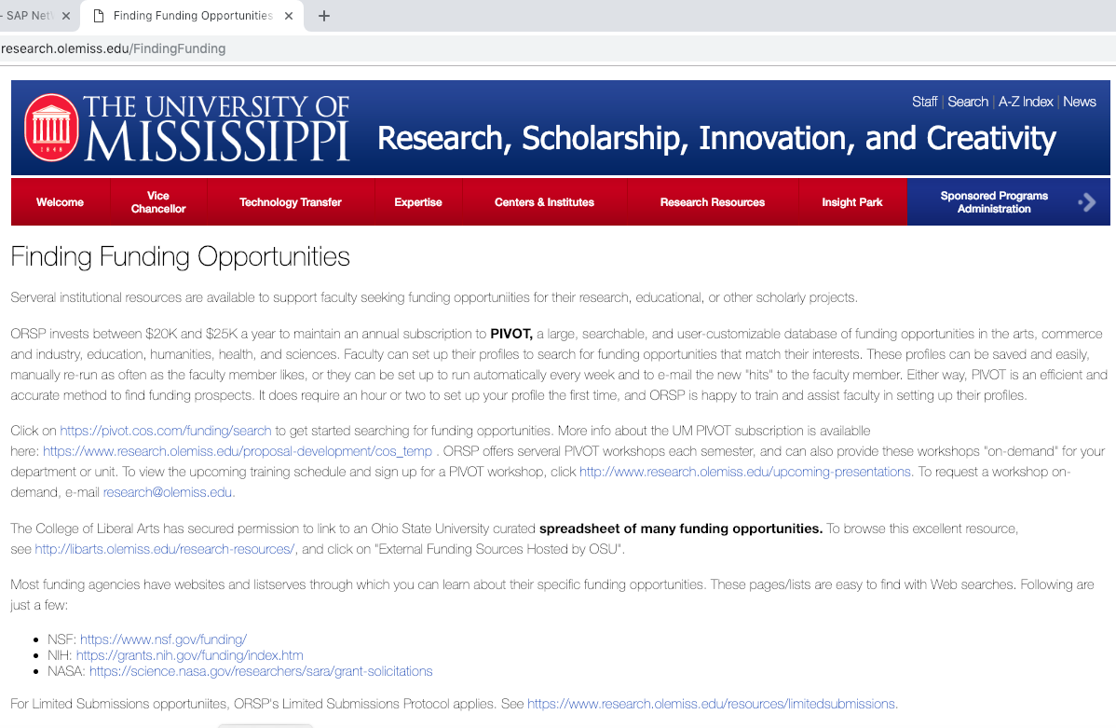
COS/Pivot Demonstration

Slide 37
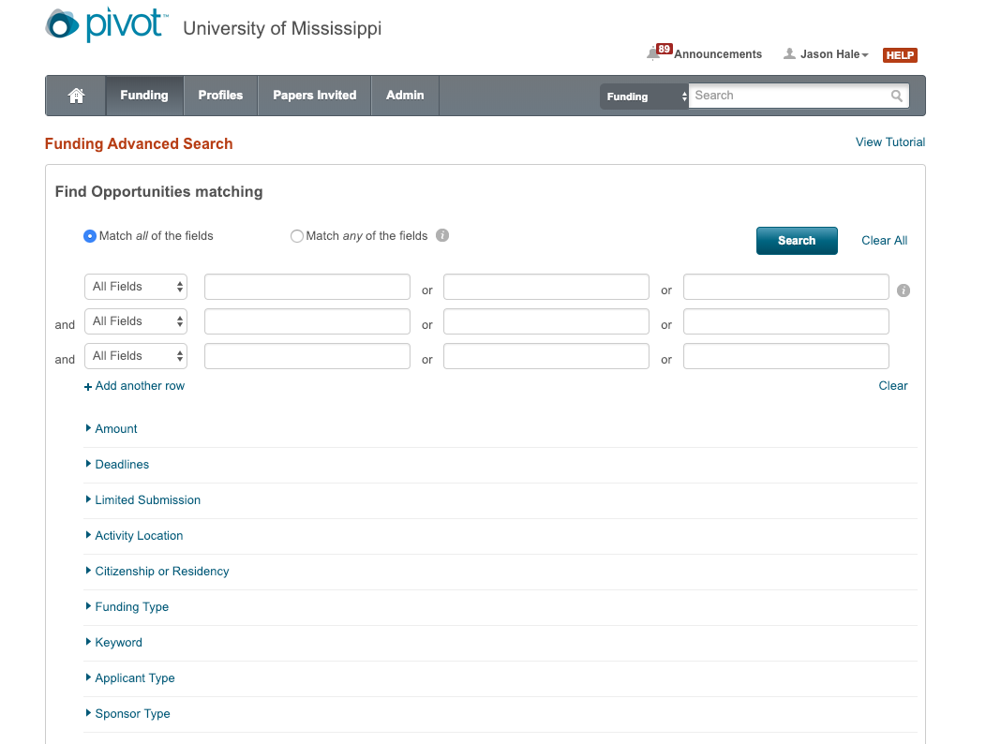
COS/Pivot Demonstration: Advanced Search

Slide 38
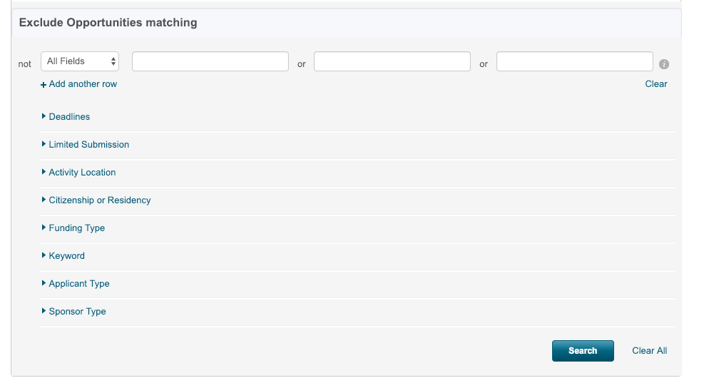
COS/Pivot Demonstration: Advanced Search

Slide 39
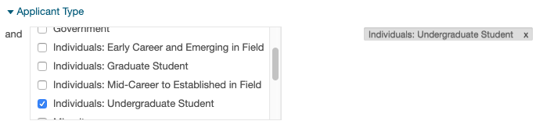

Refine Search: Applicant Types
Only show opportunities Undergraduate Students can apply to as individuals (not through UM/institution)

Slide 40
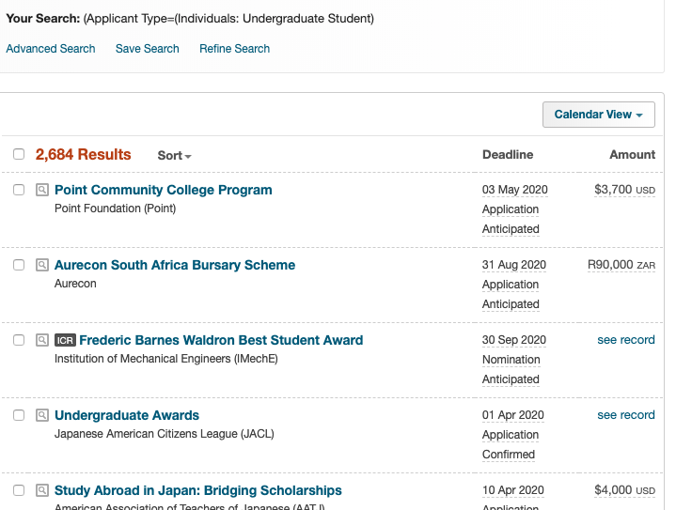
Refine Search: Applicant Type Results
That gave us over 2500 results!

Slide 41
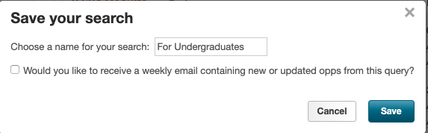
Refine Search: Applicant Type Results
Let’s Save Search

Slide 42
Refine Search: Applicant Type Results
Let’s Refine Search to remove opportunities that are limited to US Citizens or Perm Residents

Slide 43
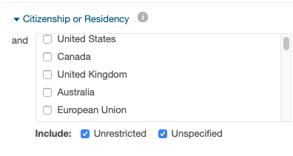
Refine Search: Citizenship/Residency
Only show opportunities that do not have Citizenship or Residency restrictions

Slide 44
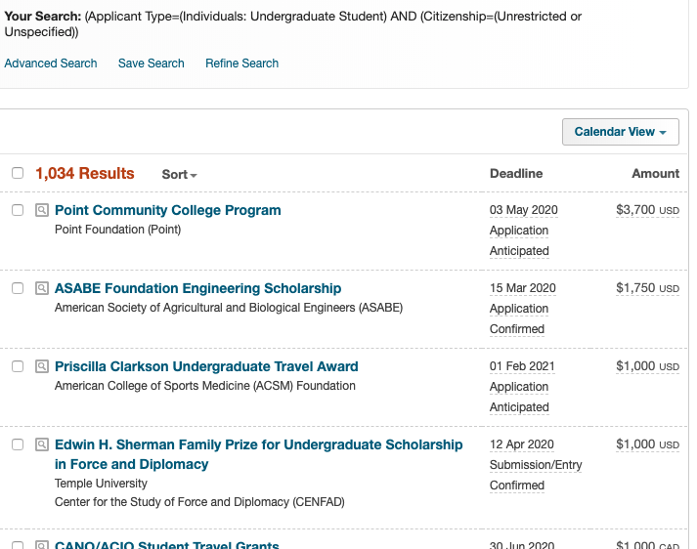
Refine Search: Citizenship/Residency Results
Only show opps w/ no Citizenship/Residency restrictions
That got rid of over half the results (but still over 1,000!)

Slide 45
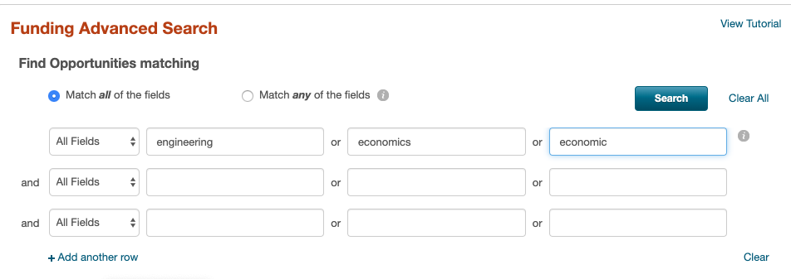
Refine Search: Keyword
Only show funding types matching a keyword
  Choose “Match ANY of the fiends”
  Enter keyword: engineering OR economic OR economics

Slide 46
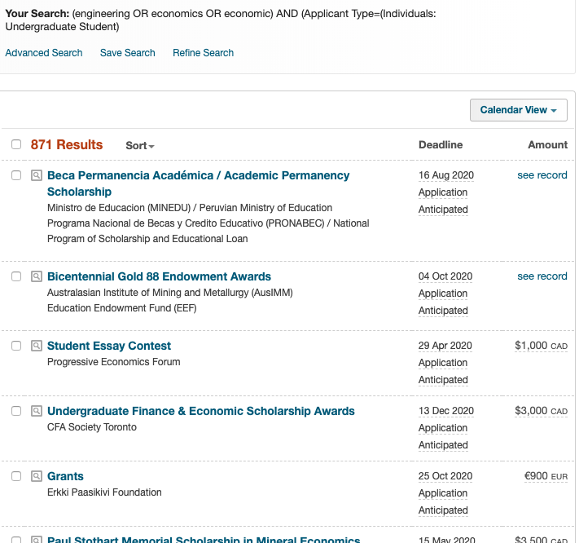
Refine Search: Keyword
Search Results
  Enter keyword: engineering OR economic OR economics

Slide 47
Refine Search: Keyword
Search Results
  Enter keyword: engineering OR economic OR economics

Slide 48
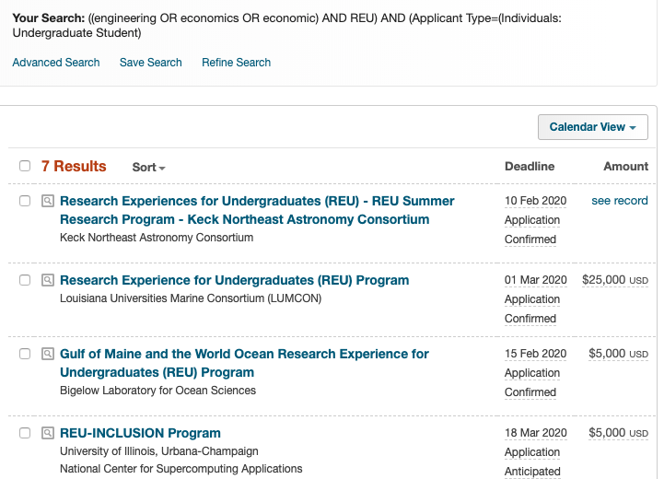
Refine Search: Keyword
REU stands for “Research Experiences for Undergraduates”
There are quite a few NSF-funded summer REU programs out there.
Search Results using OR and AND
  Enter keyword: engineering OR economic OR economic
  AND Keyword: REU

Slide 49
Finding External Ops: Things to Look For (cont.)
Is there a prescribed budget format?
Is tuition allowed?
How many awards are expected?
What is the expected funding rate?
What/who has been funded in the past?
What are the performance requirements if awarded?
What reporting requirements?
Income tax implications?
Required format for resume or biosketch

Slide 50
Finding External Ops: Things to Look For
Who is the sponsor?
When and where is the award?
How much $$ are the awards for?
What can you (and can’t you) spend the money on?
Who is the check made out to—the student, or the University?
Is U.S. citizenship or permanent residency required?
When is application deadline and process?
What all components are required in the application?

Slide 51
Links
This (and future, improved versions) presentation is downloadable from http://research.olemiss.edu/presentations
Applications for Track 1 and Track 3 awards can be submitted at https://olemiss.infoready4.com/
  (These applications are not yet live as of 2/4/20 but will be by the end of the week)
PIVOT:
https://pivot.proquest.com/funding_main

