Slide 1

LOGIC MODELS 101
MARIE BARNARD, Ph.D.
April 9, 2015

Slide 2
Objectives
Describe a logic model
Understand the value of a logic model in a grant application
Identify the key components of a logic model
Examine examples of logic models
Be able to develop a logic model

Slide 3
Logic models
Developed in evaluation science
Grounded in theory of change – does a program work??
Core of planning and evaluation
Provides a common framework

Slide 4
Logic models
A ONE page summary of a program in words and graphics
Describes the sequence of activities thought to bring about change
Demonstrates how program activities are linked to anticipated program results

Slide 5
Logic model – simplest form
INPUTS
OUTPUTS
OUTCOMES
A series of IF-THEN relationships
that explain your theory of change
Notes:
In its simplest form, a logic model is a graphic representation that shows the logical relationships between:
The resources that go into the program – INPUTS
The activities the program undertakes – OUTPUTS
The changes or benefits that result – OUTCOMES

Slide 6
Logic models – components
INPUTS: resources, contributions, investments into program
OUTPUTS: activities, services, events
OUTCOMES: results or changes for individuals to systems
ASSUMPTIONS: the beliefs we have about the program, underlying theories
EXTERNAL FACTORS: the environment in which the program exists

Slide 7

Example: Financial management program
Situation: Individuals with limited knowledge and skills in basic financial management are unable to meet their financial goals and manage money to meet their needs.
INPUTS
OUTPUTS
OUTCOMES
Extension invests time and resources
We conduct a variety of educational activities
targeted to individuals who participate
Participants gain knowledge, change practices and have improved financial well-being
WHAT WE INVEST
WHAT WE DO
WHAT RESULTS
Notes:
Let’s apply this to a typical Extension example

Slide 8
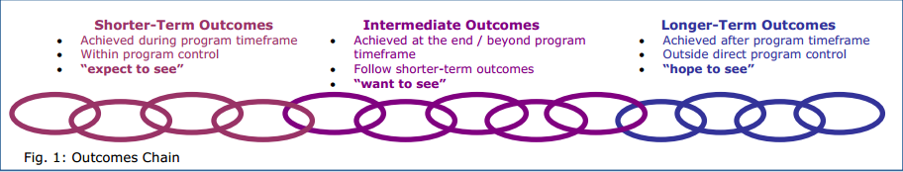
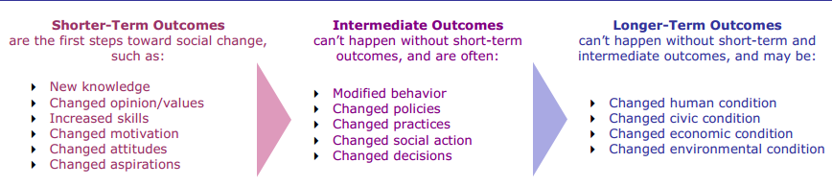
Logic models – OUTCOMES
Source: Innovation Network, Inc.

Slide 9
Logic models – FLEXIBLE TOOLS
There is no “BEST” design
Context-dependent for best choice of content to include and arrangement of that content
Try several on for size

Slide 10
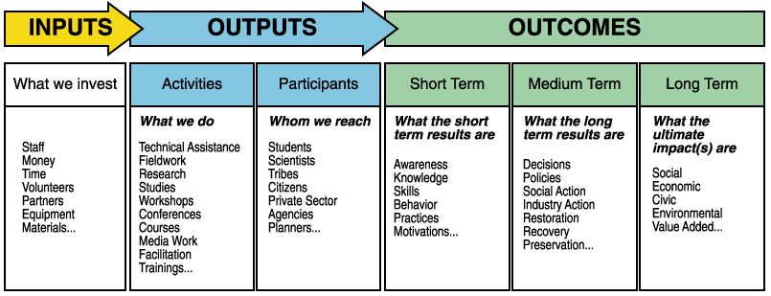
Logic model - Example

Slide 11
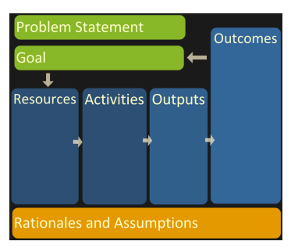
Logic model - Example

Slide 13
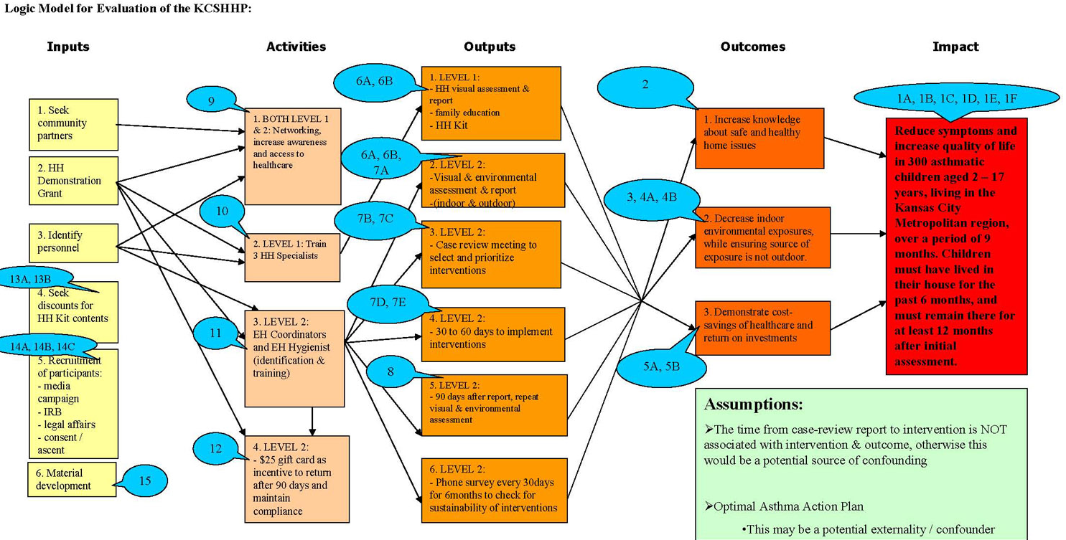
Logic model - Example

Slide 14
Logic models
NSF – “like a blueprint”
POWERFUL COMMUNICATION TOOL

Slide 15
Logic models in grant proposals
Sometimes, but not always required
If required, structure/required elements will be described in the RFP
If not required, consider including one
Why?
  Gets investigative team / partners on same page
  Easy way to communicate to a program officer what you are thinking to see if your proposal is a good fit with the funding agency
  Makes grant writing much easier
  Helps reviewers understand your proposed project

Slide 16
Logic models - tips
Focus on cause and effect relationships
Visually linking steps of your work – creating a path to solve the problem or answer the questions
KEEP IT SIMPLE – Clarity over confusion!
  Include only information directly related to theory of change
  Detail is elsewhere in your proposal
  Visually pleasing
    don’t go crazy with graphics,
    align info horizontally when possible

Slide 17
Logic models – where to begin?
Depends on how you think, how you are approaching your project, why you are creating the logic model
IDEALLY:
  Consider needs assessment / situational analysis
  Fit with mission / vision / priorities / capability / theory

Slide 18
Logic models – step by step guide
Step 1: Long-term outcomes
Step 2: Contextual factors (assumptions and external factors)
Step 3: Inputs
Step 4: Activities
Step 5: Outputs
Step 6: Short-term outcomes

Slide 19
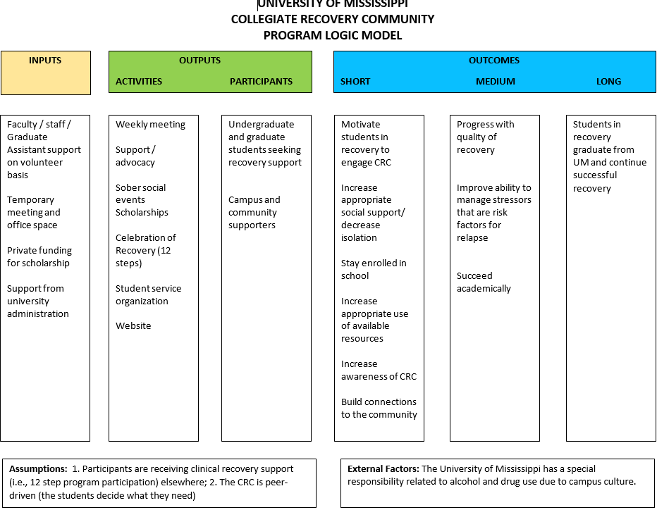

Slide 20
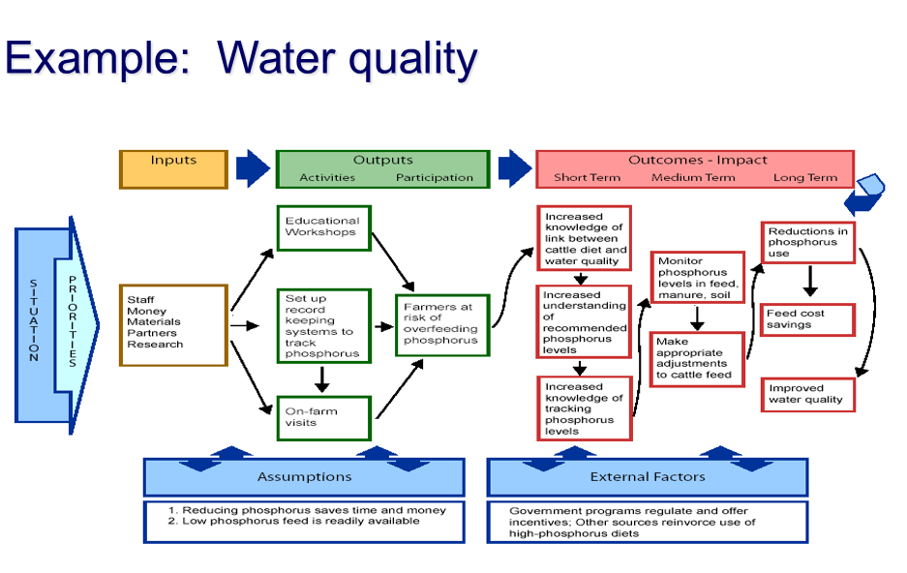
Logic model - Example

Slide 21
Example:
Statewide Tobacco Control: Smoke-free environments
INPUTS
ACTIVITIES
PARTICIPANTS
OUTCOMES
Public
Elected officials
Changes in awareness, knowledge and attitudes about SF
Demonstrations of support
Coalition
Time
Money
Partners
including youth
Research and best practices
Organize and implement Smoke-free campaign
Mgrs of public areas/events
Worksite contacts
Increased commitment, support, demand for SF environments
SF policies implemented, enforced
Residential owners, mgrs
Increased use of cessation resources
Reduction in tobacco use and exposure
Organize and implement strategy for treating tobacco addiction
Tobacco users
Adults
Youth
Changes in attitudes and motivations
Increased # of quit attempts
Influential others
Increased knowledge of availability of cessation resources
Increased # of prevention programs, policies adopted, enforcement
Youth
Organize and implement strategy to prevent youth tobacco use
Parents, schools, etc.
Change in knowledge, attitude, motivations
Policy makers
Increased commitment to eliminate access
Change in behaviors
Retailers
Notes:
Multiple chains – showing multiple clusters of programs

Slide 22
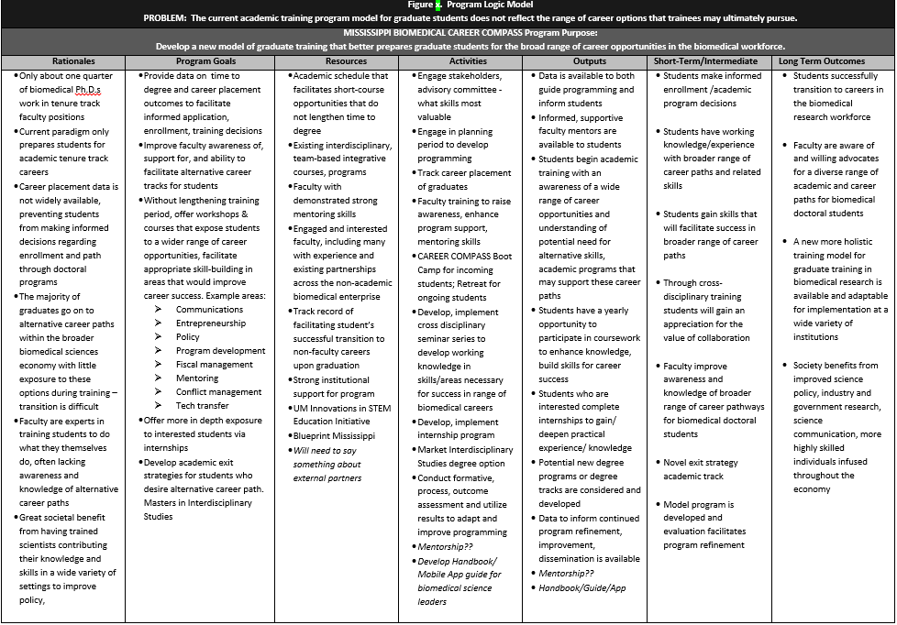

Slide 23
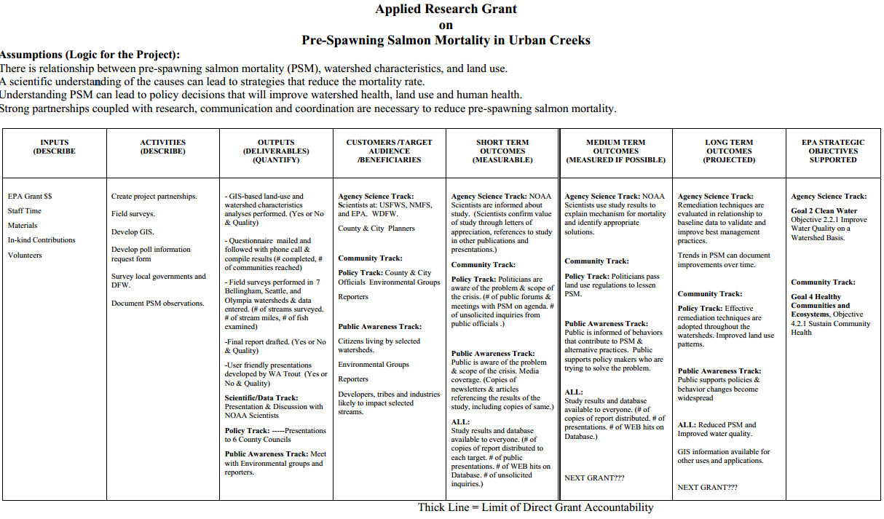
Logic model - Example

Slide 24
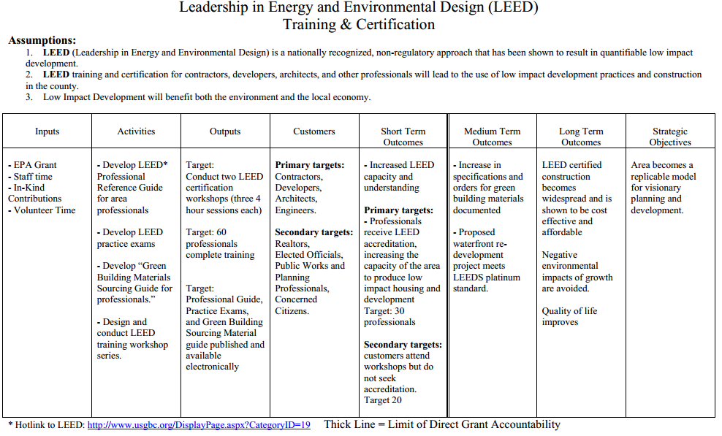
Logic model - Example

Slide 25
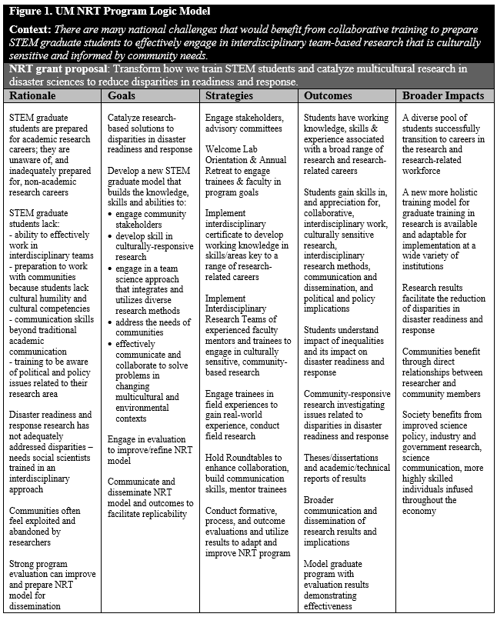

Slide 26
Logic models – where to begin?
THEORY APPROACH
OUTCOMES APPROACH
ACTIVITIES APPROACH

Slide 27
