Slide 1
Graduate Student Council Research Grants
Jason Hale
January 2020

Slide 2
Topics for Today
Program Goals
What is a GSC Research Grant?
Structure of a GSG Grant Application
Who is eligible to apply?
What can you spend GSC Grant money on?
How to Prepare/Submit a Compliant, Competitive Application?
How is Your Application Evaluated?
What next if you are selected for a GSC Research Grant?

Slide 3
Program Goals
Our Goal: To develop competitive grantsmanship culture, skills, and experience among graduate students
Your Goal:
To access additional resources/opportunities as a student
To compete better for your NEXT position (faculty, perhaps?)
  To succeed faster in those position
  Especially if you plan a career in academia/research
  But even if you don’t

Slide 4
What is a GSC Research Grant?
$1,000 award for the costs of conducting a small research or creative scholarship project
Based on a 1-year or less scope of work PROPOSED BY, and to be CONDUCTED BY, the YOU—the STUDENT
  Under the mentorship of a UM faculty member
Award goes to the department to manage on your behalf
For something NEW or EXTRA
  NOT meant to lessen planned research costs of your advisor or department
  MAY be RELATED to currently mentored research, though.

Slide 5
Your GSC Grant Proposal is really:
2 Proposals
bundled together.

Slide 6
Your GSC Grant Proposal is really:
2 Proposals
bundled together.

Slide 7
Your GSC Grant Proposal is really:
2 Proposals
bundled together.
A $1K proposal to conduct a project at UM.
A proposal to APPLY for external funding to do something entirely else.

Slide 8
A $1K proposal to conduct a project at UM.
A proposal to APPLY for external funding to do something entirely else.
<- The GSC Research Project
<- The External Opportunity

Slide 9
Both Parts will be scored: 50 total points possible.
A $1K proposal to conduct a project at UM.
A proposal to APPLY for external funding to do something entirely else.
<- The GSC Research Project
up to 30 points possible
<- The External Opportunity
up to 20 points possible
Generally, the highest scoring applicants will:
Be awarded $1K to conduct their GSC Project.
Be expected to apply to the external opportunity.
  Ext. Opp. Application does not have to be SUCCESSFUL
  Even if successful, student does not have to accept.

Slide 10
Your GSC Grant Proposal is really:
2 Proposals
bundled together.
GSC Research Project Proposal
External Opportunity

Slide 11
GSC Research Project Proposal
There are also some additional odds and ends pieces.
External Opportunity

Slide 12
Summary (1 page)
GSC Research Project Proposal
GSC Project Research Strategy (4 pages)
GSC Project Deliverables & Timeline (1 page)
There are also some additional odds and ends pieces.
GSC Project Budget/Justification (1 page)
References Cited
Biographical Sketch (2 pages)
Results from Prior GSC Support (1 page)
External Opportunity
External Opportunity Overview
External Opportunity Plan
Signed Terms of Agreement Form
Head Shot Photo
Short Student Bio (<125 words)

Slide 13
Summary (1 page)
GSC Project Research Strategy (4 pages)
GSC Project Deliverables & Timeline (1 page)
GSC Project Budget/Justification (1 page)
References Cited
Biographical Sketch (2 pages)
Results from Prior GSC Support (1 page)
And the two main proposal pieces have several sections.
External Opportunity Overview
External Opportunity Plan
Signed Terms of Agreement Form
More on preparing these in a minute….
Head Shot Photo
Short Student Bio (<125 words)

Slide 14
Timeline
Solicitation, Nov 19, 2019
Workshops: Nov 25 (Library), Dec 4 (Webinar), Dec 18 (Library), Jan 08 (online), Jan 08 (Library)
Applications Due, Jan 24, 2020
ORSP will conduct compliance review in January
Grad School & ORSP will coordinate reviews Feb/March
Winners announced March 2020
Project periods April or May 2020 – April 2021

Slide 15
Solicitation: Part 1 Overview Information
Proposals requesting over $1,000 will not be considered
For projects that will cost over $1,000
  Request up to $1,000 from GSC grant
  Show where remaining funds will come from
    Internal UM sources only
  Proposals that do not show how the entire project will be funded will not be awarded

Slide 16
Who is eligible to apply?
Fully admitted graduate students in good standing
Who can compete their projects before they graduate
Who have a UM faculty member willing to serve as their project mentor
  Probably this is their departmental advisor,
  but not necessarily
Previous GSC Grant recipients must be up-to-date on their reports

Slide 17
What can you spend GSC award money on?
Commodities, such as research or presentation supplies
Contractual expenses (e.g., printing, software licenses)
Travel for field work or required research training
Upgrades to UM computers (memory, graphics cards….)
Gift cards as incentives for research participants
Equipment that will become part or UM’s inventory
These are just some examples of eligible costs.
If unsure, ask before you propose.

Slide 18
Funding Eligibility: Most Restrictive Rule Applies
All university policies are in place
If a proposed activity or expense is eligible under the GSC guidelines, but ineligible per University policy, then University Policy prevails
If a proposed activity or expense is not prohibited by University policy, but is prohibited by GSC guidelines, then GSC guidelines prevail.
In short, the most restrictive policy or guideline applies

Slide 19
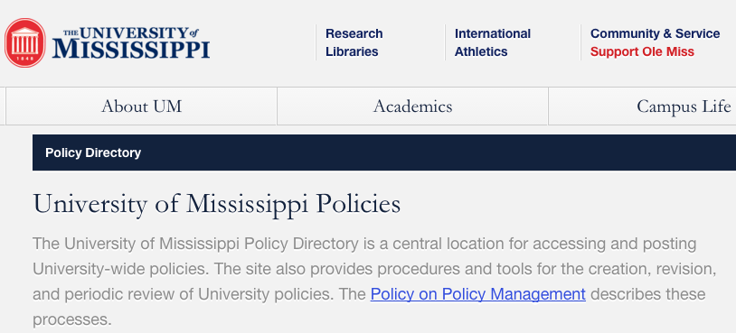
University Policies
https://secure4.olemiss.edu/umpolicyopen/index.jsp

Slide 20
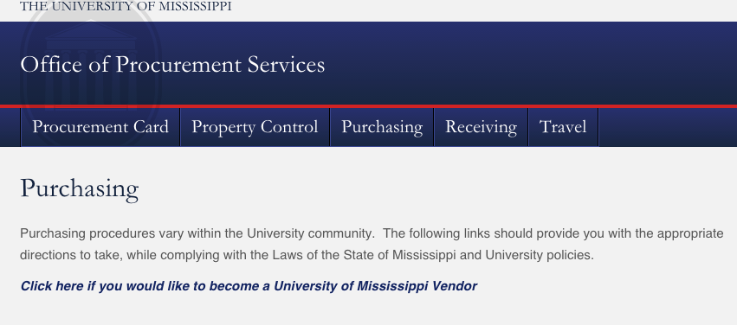
Procurement
http://procurement.olemiss.edu/purchasing/

Slide 21
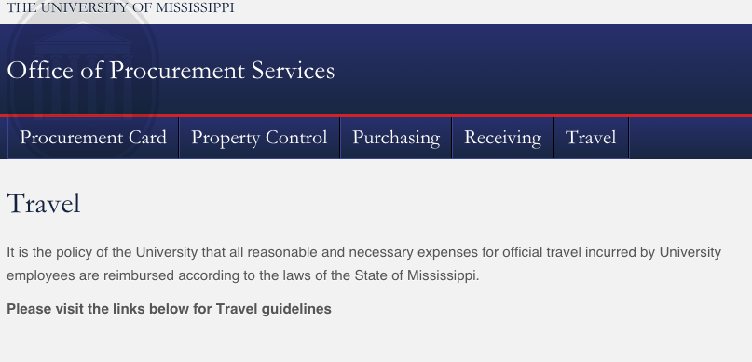
Travel
http://procurement.olemiss.edu/travel/
Travel authorizations required 5+ days before travel

Slide 22
Application: General Rules
Incomplete applications will NOT be considered.
Late applications will NOT be considered.
Plagiarized proposals will not be considered.
Noncompliant proposals will not be considered.
READ AND CAREFULLY FOLLOW ALL INSTRUCTIONS!

Slide 23
Summary (1 page)
GSC Project Research Strategy (4 pages)
GSC Project Deliverables & Timeline (1 page)
GSC Project Budget/Justification (1 page)
References Cited
Biographical Sketch (2 pages)
Results from Prior GSC Support (1 page)
External Opportunity Overview
External Opportunity Plan
Signed Terms of Agreement Form
Head Shot Photo
Short Student Bio (<125 words)

Slide 24
Application: Summary – 1 page
The summary should consist of three clearly labeled sections:
Overview (1-4 sentences summarizing summarizing who you are, including graduate program and your standing and year in the program, and what you are going to do in your GSC project)
Intellectual Merit (summarizing why this work is important to the field itself, and any methods to be used), and
External Opportunity (summarizing the external opportunity that you will apply to, including sponsor name, program name, and application due date, and how it will benefit your academic career)
Summary of funded awards will be posted on GSC Web page.

Slide 25
Summary (1 page)
GSC Project Research Strategy (4 pages)
GSC Project Deliverables & Timeline (1 page)
GSC Project Budget/Justification (1 page)
References Cited
Biographical Sketch (2 pages)
Results from Prior GSC Support (1 page)
External Opportunity Overview
External Opportunity Plan
Signed Terms of Agreement Form
Head Shot Photo
Short Student Bio (<125 words)

Slide 26
Application: GSC Project Research Strategy
(4 pages max)
Describe the research project. You may wish to include such information as: the overall goal of the larger work, the one to three specific objectives or aims for this project, the methodology to be employed, any activities to be undertaken, the significance and relevance to the field and to your academic career, the novelty of the approach, the plan for dissemination of results, risks and mitigation strategies, and/or any anticipated broader impact to society or UM.
Briefly list any relevant facilities, equipment or other resources you will have at your disposal (and intend to use).

Slide 27
Summary (1 page)
GSC Project Research Strategy (4 pages)
GSC Project Deliverables & Timeline (1 page)
GSC Project Budget/Justification (1 page)
References Cited
Biographical Sketch (2 pages)
Results from Prior GSC Support (1 page)
External Opportunity Overview
External Opportunity Plan
Signed Terms of Agreement Form
Head Shot Photo
Short Student Bio (<125 words)

Slide 28
Application: Other Components
GSC Project Deliverables and Timeline: 1 page max
Budget and Budget Justification: 1 page max, including:
Detailed Budget
List supplies, commodities, travel, and other research related expenses you are requesting and the estimated cost of each. Pay careful attention to ensure all proposed expenses are compliant with this RFA and with the University’s spending and reimbursement policies.
Budget Justification
Include a paragraph describing why these costs are necessary for the project.
Current and Pending Support
Detail all sources of current or committed funding (including graduate assistantships) to conduct this project. For proposed projects whose total cost exceeds $1,000, tell where the rest will be coming from.

Slide 29
Summary (1 page)
GSC Project Research Strategy (4 pages)
GSC Project Deliverables & Timeline (1 page)
GSC Project Budget/Justification (1 page)
References Cited
Biographical Sketch (2 pages)
Results from Prior GSC Support (1 page)
External Opportunity Overview
External Opportunity Plan
Signed Terms of Agreement Form
Head Shot Photo
Short Student Bio (<125 words)

Slide 30
Application: Other Components
References Cited: (no page limit)
Use the citation style that us customary in your discipline (APA, MLA, etc.) and be consistent.
Biographical Sketch: (2 pages maximum)
Include a 1-2 page biographical sketch
Suggested formats: NSF-style or NIH-style
See NSF PAPPG 19 for instructions on NSF Biosketch format https://www.nsf.gov/pubs/policydocs/pappg19_1/pappg_2.jsp#IIC2f
See NIH bioksetch instructions: https://grants.nih.gov/grants/forms/biosketch.htm

Slide 31
Summary (1 page)
GSC Project Research Strategy (4 pages)
GSC Project Deliverables & Timeline (1 page)
GSC Project Budget/Justification (1 page)
References Cited
Biographical Sketch (2 pages)
Results from Prior GSC Support (1 page)
External Opportunity Overview
External Opportunity Plan
Signed Terms of Agreement Form
Head Shot Photo
Short Student Bio (<125 words)

Slide 32
Results from Prior GSC Grants
1 page
For past recipients only. Tell the title, dates, and advisor of the previous GSC grant, the amount of funds spent, and the status of any due or overdue mid-term or final reports.|
Summarize the results of the project (or project so far) in terms of activities, findings, and dissemination of results (presentations given, articles submitted or published, conference presentations given or accepted, etc.) as well as any external funding applications submitted and/or awards received.
Your report(s) from any previous GSC grant may be a source for preparing this section

Slide 33
Summary (1 page)
GSC Project Research Strategy (4 pages)
GSC Project Deliverables & Timeline (1 page)
GSC Project Budget/Justification (1 page)
References Cited
Biographical Sketch (2 pages)
Results from Prior GSC Support (1 page)
External Opportunity Overview
External Opportunity Plan
Signed Terms of Agreement Form
Head Shot Photo
Short Student Bio (<125 words)

Slide 34
Application: External Opportunity Overview
1 page
Describe the external opportunity that you plan to apply for, or have very recently applied for. This could be a scholarship, a graduate or post-graduate fellowship, or some other type of grant to the institution that will result in an opportunity for you, perhaps through a graduate assistantship. Be sure to include all of the following information, where applicable: sponsor name, program name, due date, type of funding (e.g., scholarship, fellowship, grant, etc.), maximum amount of award (and how much you plan to ask for), eligible costs (for what you are allowed to use the money), who receives the award (the student or the institution), who submits the application (the student or the institution), eligibility requirements, anticipated duration of the award (start and end dates), review criteria, anticipated number of awards, and any other relevant information we should be aware of. Please provide a URL link to the opportunity, and also tell us how you learned about the external opportunity.

Slide 35
Summary (1 page)
GSC Project Research Strategy (4 pages)
GSC Project Deliverables & Timeline (1 page)
GSC Project Budget/Justification (1 page)
References Cited
Biographical Sketch (2 pages)
Results from Prior GSC Support (1 page)
External Opportunity Overview
External Opportunity Plan
Signed Terms of Agreement Form
Head Shot Photo
Short Student Bio (<125 words)

Slide 36
Application: External Opportunity Plan
1 page
Describe plan for competing for this opportunity. If you have already submitted an application but have not yet learned the result, you can count that—tell us what you proposed. You may wish to include such information as: an overview of the project or theme of your proposal/application (which may or may not be directly related to the proposed GSC Research Project); a timeline for developing and submitting your proposal; a draft plan for how you will spend the award money, in accordance with the opportunity guidelines; and how this opportunity, if funded, will impact your own academic or career trajectory, whether at University of Mississippi, some other institution, or beyond. Who will serve as your project graduate advisor?

Slide 37
Summary (1 page)
GSC Project Research Strategy (4 pages)
GSC Project Deliverables & Timeline (1 page)
GSC Project Budget/Justification (1 page)
References Cited
Biographical Sketch (2 pages)
Results from Prior GSC Support (1 page)
External Opportunity Overview
External Opportunity Plan
Signed Terms of Agreement Form
Head Shot Photo
Short Student Bio (<125 words)

Slide 38
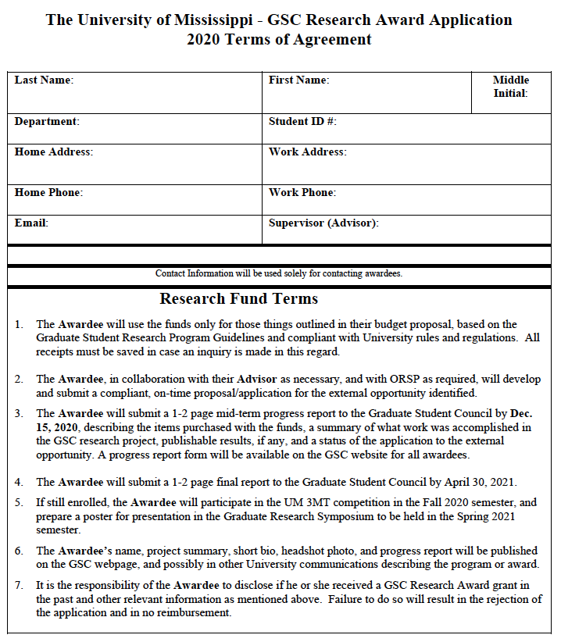
Signed Agreement Form

Slide 39
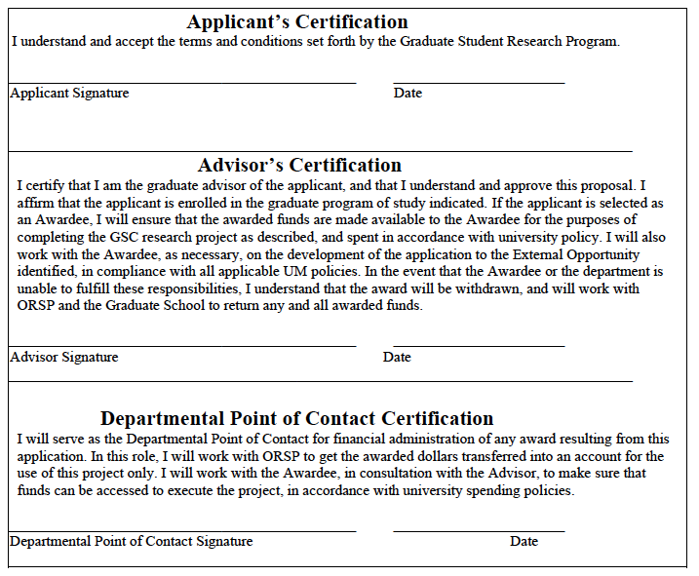
Signed Agreement Form

Slide 40
Application: Submission
Use Ole Miss InfoReady Review Portal
https://olemiss.infoready4.com/
Sign in with UM WebId/Password
Use Chrome to verify your account
Competition is called:
“Graduate Student Council Research Grants 2020”

Slide 41
Application: Submission
The Application
One Summary document (MS Word preferred, or PDF acceptable)
One Body document, as a single PDF file, as detailed in Part III, Section 2, including:
GSC Project Research Strategy (4 pages)
GSC Project Deliverables and Timeline (1 page)
GSC Project Budget and Budget Justification (1 page)
References Cited (no page limit)
Biographical Sketch (2 pages)
Results from Prior GSC Grants (1 page, if applicable)
External Opportunity Overview (1 page)
External Opportunity Plan (1 page)
Signed Terms of Agreement Form
Headshot Photograph (Hi Res)
Short Student Bio (125 words or less)
Summary (1 page)
GSC Project Research Strategy (4 pages)
GSC Project Deliverables & Timeline (1 page)
GSC Project Budget/Justification (1 page)
References Cited
Biographical Sketch (2 pages)
Results from Prior GSC Support (1 page)
External Opportunity Overview
External Opportunity Plan
Signed Terms of Agreement Form
Head Shot Photo
Short Student Bio (<125 words)

Slide 42
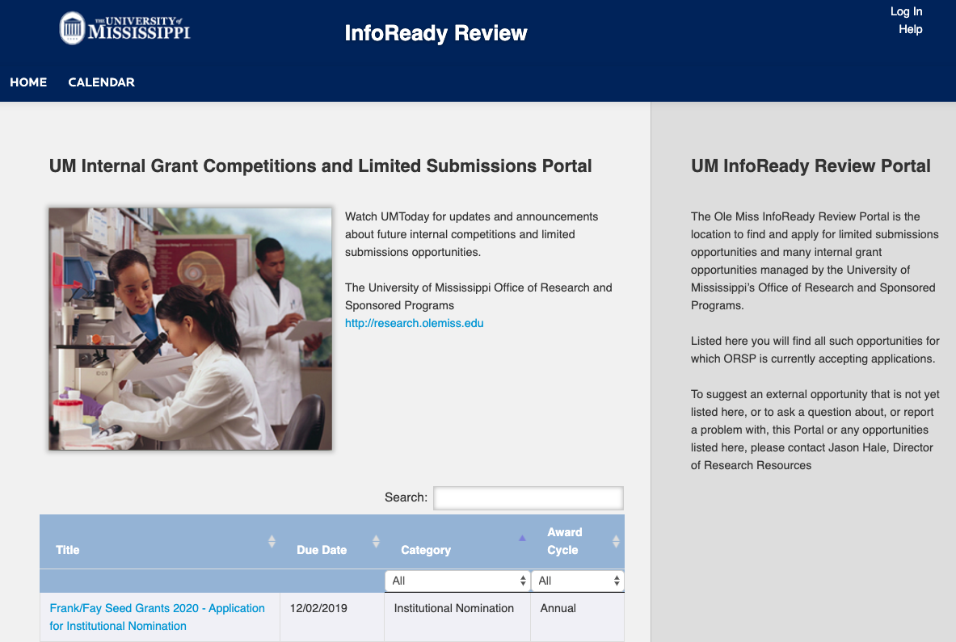
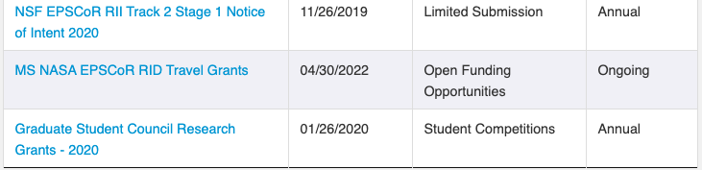
Application: Submission

Slide 43
Review & Competition
ORSP will pre-review all applications and disqualify those that are not compliant with the instructions
ORSP and Graduate School will enlist reviewers from faculty and staff from around campus

Slide 44
Review & Competition
Review Categories
  Arts, humanities, journalism, & new media
  Social sciences and education
  Business, Law, and Accounting
  Physical and life sciences, or
  Math, computer science, and engineering
Each application will be reviewed by at least two reviewers
ORSP will notify submitters of results (chosen or not)
Reviewer comments and scores will be made available through the InfoReady Portal

Slide 45
Review Criteria (50 points maximum)
GSC Research Project: Merit (10 points)
Does the narrative make a compelling case, understandable to a reader from a related but different discipline, that the proposed work will advance knowledge and understanding in a way that compliments, or fills a gap in, work that has come before?
What is the novelty or originality of the proposed work or approach?

Slide 46
Review Criteria (50 points maximum)
GSC Research Project: Soundness of Plan (10 points)
Does the narrative make a compelling case that the project will be completed as proposed within the project period, using the resources available?
Are potential risks identified, and are contingencies in
place to mitigate those risks?

Slide 47
Review Criteria (50 points maximum)
Overall Clarity (10 points)
Is the proposal compelling, easy to understand, and grammatically correct?

Slide 48
Review Criteria (50 points maximum)
External Opportunity: Merit (10 points)
Is it clear that the applicant has researched and understands all the key requirements of the external opportunity? Is the opportunity appropriate for the student’s stage and program of study?
External Opportunity: Soundness of Plan (10 points)
Given what was written, how likely does it seem that the student will be able to develop and submit an on-time, compliant application or proposal?
How competitive is the proposal likely to be?

Slide 49
Award and Requirements
Awardees will sign an award agreement with ORSP
Funds will be transferred to a Departmental Account under the control of the Advisor or Dept. Point of Contact
Awardees will present at the Graduate School 3M Thesis Competition in Fall 2020
Awardees will present a poster at the GSC poster symposium in Spring 2021
Awardees will submit mid-term (December) and final (May) reports to GSC

Slide 50
Finding External Opportunities
UM’s COS/Pivot Subscription

Slide 51
Finding External Ops: Things to Look For
Who is the sponsor?
When and where is the award?
How much $$ are the awards for?
What can you (and can’t you) spend the money on?
Who is the check made out to—the student, or the University?
Is U.S. citizenship or permanent residency required?
When is application deadline and process?
What all components are required in the application?

Slide 52
Finding External Ops: Things to Look For (cont.)
Is there a prescribed budget format?
Is tuition allowed?
How many awards are expected?
What is the expected funding rate?
What/who has been funded in the past?
What are the performance requirements if awarded?
What reporting requirements?
Income tax implications?
Required format for resume or biosketch

Slide 53
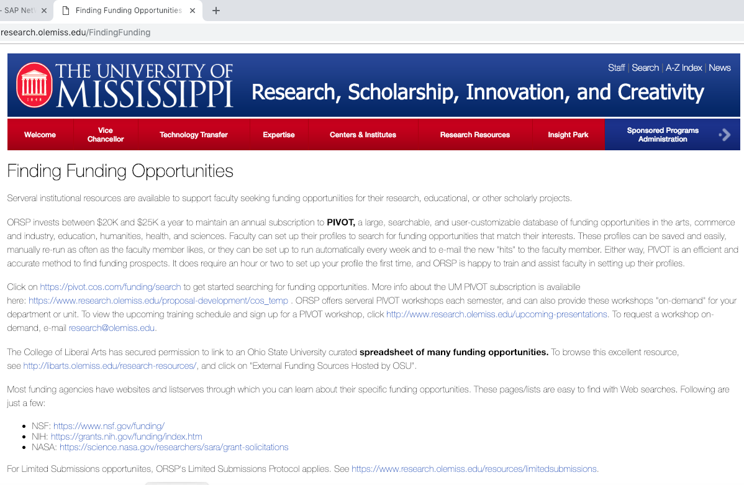
COS/Pivot Demonstration

Slide 54
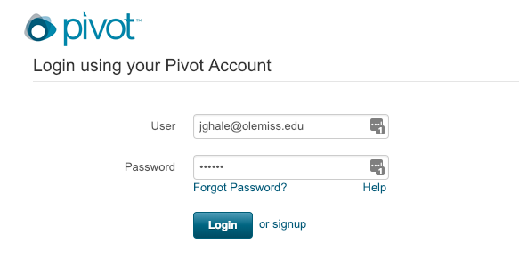
COS/Pivot Demonstration
The first time click “signup” to sign up for your account
Use your @go.olemiss.edu e-mail address
Select a password—this is NOT the same as your WebId password

Slide 55
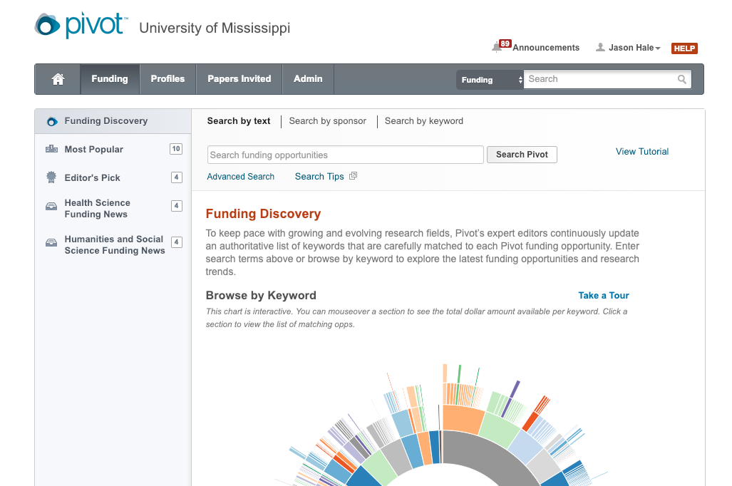
COS/Pivot Demonstration
Add search terms and click Search Pivot
Or Click Advanced Search to specify different parameters

Slide 56
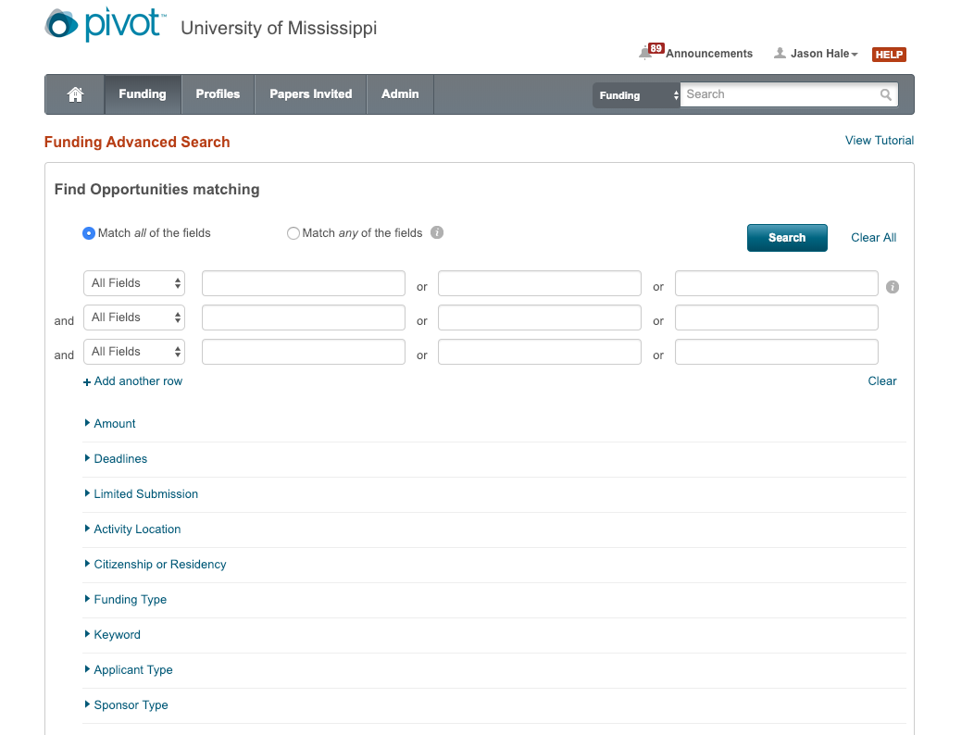
COS/Pivot Demonstration: Advanced Search

Slide 57
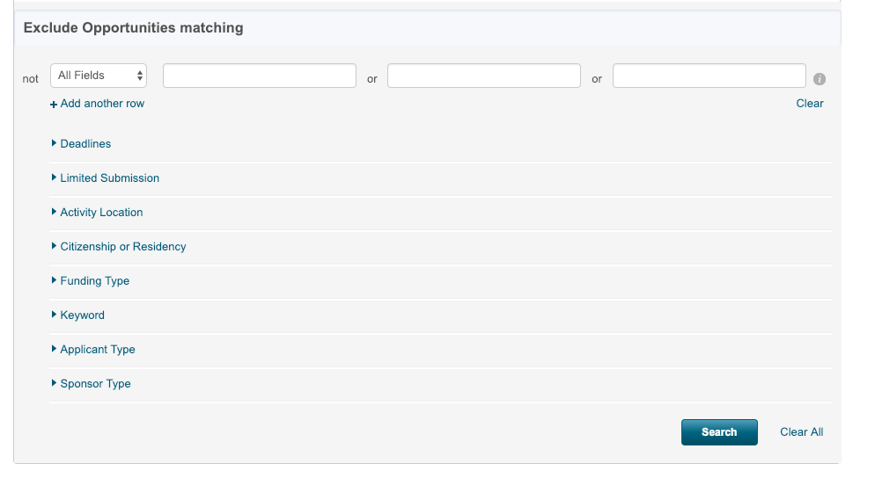
COS/Pivot Demonstration: Advanced Search

Slide 58
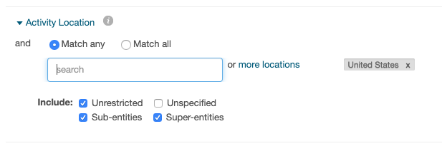
Advanced Search: Activity Location
To search based on where an activity can occur
Typically: Enter United States
Unrestricted = include opps that do not restrict activity location
Unspecified = include opps that do not seem to restrict location

Slide 59
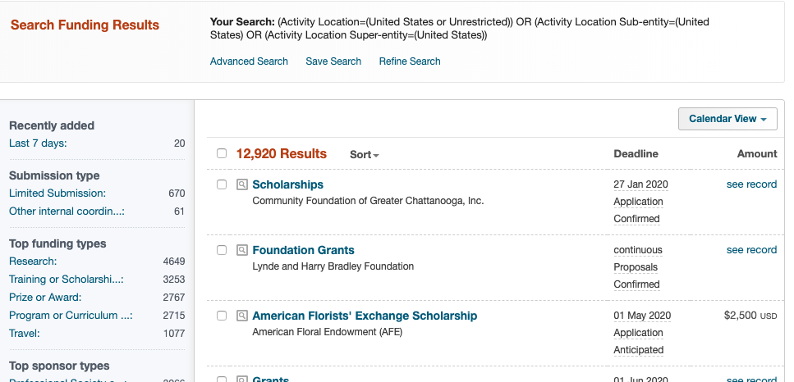
Advanced Search: Activity Type - Results
So many results! Click Refine Search to narrow the list….

Slide 60
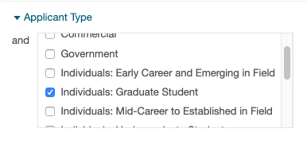

Refine Search: Applicant Types
Only show opportunities Graduate Students can apply to as individuals (not through UM/institution)

Slide 61
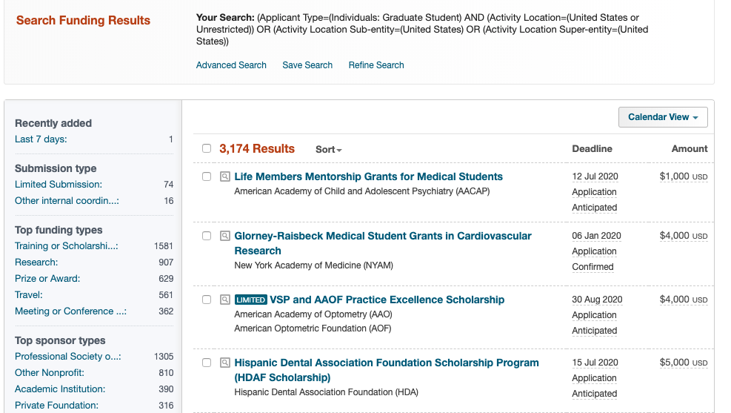
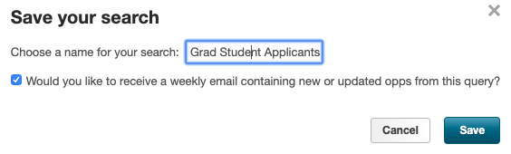
Refine Search: Applicant Type Results
That cut the candidate opportunity list by around ¾.
Let’s Save Search

Slide 62
Refine Search: Applicant Type Results
Let’s Refine Search to remove Citizenship and Residency Restrictions

Slide 63
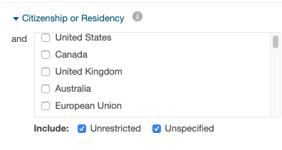
Refine Search: Citizenship/Residency
Only show opportunities that do not have Citizenship or Residency restrictions

Slide 64
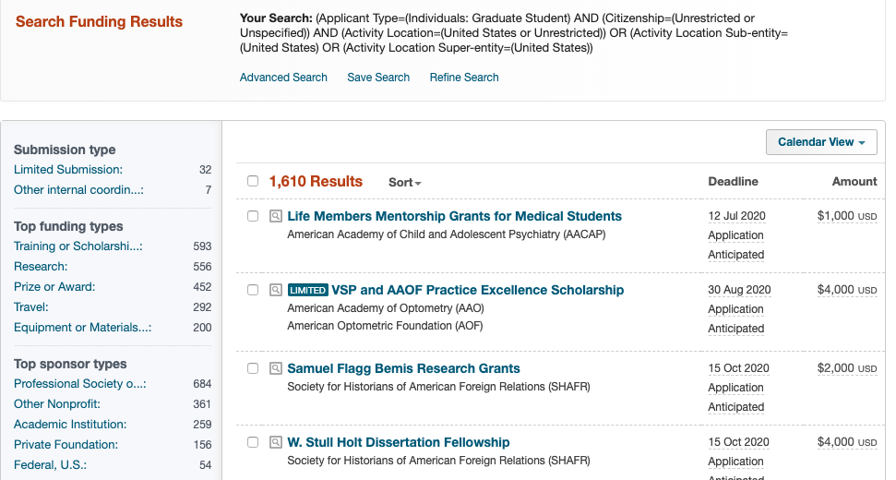
Refine Search: Citizenship/Residency Results
Only show opps w/ no Citizenship/Residency restrictions
Save Search; then Refine Search

Slide 65
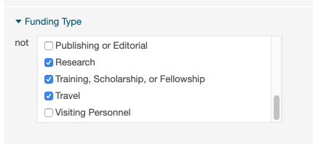

Refine Search: Funding Type
Only show funding types of certain interest….

Slide 66
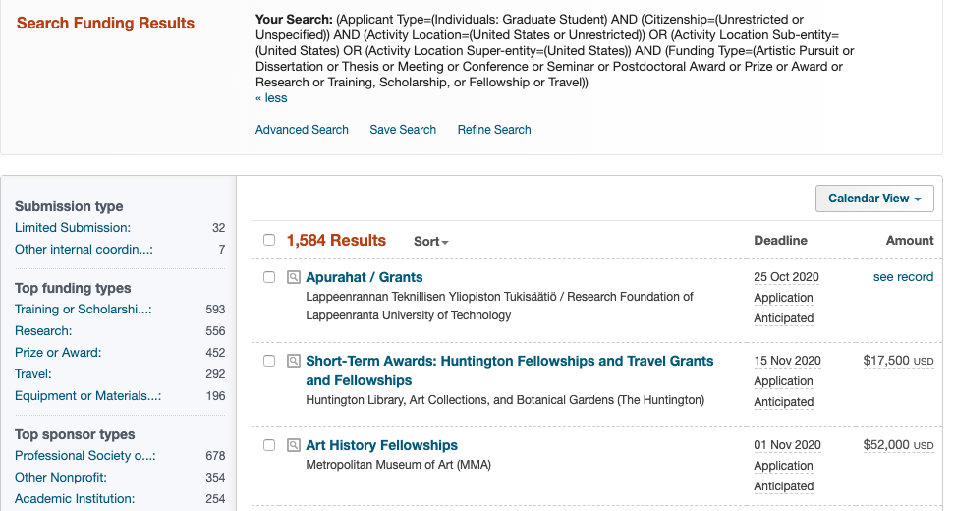
Refine Search: Funding Type Results

Slide 67
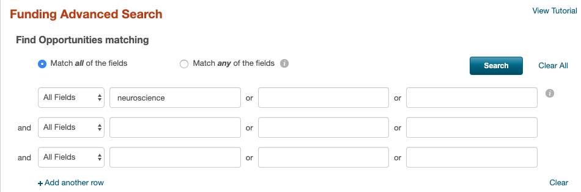
Refine Search: Keyword
Only show funding types matching a keyword
  Choose “Match all of the fiends”
  Enter keyword: neuroscience

Slide 68
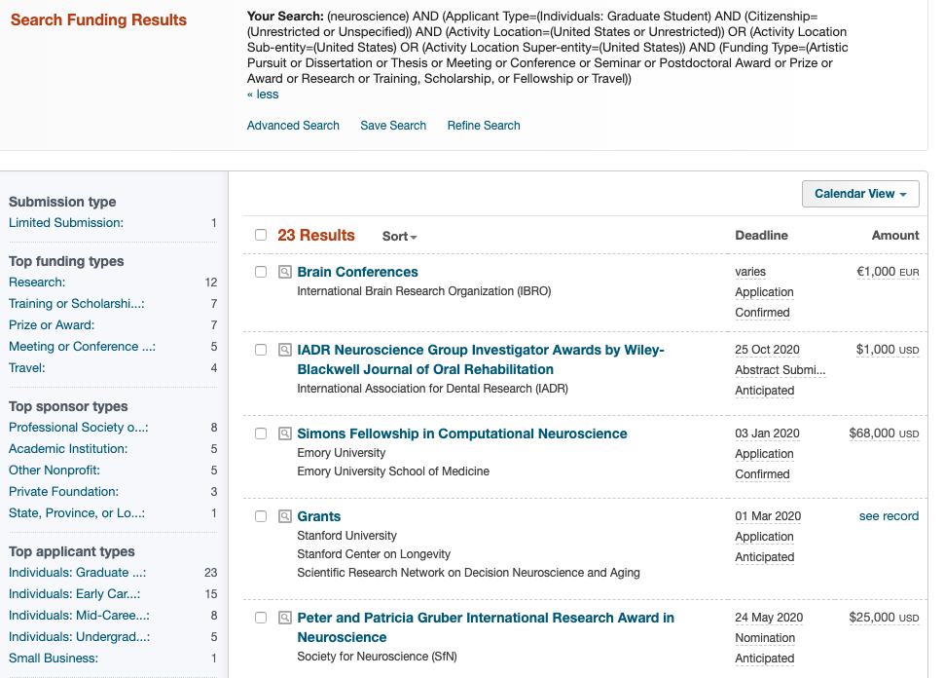
Refine Search: Keyword Results

Slide 69
Example Opportunities
The following are just a FEW of the over 1,500 opportunities that graduate students are eligible to apply for, regardless of citizenship/residency status.
Even more opportunities are available for U.S. citizens or permanent residents—especially from federal sponsors.

Slide 70
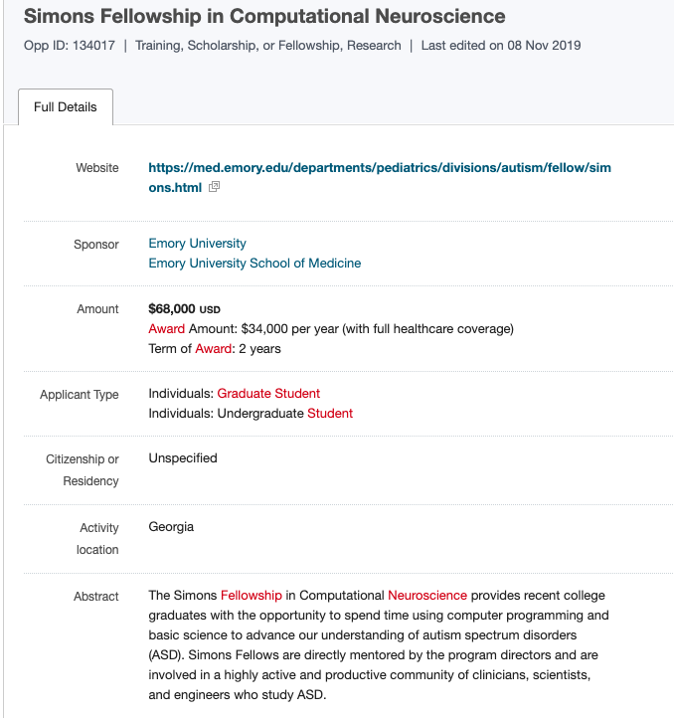
Keyword: neuroscience

Slide 71
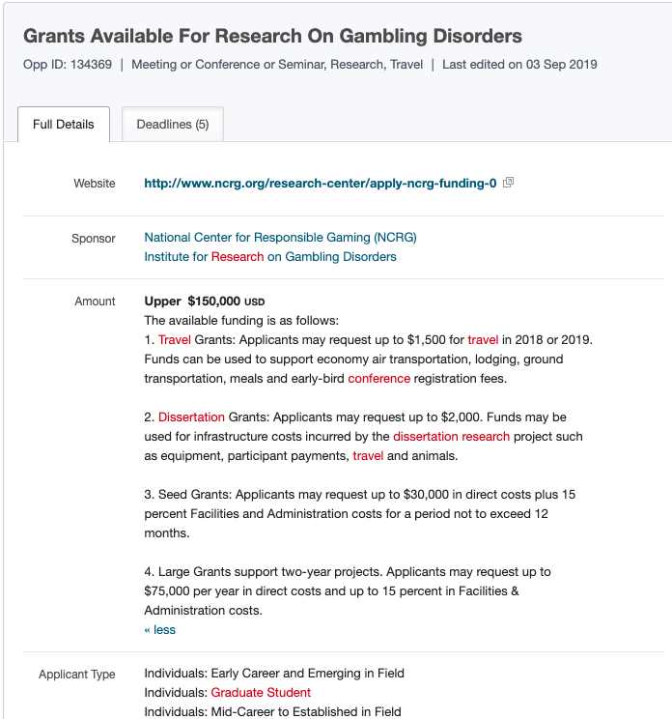
Keyword: neuroscience

Slide 72
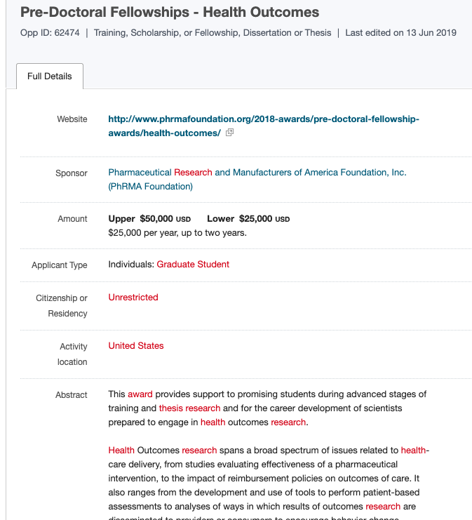
Keyword: health

Slide 73
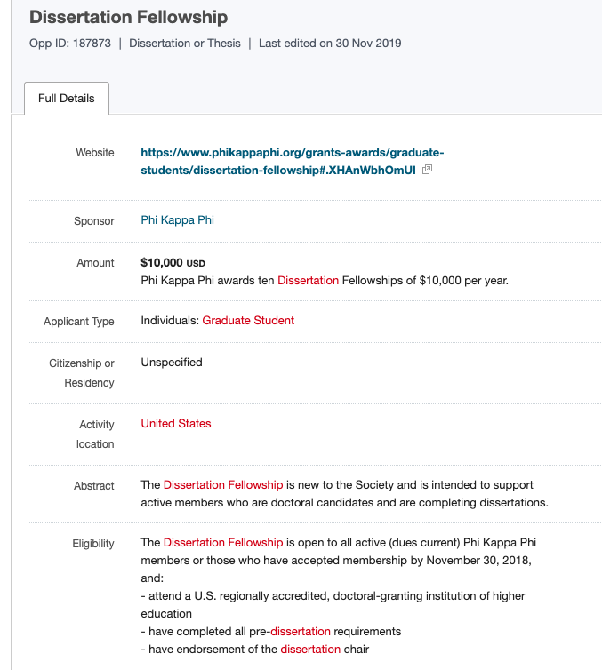
Keyword: health

Slide 74
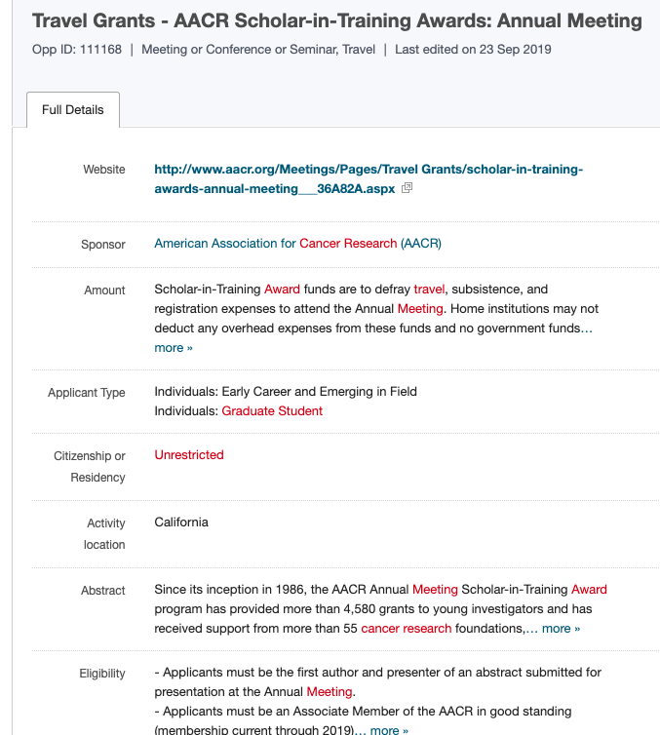
Keyword: cancer

Slide 75
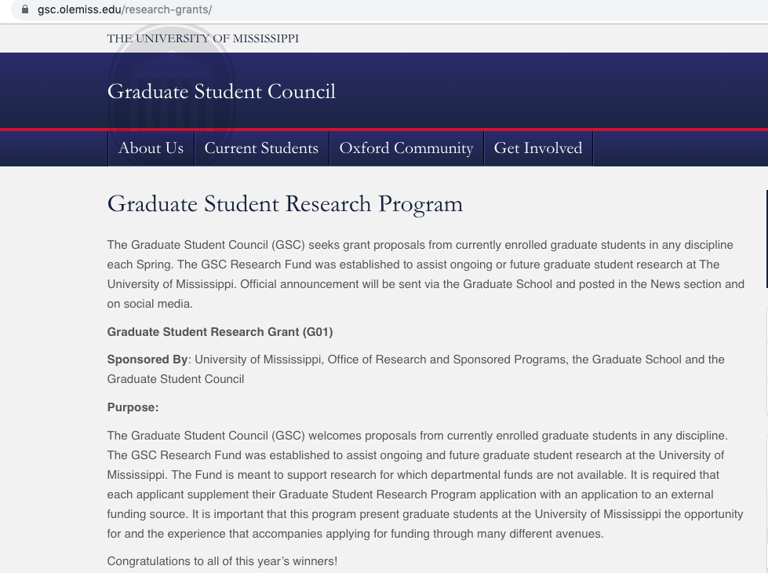

Slide 76
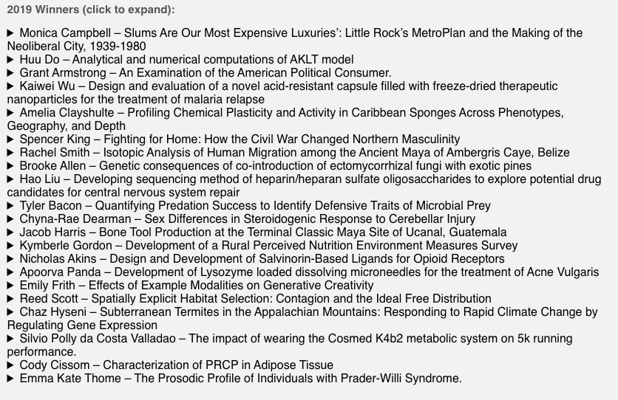
Read Summaries Here:
https://gsc.olemiss.edu/research-grants/

Slide 77
External Funding Opportunities Targeted by 2019 GSC Grant Winners
LBJ Foundation: Harry Middleton Fellowship in Presidential Studies
Kavli Institute of Theoretical Physics, UC Santa Barbara
Time-sharing Experiments for the Social Sciences Young Investigator Competition (NSF)
The International Pharmaceutical Excipient Council (IPEC) foundation
Eric Reid Fund for Methodology
Alfred M. Landon Research Grant
Sigma Xi Grants in Aid of Research
NSF GRFP
Wings for Life Spinal Cord Research Foundation
Sigma Xi
American Ornithological Society
Sigma Xi Grants in Aid Research
Robert Wood Johnson Foundation Culture of Health Leaders Program
Graduate Research Fellowship Program (NSF)
American Psychological Foundation
Sigma Xi
The William L. and Ruth D. Nutting Termite Research Grant
National Strength and Conditioning Association
Michael Moody Fitness Scholarship
Sertoma

Slide 78
What is Next?
Read that Request for Applications (RFA) carefully
Identify a GSC Research Project to Propose
  Consult with your graduate advisor
Identify an External Opportunity
  Search online sources (e.g., COS/Pivot)
  Find candidate opportunities of interest
  Carefully read the rules and guidelines
  Select the opportunity you will go for

Slide 79
What is Next?
Write your Proposal
  Write GSC Project Research Strategy & Other Components
  Write the Funding Opportunity Sections
Comply with the RFA
  If RFA and this PPT are inconsistent, RFA rules
  Don’t let your application get returned without review!
Submit your application by the due date
Comply with award conditions if awarded
Refer questions to Jason Hale at jghale@olemiss.edu

Slide 80

https://news.olemiss.edu/graduate-students-receive-grants-research-efforts/

Slide 81
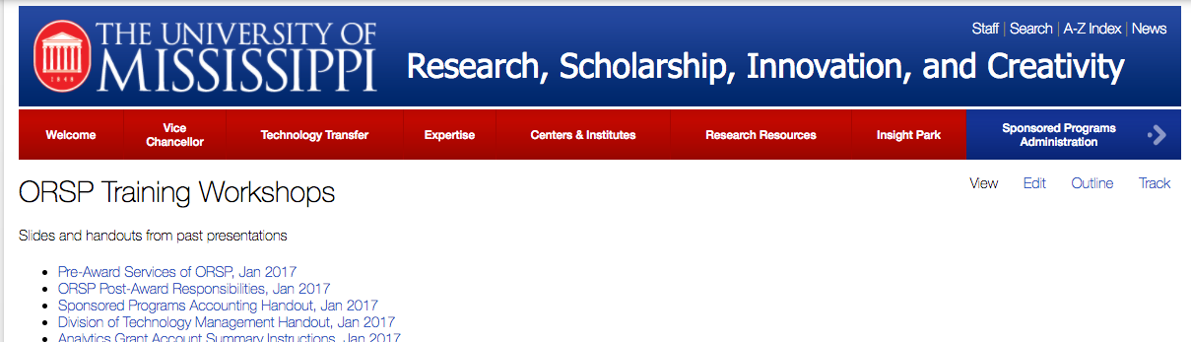
Access this presentation online
http://www.research.olemiss.edu/presentations

