Slide 1
Inclusive Excellence:
Addressing Diversity, Equity, and Inclusion in Grant Proposals
Division of Diversity and
Community Engagement

Slide 2
Presentation Outline
Foundational Concepts
Understanding Our Context
Roadmap to Addressing DEI in Grant Writing
Best Practices

Slide 3
Projects Advancing Diversity, Equity, and Inclusion:
Key Questions to Consider & Answer in your Proposal
1. What “problem” has the sponsor identified that needs to be addressed?
What are the key concerns raised by the sponsor?
Who is your audience, and what do they care about?
2. Which underrepresented groups will be chosen for inclusion?
What groups does the grantor include in its definition of underrepresented?
What is the rationale for targeting these groups in particular?
What is the local context? (cite institutional or local documents)
What (local, regional, national) disparities exist for these groups? (cite data or research)
What are the key challenges? (cite data and/or research)
3. How are you uniquely qualified to address this problem?
Be specific-What is the evidence of your past track record of success working on this problem?
How have you engaged these groups in the past? What did you learn from that experience?

Slide 4
Projects Advancing Diversity, Equity, and Inclusion:
Key Questions to Consider & Answer in your Proposal
4. What is your plan to address the “problem” identified?
Is it a diversity, equity, and/inclusion “problem”?
What will be your approach to reduce disparities, and why?
  Does it build on what has been shown to be successful? Cite.
  Is it attempting something innovative? Explain.
How will you recruit and legally select participants to maximize diversity?
  From what communities? How will you reach them? Do you have committed partners? Do you have a track record yet?
What activities will the participants be involved in, and why?
How will participants benefit?
How will project advance/disseminate knowledge on reducing disparities?
What quantifiable performance metrics will you use?
How will you assess success or failure?

Slide 5
Foundational
Concepts

Slide 6

DIVERSITY
The term is often used to include aspects of group (race, ethnicity, gender, sexual orientation, class) and individual identities (talents, skills, perspectives)
The term simply describes the presence of individuals from various backgrounds and/or with various identities.

Slide 7
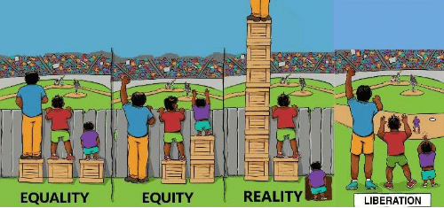
EQUITY
Addresses justice, impartiality, and fairness within the procedures, processes, and distribution of resources. Understanding the underlying or root causes of outcome disparities caused by institutions or systems.
This includes elimination of policies, practices, attitudes and cultural messages that reinforce or fail to eliminate differential outcomes by group identity/background.

Slide 8

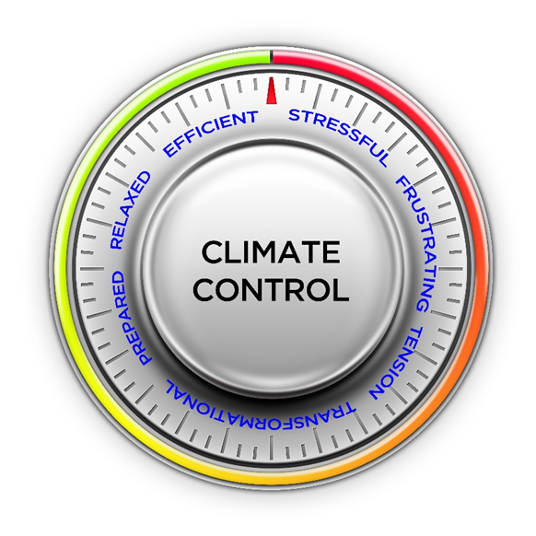
INCLUSION
Authentically brings the perspectives and contributions of all people to the table, equitably distributes power, and incorporates their needs, assets and perspectives into the design and implementation of processes, policies, activities, and decision-making.

Slide 9
DIVERSITY
People
EQUITY
Power
INCLUSION
Participation
# of racial minority students
# of women students
# of LGBTQ+ students
# of students with disabilities
# of students with children
# of international students
% of women students in key student leadership roles
% of racial minority students in debt
% of racial minority students receiving full-tuition scholarship
Amount of research support for female students
Childcare
Accommodations for students with Disabilities
Childcare
Community spaces for LGBTQ+ students
Addressing classroom climate
Work-Life Balance
Ensuring Project/Team Equity
Ensuring equitable participation in High Impact Practices
Avoid Isolating/Singling-Out
Micro-aggressions
INDIVIDUAL, RECRUITMENT, INCREASED ACCESS AND OPPORTUNITY
INSTITUTIONAL, RETENTION, PERSISTENCE, REMOVE INSTITUTIONAL BARRIERS, DECREASE DISPARITIES
CLIMATE, INDIVIDUAL AND INSTITUTIONAL, TREATMENT, TARGETING BEHAVIOR, DECISION MAKING

Slide 10
Definition - Underrepresented Groups
National Science Foundation (NSF)
  Women
  Persons with Disabilities
  Underrepresented minorities
      Black/African American
      American Indian
      Alaskan Native
      Hispanic (Hispanic (including persons of Mexican, Puerto Rican, Cuban, and Central or South American origin)
      Pacific Islander
  U.S. citizen and permanent resident
  Identification of a particular group as underrepresented may vary by discipline (e.g., women are underrepresented in many STEM fields; Asian Americans in social science and humanities fields.)
  (https://www.nsf.gov/mps/dmr/diversity.jsp)

Slide 11
Definition - Underrepresented Groups
National Institute of Mental Health (NIMH)
NSF Groups +
Individuals from disadvantaged backgrounds
  Individuals who come from a family with an annual income below established low-income thresholds. These thresholds are based on family size, published by the U.S. Bureau of the Census; adjusted annually for changes in the Consumer Price Index; and, adjusted by the Secretary for use in all health professions programs. The Secretary of Health and Human Services (HHS) periodically publishes these income levels at http://aspe.hhs.gov/poverty/index.shtml.
  Individuals who come from an educational environment such as that found in certain rural or inner-city environments that has demonstrably and directly inhibited the individual from obtaining the knowledge, skills, and abilities necessary to develop and participate in a research career.
  The disadvantaged category refers to the financial and educational status of individuals while residing in the United States and is only applicable to programs focused on high school and undergraduate candidates.

Slide 12
Definition - Underrepresented Groups
National Institute of Health (NIH)
NSF + NIMH
Individuals from disadvantaged backgrounds, defined as those who meet two or more of the following criteria:
  Were or currently are homeless, as defined by the McKinney-Vento Homeless Assistance Act (Definition: https://nche.ed.gov/mckinney-vento/);
  Were or currently are in the foster care system, as defined by the Administration for Children and Families (Definition: https://www.acf.hhs.gov/cb/focus-areas/foster-care);
  Were eligible for the Federal Free and Reduced Lunch Program for two or more years (Definition: https://www.fns.usda.gov/school-meals/income-eligibility-guidelines);
  Have/had no parents or legal guardians who completed a bachelor’s degree (see https://nces.ed.gov/pubs2018/2018009.pdf);
  Were or currently are eligible for Federal Pell grants (Definition: https://www2.ed.gov/programs/fpg/eligibility.html);
  Received support from the Special Supplemental Nutrition Program for Women, Infants and Children (WIC) as a parent or child (Definition: https://www.fns.usda.gov/wic/wic-eligibility-requirements).
  Grew up in one of the following areas: a) a U.S. rural area, as designated by the Health Resources and Services Administration (HRSA) Rural Health Grants Eligibility Analyzer, or b) a Centers for Medicare and Medicaid Services-designated Low-Income and Health Professional Shortage Areas (qualifying zipcodes are included in the file). Only one of the two possibilities listed can be used as a criterion for the disadvantaged background definition.
  https://diversity.nih.gov/about-us/population-underrepresented

Slide 13
Definition - Underrepresented Groups
TRIO
NSF Racial/Ethnic Minority Groups
First generation college student
  (A) an individual both of whose parents did not complete a baccalaureate degree; or
  (B) in the case of any individual who regularly resided with and received support from only one parent, an individual whose only such parent did not complete a baccalaureate degree.
Low-income individual
  The term “low-income individual” means an individual from a family whose taxable income for the preceding year did not exceed 150 percent of an amount equal to the poverty level determined by using criteria of poverty established by the Bureau of the Census.
Veteran eligibility
  No veteran shall be deemed ineligible to participate in any program under this division by reason of such individual's age who—
  (A) served on active duty for a period of more than 180 days and was discharged or released therefrom under conditions other than dishonorable;
  (B) served on active duty and was discharged or released therefrom because of a service connected disability;
  (C) was a member of a reserve component of the Armed Forces called to active duty for a period of more than 30 days; or
  (D) was a member of a reserve component of the Armed Forces who served on active duty in support of a contingency operation (as that term is defined in section 101(a)(13) of title 10) on or after September 11, 2001.

Slide 14
Understanding Our Landscape

Slide 15


Slide 16
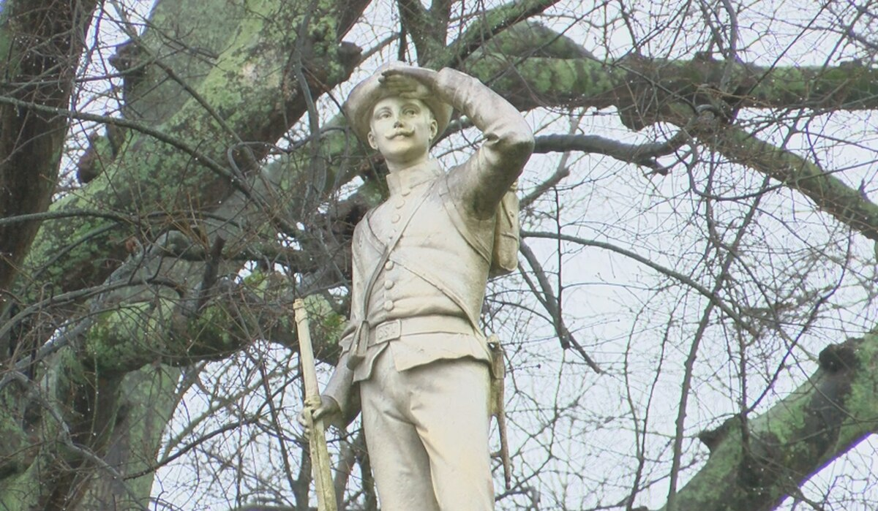

Slide 17
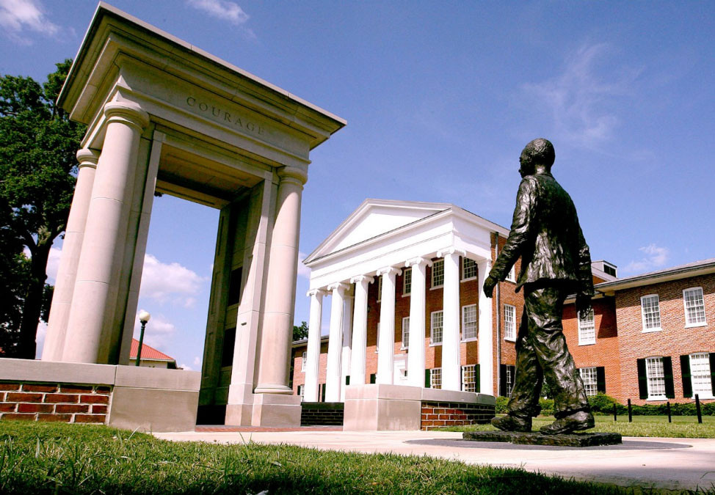

Slide 18
Our State and Institutional History
The University of Mississippi is actively pursuing inclusive excellence through major institutional change in a state recognized for persistent poverty and racial inequality. For decades after the violently protested integration of UM in 1962, individual faculty and administrators have worked to create an inclusive climate and build programs to open doors for underrepresented students. We are now on the cusp of more coordinated institutional change with the 2017 establishment of the Division of Diversity and Community Engagement. Support is in place to advance inclusive teaching in STEM and we are ready and eager to do this work. Joining the HHMI IE3 learning community would maximize the impact of existing campus diversity and inclusion efforts and help center the role of faculty.

Slide 19
Our State and Institutional History
Chartered in 1844, the University of Mississippi (UM) is a flagship, public, Research I institution in Oxford, Mississippi. In 1962, the university was presented on the national stage as epicenter for protest and racial integration. Since, UM, also known as Ole Miss, has vacillated in the public’s mind as an institution stubbornly rooted in the past and also as a progressive campus overcoming divisive forces to take action to shed symbols and end practices that continued to harbor racism and inequity. Because of its history and ever-present need to address racial equity, UM is uniquely positioned to serve as a national leader in developing programs that reconcile a history of racial discrimination to create a more inclusive climate that will move the needle on achieving equity in higher education.
To fully appreciate the challenges and opportunities for colleges and universities in Mississippi, it is important to understand several dimensions of the demographic and socioeconomic landscape of the state. Disproportionately high numbers of individuals in three significant categories highlight the challenges and opportunities that these institutions face: people living in rural communities (51.2%), people living below poverty (21.5%), and African Americans (38%). As the flagship university of the state of Mississippi, UM understands its unique responsibility to serve our residents in these often intersectional groups, because of the history of inaccessibility and inequity in our state.

Slide 20
Nuances of Diversity Data
Minority – a category of people who experience relative disadvantage as compared to members of a dominant social group
  Underrepresented Racial/Ethnic Minority Groups (Black/African American, Hispanic/Latino/a, American Indian, Alaskan Native, Pacific Islander, Hawaiian)
  Minority vs. Underrepresented Racial/Ethnic Minority Groups (Asian American)
Multi-racial (2 or more races)
Black vs African American or Latino/a vs. Hispanic
  Sponsor language/data
IHL/IPEDs distinction
  consistency, definition
Gender Identity/Sex
  (women/men/trans*- social category) (female/male – biological category)
Gender
  diversity vs. equity vs. inclusion

Slide 21
DIVERSITY
People
EQUITY
Power
INCLUSION
Participation
Women were 51.5% of the population
“Women have reached parity with men among S&E bachelor’s degree recipients—half of S&E bachelor’s degrees were awarded to women in 2016”(https://ncses.nsf.gov/pubs/nsf19304/digest/introduction)
Women are still underrepresented in S&E occupations
Women have been shown to be underrepresented in doctorate-granting research institutions at senior faculty levels in most biomedical-relevant disciplines (https://grants.nih.gov/grants/guide/notice-files/NOT-OD-20-031.html)
NIH encourages institutions to consider women for faculty-level, diversity-targeted programs to address faculty recruitment, appointment, retention or advancement.
Invisible Labor
Emotional Labor
“About 19 percent of the men said they experienced sexual discrimination at work, versus 50 percent of the women. In certain heavily male-dominated subsets of STEM, 78 percent of the women experienced gender discrimination” (Funk & Parker 2018).
INDIVIDUAL, RECRUITMENT, INCREASED ACCESS AND OPPORTUNITY
INSTITUTIONAL, RETENTION, PERSISTENCE, REMOVE INSTITUTIONAL BARRIERS, DECREASE DISPARITIES
CLIMATE, INDIVIDUAL AND INSTITUTIONAL, TREATMENT, TARGETING BEHAVIOR, DECISION MAKING
Notes:
Cary Funk and Kim Parker, Women and Men in STEM Often at Odds Over Workplace Equity, Pew Research Center, Social & Demographic Trends, January 9, 2018.

Slide 22
Institutional Student Data
African American Students
9.7% (314) of new UM undergraduate students (2019-20)
12.2% (2,019) of all UM undergraduate students in (2019-20)
20% of Mississippi resident undergraduate student enrollment; 6.6% of Mississippi non-resident undergraduate student enrollment
88% of UM African American undergraduate students are Mississippi residents
Market share of Mississippi residents enrolled in MS colleges/universities (15% UM vs 25% MSU, 2018)
88% of African American students @ UM are Mississippi residents (2527/2232); 83% of African American students @ MSU are Mississippi residents (3328/4022) (2018-19)
51% of UM White undergraduate students are Mississippi residents
African American men have the lowest retention/graduation rates of any other student demographic

Slide 23
Institutional Student Data
Retention Rate to Year 2 81.7% Black/86.7% White
Rate of attrition for African American students (beyond Year 2) almost doubled that of White students (2006-2013 cohort)
Year to year persistence rate- White students (85.5, 77.5, 73.5) and Black/African American (80.7, 64.8, 62.02), Latinx/Hispanic (79.8, 73.7, 65.9), and American Indian students (63.6, 71.4, 53.3) (18-19)
4-year Graduation Rate 27% Black/51% White/61% Asian (18.9% - African American - NCES) (18-19)
5-year Graduation Rate 40% Black/67% White/73% Asian (35.5% - African American - NCES) (18-19)
Market share of minority Mississippi residents enrolled in MS colleges (15% UM vs 25% MSU, 2018)
IREP/IHL – Minority Data
  National Center for Educational Statistics

Slide 24
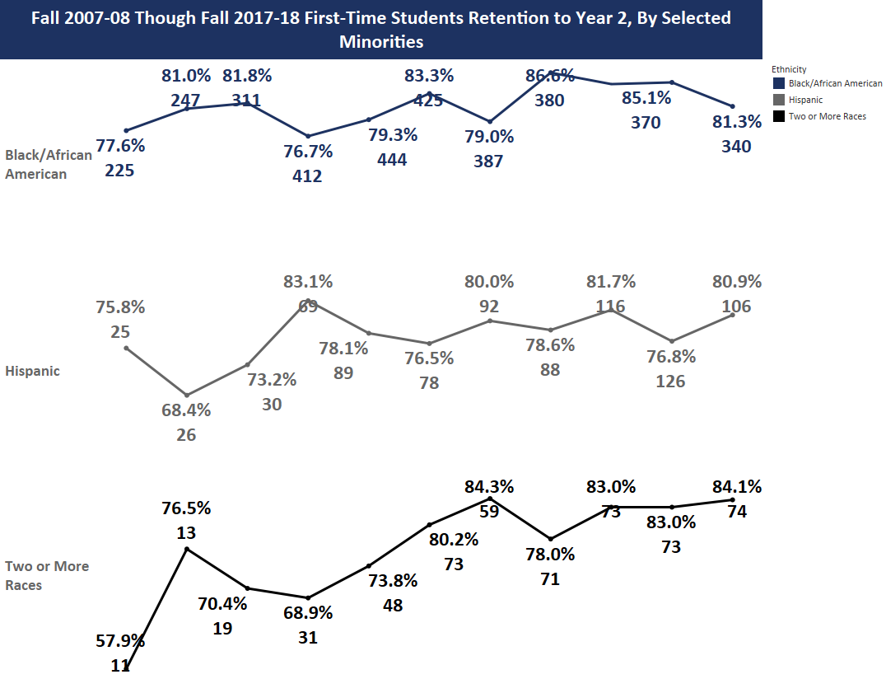
Notes:
Trends – good point

Slide 25
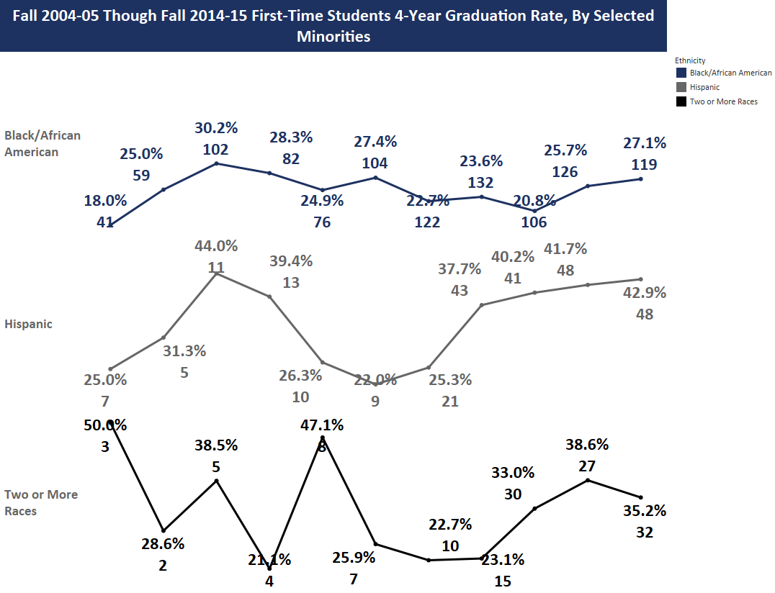

Slide 26
Faculty Gender/Racial Diversity – UM
Retrieved from Tableau, 2018

Slide 27
Faculty Gender/Racial Diversity – National
Retrieved from NCES, 2016

Slide 28
Institutional Faculty Data
Faculty (N=1105), 2018-2019
  53% of all faculty TT/ Tenured (36% Tenured/17% TT)
  47% of all faculty NTT
  55% men (611)
  45% women (494)
  80% White (884)
  8% Asian (88)
  6% Black (63)
  3% Multiracial (31)
  .45% American Indian/ Alaska Native (5)
  .09% Native Hawaiian or Pac. Islander (1)
  IREP – IHL Data

Slide 29
Institutional Faculty Data
Of all 1105 faculty, largest groups by Race/tenure/tenure-track/Non tenure track (2018-19)
  White Non tenure track (426)
  White Tenured (330)
  White Tenure track (128)
  Asian Tenure track (41)
  Black Non tenure track (31)
  Asian Non tenure track (26)
  Black Tenured (23)
  Latino Non tenure track (21)
  Asian Tenured (21)
  Multi-racial Tenured (19)
  Black Tenure track (9)
  Latino Tenure track (7)
  IREP – IHL Data

Slide 30
Institutional Faculty Data
Of all 1105 faculty, largest groups by gender/tenure/tenure- track/non tenure track (2018-2019)
  26% Non-tenure track women (282)
  24% Tenured men (268)
  21% Non-tenure track men (234)
  12% Tenured women (132)
  10% Tenure track men (109)
  7% Tenure track women (80)
  IREP – IHL Data

Slide 31
Roadmap to Addressing DEI in Grant Writing

Slide 32
Projects Advancing Diversity, Equity, and Inclusion:
Key Questions to Consider & Answer in your Proposal
1. What “problem” has the sponsor identified that needs to be addressed?
What are the key concerns raised by the sponsor?
Who is your audience, and what do they care about?
2. Which underrepresented groups will be chosen for inclusion?
What groups does the grantor include in its definition of underrepresented?
What is the rationale for targeting these groups in particular?
What is the local context? (cite institutional or local documents)
What (local, regional, national) disparities exist for these groups? (cite data or research)
What are the key challenges? (cite data and/or research)
3. How are you uniquely qualified to address this problem?
Be specific-What is the evidence of your past track record of success working on this problem?
How have you engaged these groups in the past? What did you learn from that experience?

Slide 33
Example
CLIMATE, INDIVIDUAL AND INSTITUTIONAL, TREATMENT, TARGETING BEHAVIOR, POWER DISTRIBUTION
RETENTION, PERSISTENCE, REMOVE INSTITUTIONAL BARRIERS, DECREASE DISPARITIES
What “problem” has the grantor identified that needs to be addressed?
What are the key concerns raised by the grantor?
Who is your audience, and what do they care about?
NSF Advance
The NSF ADVANCE program goal is to broaden the implementation of evidence-based systemic change strategies that promote equity for STEM² faculty in academic workplaces and the academic profession. The NSF ADVANCE program provides grants to enhance the systemic factors that support equity and inclusion and to mitigate the systemic factors that create inequities in the academic profession and workplaces. Systemic (or organizational) inequities may exist in areas such as policy and practice as well as in organizational culture and climate. For example, practices in academic departments that result in the inequitable allocation of service or teaching assignments may impede research productivity, delay advancement, and create a culture of differential treatment and rewards. Similarly, policies and procedures that do not mitigate implicit bias in hiring, tenure, and promotion decisions could lead to women and racial and ethnic minorities being evaluated less favorably, perpetuating historical under-participation in STEM academic careers and contributing to an academic climate that is not inclusive.
All NSF ADVANCE proposals are expected to use intersectional approaches in the design of systemic change strategies in recognition that gender, race and ethnicity do not exist in isolation from each other and from other categories of social identity.

Slide 34
Which underrepresented groups will be chosen for inclusion?
What groups does the grantor include in its definition of underrepresented?
What is the rationale for targeting these groups in particular?
What is the local context? (cite institutional or local documents)
What (local, regional, national) disparities exist for these groups? (cite data or research)
What are the key challenges? (cite data and/or research)
NSF Advance
The NSF ADVANCE program goal is to broaden the implementation of evidence-based systemic change strategies that promote equity for STEM² faculty in academic workplaces and the academic profession. The NSF ADVANCE program provides grants to enhance the systemic factors that support equity and inclusion and to mitigate the systemic factors that create inequities in the academic profession and workplaces. Systemic (or organizational) inequities may exist in areas such as policy and practice as well as in organizational culture and climate. For example, practices in academic departments that result in the inequitable allocation of service or teaching assignments may impede research productivity, delay advancement, and create a culture of differential treatment and rewards. Similarly, policies and procedures that do not mitigate implicit bias in hiring, tenure, and promotion decisions could lead to women and racial and ethnic minorities being evaluated less favorably, perpetuating historical under-participation in STEM academic careers and contributing to an academic climate that is not inclusive.
All NSF ADVANCE proposals are expected to use intersectional approaches in the design of systemic change strategies in recognition that gender, race and ethnicity do not exist in isolation from each other and from other categories of social identity.
Intersectionality is a theoretical framework for understanding how aspects of one's social and political identities (gender, race, class, sexuality, ability, etc.) might combine to create unique modes of discrimination.
CLIMATE, INDIVIDUAL AND INSTITUTIONAL, TREATMENT, TARGETING BEHAVIOR, POWER DISTRIBUTION
WHAT GROUPS FACE INEQUITIES BASED ON LOCAL INSTITUTIONAL DATA?
Notes:
Example of intersectional approaches – FIU international and domestic faculty

Slide 35
Understanding the Context (local, regional, national)
The representation of African American faculty to African American students is 27:1.
Mississippi leads the 50 states in the percentage of residents who are African Americans: 38%. (Louisiana is second at 32%).
At the University of Mississippi, over 10 years (2002-2011), minority enrollment has increased by 78.9 % and African-American enrollment is up 84.0%. Last fall, 24.2% (nearly one in four) of UM students were minorities and 16.5% were African-American.
We will develop a K-12 outreach program of science demonstrations at the North Panola high school, North Panola Junior high school and Green Hill elementary schools. 97% of the students at these schools are African American and 87% qualify for free lunch programs. Through this outreach program, we will try to recruit these students into our high school, undergraduate and graduate programs.

Slide 36
How are you uniquely qualified to address this problem?
Be specific-What is the evidence of your past track record of success working on this problem?
How have you engaged these groups in the past? What did you learn from that experience?
Establish a Track Record (Be Specific –Evidence Based)
Too Broad: A group of tick researchers at UM’s has offered an exciting course on ticks, edited a useful handbook on ticks, developed several outreach programs, and collaborated on lots of research—all involving members of underrepresented groups.
Specific:
The PI and 5 senior Native American women students built a traveling “TickMobile” that has so far shown 1,000 kindergartners attending public schools in the Mississippi Delta how to safely extract ticks from other children on the playground.
The PI developed the “Tick Engineering Camp” through which she has recruited 10 students (including seven women and one African American student) into the Center for Manufacturing Engineering.
The PI sponsored Brad Paisley to the Oxford Science Café in 2012, where he performed his song “I’d Like to Check You for Ticks” for over 100 community members, at least 50 of whom were older adults.

Slide 37
How are you uniquely qualified to address this problem?
Be specific-What is the evidence of your past track record of success working on this problem?
How have you engaged these groups in the past? What did you learn from that experience?
Establish a Track Record (Be Specific –Evidence Based)
The PI has mentored four high school, nine undergraduate, and four graduate students to date, over 50% of whom are from underrepresented groups (mostly Latino/a and Women) and this commitment will continue during this project period.
The PI’s research group has published 15 tick-related articles in peer-reviewed journals, including 5 articles with undergraduate co-authors, and two with an undergraduate, Latino/a student as the lead author [Give References]. This project should result in between 2 and 4 additional student co-authored journal publications.

Slide 38
Projects Advancing Diversity, Equity, and Inclusion:
Key Questions to Consider & Answer in your Proposal
4. What is your plan to address the “problem” identified?
Is it a diversity, equity, and/inclusion “problem”?
What will be your approach to reduce disparities, and why?
  Does it build on what has been shown to be successful? Cite.
  Is it attempting something innovative? Explain.
How will you recruit and legally select participants to maximize diversity?
  From what communities? How will you reach them? Do you have committed partners? Do you have a track record yet?
What activities will the participants be involved in, and why?
How will participants benefit?
How will project advance/disseminate knowledge on reducing disparities?
What quantifiable performance metrics will you use?
How will you assess success or failure?

Slide 39
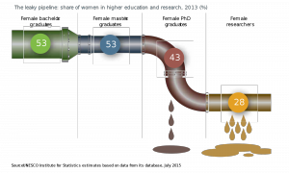
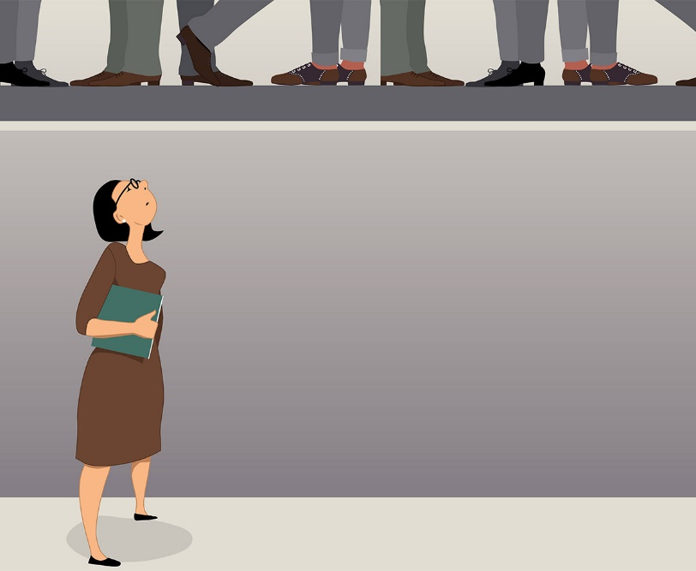

Approach to Reduce Disparities
DIVERSITY
People
EQUITY
Power
INCLUSION
Participation
INDIVIDUAL, RECRUITMENT, INCREASED ACCESS AND OPPORTUNITY
INSTITUTIONAL, RETENTION, PERSISTENCE, REMOVE INSTITUTIONAL BARRIERS, DECREASE DISPARITIES
CLIMATE, INDIVIDUAL AND INSTITUTIONAL, TREATMENT, TARGETING BEHAVIOR, DECISION-MAKING

Slide 40
Recruitment Strategies
Internal
  Minority Student Affinity Groups (BPGSA, NOBCChE, BSU, NSBE, NABA, etc.)
  Center for Inclusion and Cross-Cultural Engagement
  McNair Scholars Program, Grove Scholars Program, IMAGE (NSF LSMAMP)
  NSF Supplemental Funding
  NSF REU Programs
  URM Faculty
External
  Recruiting from HBCUs, Tribal Colleges, and other institutions with significant numbers of students from underrepresented groups (build on existing relationships, shared responsibility for program design, mutually beneficial partnerships, etc.)
  Participation in national student science conferences that draw significant participation from students from underrepresented groups
  Advertising programs in that include or prioritize under-represented racial or ethnic groups in media-based communication

Slide 41
Best Practices

Slide 42
Do: Demonstrate Need/Equity Minded Responses
Don’t: Blame Underrepresented Groups
  Asset-based vs. Deficit Based Language
  Asset-based approach focuses on strengths. It views diversity in thought, culture, and traits as positive assets. Teachers and students alike are valued for what they bring to the classroom rather than being characterized by what they may need to work on or lack.
  Deficit-based approaches focus on the perceived weaknesses of individuals or groups, such that the individuals or groups become viewed as “the problem.”
  Avoid Pejorative Words/Concepts
  At-risk vs Students disproportionately/historically disadvantaged because of …
  Achievement gap vs Opportunity gap
  Minority (abilities vs representation)
  Equity-Minded Approaches
  Identifying major changes in institutional practices, routines, and culture needed to obtain equitable outcomes for historically marginalized and minoritized populations. Frames inequities as a problem of practice rather than a problem with students, emphasizing the responsibility of higher education institutions, faculty, staff, and leaders to eliminate disparities in educational outcomes and create equity for all students (Bensimon, Center for Urban Education).

Slide 43
Do: Demonstrate Need/Equity-Minded Responses
Don’t: Blame Underrepresented Groups
POOR
Underrepresented minority high school students in Mississippi are generally unprepared for college. They often lack the skills, rigorous classes, and knowledge about the college experience. These deficits make it difficult for them to be competitive in our full-scholarship competitions at the university. We need to develop a program that better prepares these students so that they have an opportunity to avoid financial challenges during college.
GOOD
Underrepresented minority students are not competitive in full-scholarship competitions at the university, because 65% of them live in rural communities in Mississippi that have limited access to enhanced college-preparation resources (GRE Prep courses, Advanced Placement courses, etc.). The lack of access to these awards increases the likelihood that these students face financial challenges and insecurity during college. As a result, the university should consider adding more equitable and proven measures that appropriately assess student’s ability to excel in college.

Slide 44
Don’t: Editorialize or Use Sweeping Rhetoric
Do: Make Fact-Based Claims
POOR
Mississippi is the worst state in the nation when it comes to Advanced Placement.
Mississippi’s political elite devalues public education; that is why our Advanced Placement offerings are so dismal.
GOOD
Mississippi lags the nation in both the percentage of its students who take AP exams in any subject (2014 rank: 49th at 17.2%, leading only North Dakota) and the percentage of AP exams passed in any subject with a score of 3 or better (2014 rank: 49th at 32.4%, leading only Arkansas).
In 2014, only about 44% (126 out 282) of Mississippi’s public high schools even offered AP courses of any type (College Board, 2014).

Slide 45
NSF Broader Impacts
What is the potential of this project to benefit the society and/or contribute to the achievement of specific, desired societal outcomes?
Per NSF, “such incomes include, but are not limited to: full participation of women, persons with disabilities, and underrepresented minorities in science, technology, engineering, and mathematics (STEM); improved STEM education and educator development at any level; increased public scientific literacy and public engagement with science and technology; improved well-being of individuals in society; development of a diverse, globally competitive STEM workforce; increased partnerships between academia, industry, and others; improved national security; increased economic competitiveness of the United States; and enhanced infrastructure for research and education.”

Slide 46


Slide 47

What grant mentorship is available?
UM has an institutional membership in the
National Center for Faculty Development and Diversity
https://www.facultydiversity.org/
UM folks can partner with mentors grant writing mentors from other member orgs.
“The National Center for Faculty Development & Diversity is an independent professional development, training, and mentoring community for faculty members, postdocs, and graduate students. We are 100% dedicated to supporting academics in making successful transitions throughout their careers.”
“Members receive a weekly motivational email (the Monday Motivator) and access to the full NCFDD Core Curriculum, guest expert webinars, intensive multi-week courses facilitated by national experts, a private discussion forum, monthly writing challenges, and the opportunity to connect with a writing accountability partner.”

Slide 48
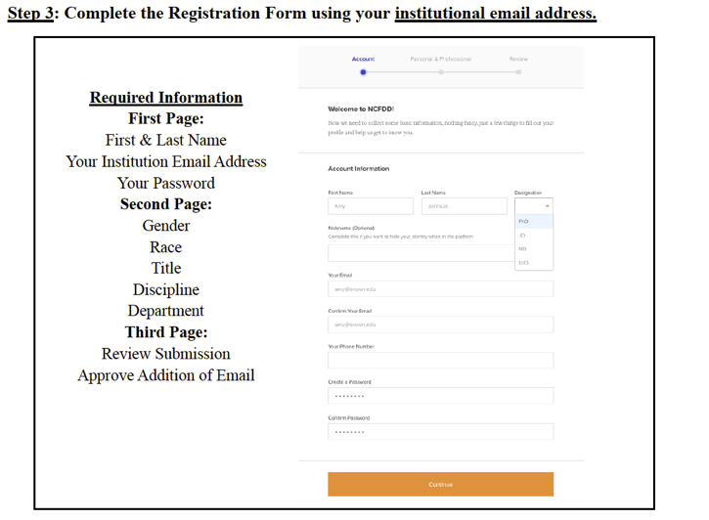
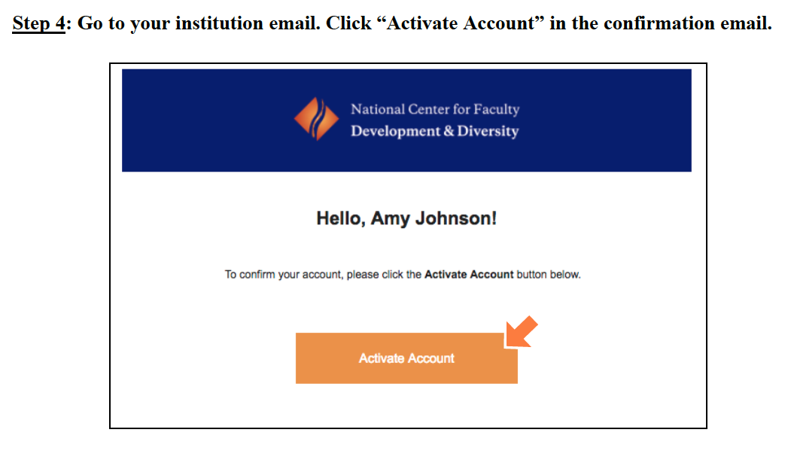

Slide 49
What grant mentorship is available?
ORSP Grant Mentorship Incentive Program
http://research.olemiss.edu/GrantMentors
Provides an avenue for UM/Oxford Faculty with expertise and experience to make substantial contributions to the enhancement of competitive funding proposals to receive extra and/or supplemental compensation by serving as Grant Mentors.

Slide 50
What grant mentorship is available?
Enhanced Narrative Review
http://research.olemiss.edu/EnhancedReview
ORSP Enhanced Review
Internal, no-cost, non-technical review of a proposal Draft Narrative
T.I.G. External Disciplinary Expert Review
For $750, an external disciplinary expert with sponsored programs experience will review and provide suggestions for improvement.
TIG Internal Review With Revisions
Fee-based comprehensive mentoring and reviews for larger grants

Slide 51
What if the sponsor doesn’t explicitly refer
to diversity, equity or inclusion ?
Things you can do:
Look for other language in the funding solicitation or other communications that signal what the sponsor cares about, and then use the roadmap from today’s presentation to tie those sponsor interests to DEI.
Initiate a preliminary conversation with the program officer or other sponsor official, to see whether, and to what degree, the sponsor will entertain proposals that include DEI elements not explicitly called for in the funding announcement.

Slide 52
What is the best way to get institutional data
to support grant proposals?
Tableau
https://olemiss.edu/tableau/
Individuals applying for grants are welcome to use the data in the Tableau visualizations to prepare their grants. I offer a strong word of caution, however. The individual should ensure that the data required for the grant application is the data that is available in Tableau. It may be that a period of time differs or definitions between the grant application and Tableau differ slightly. For example, we may post data on an academic year basis, but the grant wants calendar year.
Initiate a preliminary conversation with the program officer or other sponsor official, to see whether, and to what degree, the sponsor will entertain proposals that include DEI elements not explicitly called for in the funding announcement.

Slide 53
What is the best way to get institutional data
to support grant proposals?
IREP Data Inquiry Form
https://irep.olemiss.edu/data-inquiry-form/
Anyone is welcome to submit an inquiry form at any time.
That said, in the case of grants, especially large grants (e.g., NIH or NSF) the request can be very time consuming and labor intensive. The requestor should allow a minimum of two weeks or longer for more complex analyses.

Slide 54
What is the best way to get institutional data
to support grant proposals?
Diversity Dashboard
Diversity and Community Engagement leaders have been in conversations with IREP about creating a Diversity Dashboard with more fine-tuned institutional data that can inform, among other initiatives, DEI proposal development.
At this time, this is still a work-in-progress.

Slide 55
When should one reach out to the Center for Research Evaluation (CERE) to consult on an evaluation for a proposed project?
As early in the process as possible!
https://cere.olemiss.edu/
The earlier you talk to CERE, the better than will be able to understand your goal and help you to structure an approach where the progress towards achieving those goals can be measured.
CERE has also been working on developing framework for measuring DEI in Mississippi.

Slide 56
Is there a recommended “binary” sex/gender nomenclature to use in most federal grants? woman/man vs. female/male?
From Kirsten Dellinger:
As a sociologist, I would suggest women and men. But I do think there is a lot of variation in what people use or prefer.
From Jason Hale:
We (ORSP) have no clear, sweeping recommendation here, other thank to know and use the terminology that the sponsor uses.
Male/female tends to be more of a biological classification vs. an identity classification. When addressing challenges and solutions related to diversity, equity, and inclusion (DEI), it might make more sense to use language that evokes group identity rather than anatomical difference.
However, as Dr. Dellinger pointed out in the Q/A discussion, terms like “male-dominated-culture” evoke DEI issues just fine and are commonly understood.

Slide 57
African Americans are 38% of MS population. What % of all MS college enrolled are African American? (how does the college population compare vs. the general population)
Katie Busby shared these resources:
IHL reports: http://www.mississippi.edu/research/stats.asp
IHL interactive data portal: http://www.mississippi.edu/research/idp.asp
IHL Fall Enrollment Fact Book:
http://www.mississippi.edu/research/downloads/2019enrollmentbook.pdf
The IHL System Profile: http://www.mississippi.edu/research/downloads/profile2018.pdf
IHL Fast Facts:
http://www.mississippi.edu/research/downloads/fast_facts_1920.pdf

Slide 58
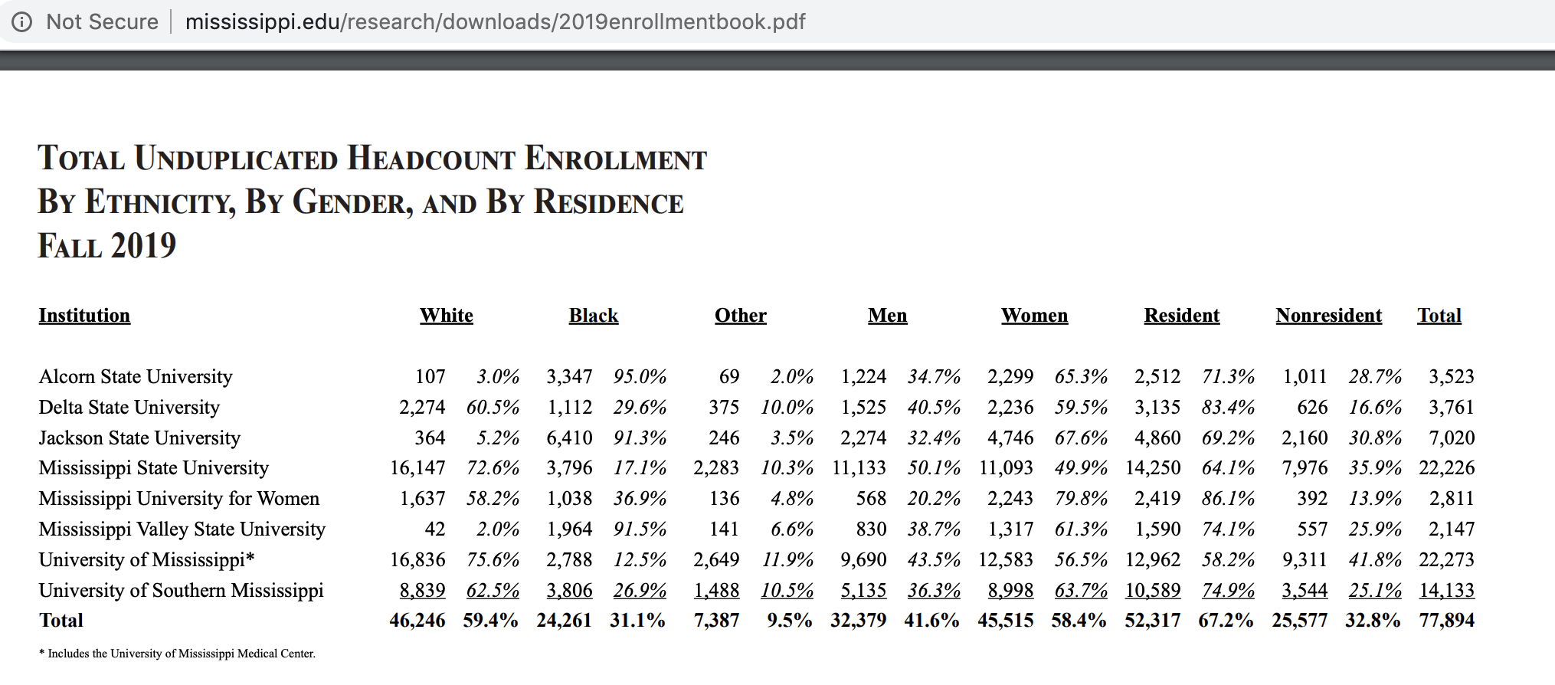
African Americans are 38% of MS population. What % of all MS college enrolled are African American? (how does the college population compare vs. the general population)

Slide 59
African Americans are 38% of MS population. What % of all MS college enrolled are African American? (how does the college population compare vs. the general population)
From Jason Hale:
For national comparison purposes, NSF provides statistical tables on trends in the participation of women, minorities, and persons with disabilities in science and engineering fields. Topics include higher-education enrollments, degrees, institutions, and financial support and employment status, occupations, sectors, and salaries. A formal report is issued every two years. The 2019 report (and tables) are accessible here: https://ncses.nsf.gov/pubs/nsf19304/
For example, from Table 2-1, we see that in 2016, Non-Hispanic Black or African American undergraduate enrollment at all US institutions was 2,111,156 out of 17,081,187, or about 12.4%. From Table 1-2, in 2017 (almost the same year), Non-Hispanic Black or African between the ages of 18-24 were residents represented about 14.% of the US population in that age range (4,402.172 out of 30,672,088).

Slide 60
Additional Information
The name of the equity gap expert Dr. Caldwell mentioned in the May 13 presentation is Estela Mara Bensimon. Dr. Benison is professor of higher education at the USC Rossier School of Education and Director of the Center for Urban Education.
Link to David J. Asai’s commentary “Race Matters” that uses the term “PEERs” – persons excluded because of their ethnicity and race.
https://www.cell.com/cell/pdf/S0092-8674(20)30337-8.pd
Katie Morrison, Director of Foundation Relations, mentioned that University Development has access to some resources that the Office of Development subscribes to, including background info on private foundations, typical grant amounts, universities who have received those grants, etc. Contact Katie if you would like assistance navigating what a particular private foundation might be interested in funding.
The recording(s) of this presentation, along with any updates to the slides, will be made available by the end of May at http://research.olemiss.edu/presentations.

